Slide 1
Zones of Regulation
Understanding and communicating our emotions

Slide 2
Self regulation
What is self regulation?
The ability to focus your attention, control your emotions and manage your thinking, behaviour and feelings.

Slide 3
Self regulation
HOT
COLD
MUDDY

Slide 4
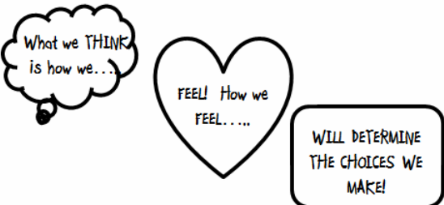
Self regulation
You can also regulate how you feel.

Slide 5
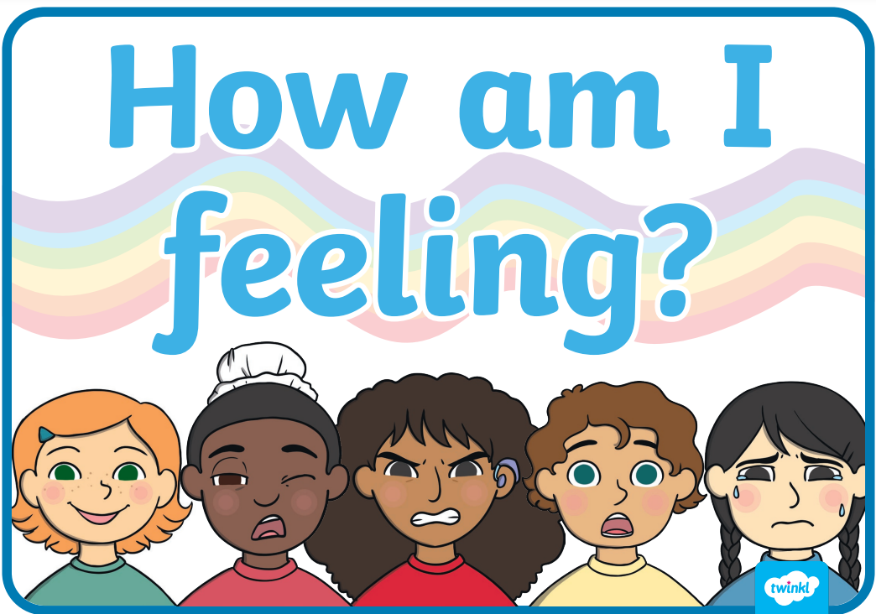
Zones of regulation
To do this, we need to check in with ourselves regularly and see how our brain and body is feeling.

Slide 6
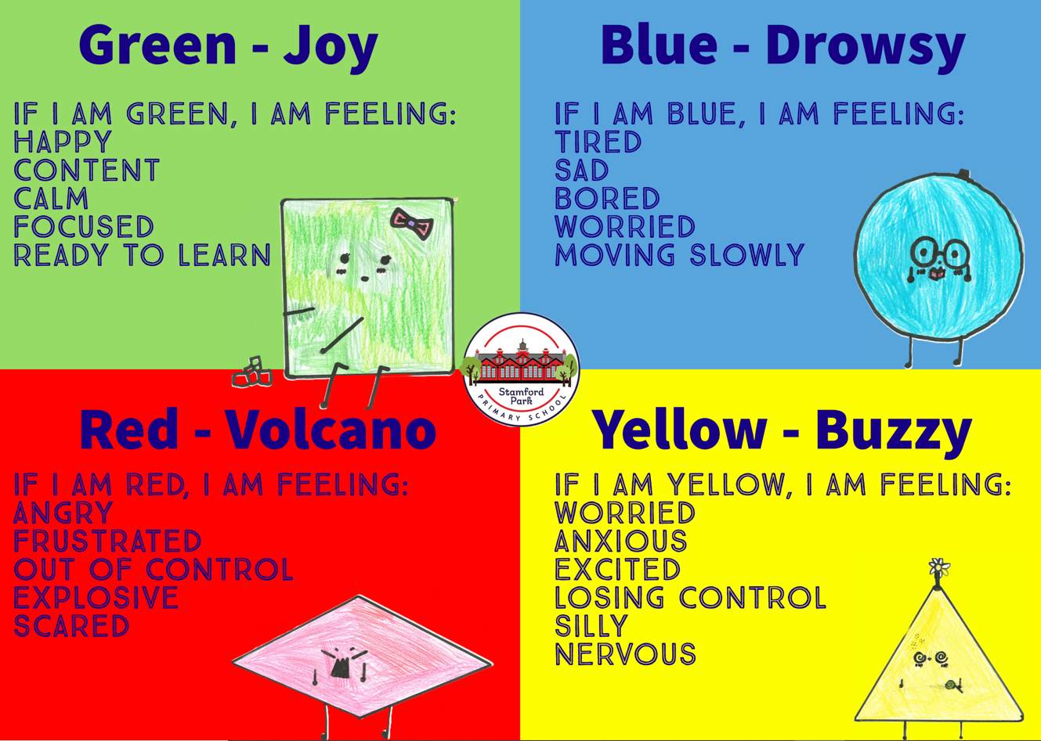

Slide 7
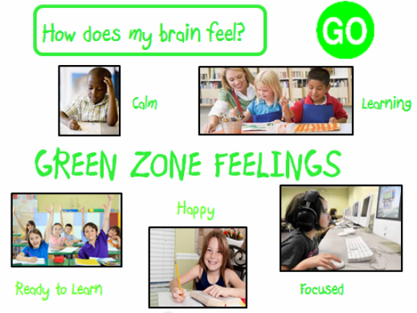

Slide 8
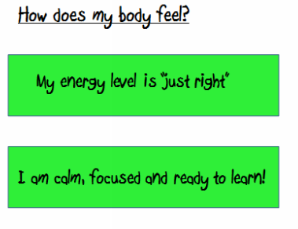
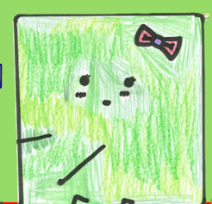

The green zone - The learning zone!!
We are expected to be in the Green Zone while we are learning. It is when our brains and bodies are relaxed and focused!

Slide 9
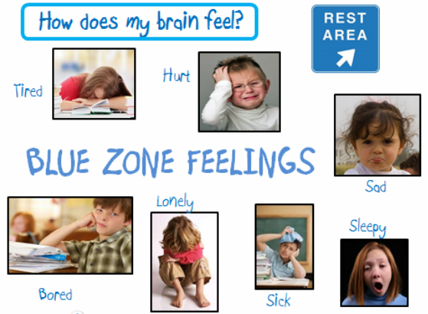

Slide 10
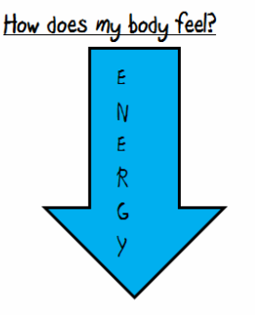
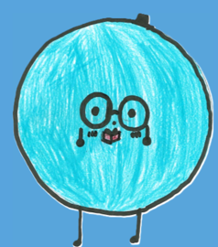

The Blue Zone
We are expected to be in the Blue Zone just before bed time or when we are watching the TV. We are running slow! We might be tired or sad. This is an unexpected zone to be in for learning.

Slide 11
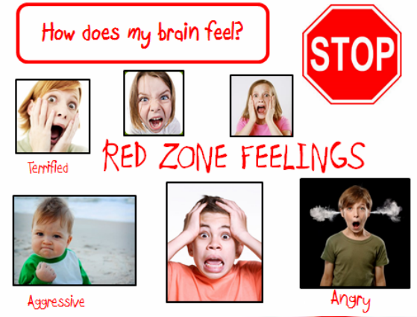

Slide 12
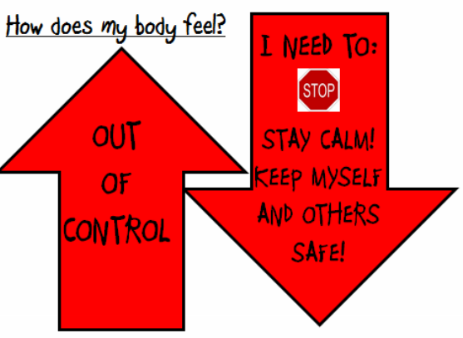
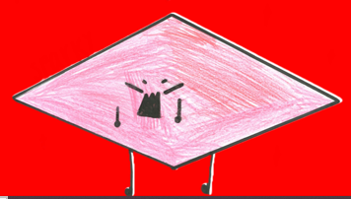

The Red Zone
When we are at school, the red zone is never expected! We must keep ourselves and others safe!

Slide 13
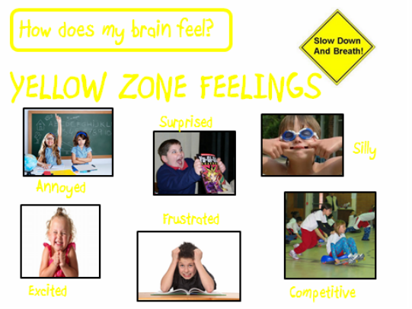

Slide 14
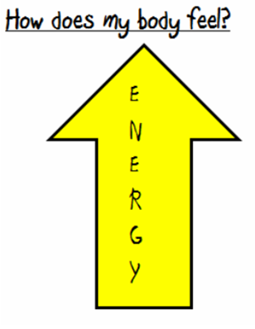
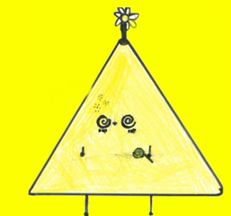
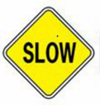
The Yellow Zone
During play time, lunch time and even at the end of the day, it’s expected for us to be in the YELLOW ZONE!!

Slide 15
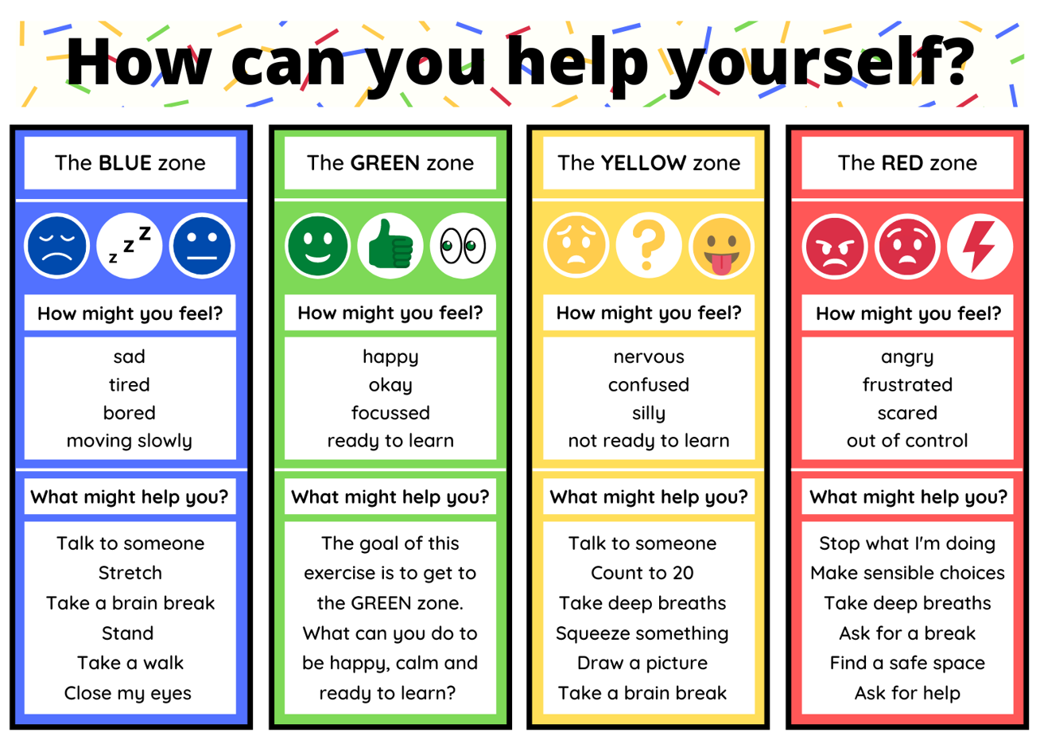

Slide 16
Who will use this?
In school, who should you be able to talk about your emotions to using the zones?
Staff
Students
Parents
Everyone should be able to use this model!

Slide 17
An example might be:
Staff member: “Hannah, what zone are you in now?”
Hannah: “I am feeling a bit red”
Staff member: “Okay, let’s have a quick chat and see how I can help”

Slide 18
An example might be:
Hannah: “I am feeling a bit red”
Staff member: “Okay, let’s have a quick chat and see how I can help”
“I am not free to talk right now, but let’s meet during break”

Slide 19
When does this start
RIGHT NOW!

Slide 20
Where can I look to remind myself?
In class
Staff lanyards
School website

Slide 21
Can I make my own list of helpful strategies?
Of course! A template can be given to you if you would like one.

