Slide 1


Mental Health and Wellbeing

Slide 2
Welcome!
Today we are going to discuss:
Key staff
Whole school provision
JIGSAW Curriculum
Identification
Targeted support
External agencies
Confidentiality, safeguarding and record keeping

Slide 3
Key Staff
Role | Staff
Designated Safeguarding Leaders (DSL) | Mrs Price (DSL) Mrs Bogart (Deputy DSL) Mr Spinola (Deputy DSL)
Senior Mental Health Lead | Mr Smith
PSHE Curriculum Lead | Mrs Southworth
LGBT+ Lead | Mrs Williams
Behaviour Lead | Mr Smith
Race, Inclusion and Diversity Lead | Mrs Cook Ms Esa

Slide 4
Whole School provision
At SPPS we understand the importance mental health and wellbeing plays in our children’s education.
We aim to:
provide a “whole-school approach to support mental health and wellbeing” (Ofsted 2019)
educate the children on how they can be resilient and emotionally literate young people.
know how to raise concerns about their own health or that of others safely.
be able to talk openly about mental health, acting as role models within the community.

Slide 5
Whole School provision
A supportive environment in which to work
JIGSAW Curriculum
A clear behaviour policy
‘Think about it Thursday’ sessions
Assemblies on key dates or areas
Mental health and wellbeing focus week
Quality first teaching
A key adult for ad hoc support
Anti-bullying sessions and focus week
Year 5 and 6 have access to an NSPCC Workshop – Once every two years.

Slide 6

Children’s Mental Health Week
Children’s Mental Health Week 2023 will take place from 6th -12th February 2023.
Children’s Mental Health week was in fact first launched by Place2Be in 2015!
  The theme for 2023 is “Let’s Connect”: https://www.childrensmentalhealthweek.org.uk/

Slide 7

JIGSAW Curriculum
JIGSAW is a whole school PSHE curriculum that includes all statutory RSE curriculum topics.
It is an engaging, discussion focused session in which children can safely discuss various topics as a class or in small groups, whilst being led through games and activities to embed softer skills such as cooperation, resilience, tolerance and respect.

Slide 8
JIGSAW Curriculum
JIGSAW is a timetabled slot each week dedicated to six topics:
Being me
Celebrating differences
Dreams and goals
Healthy me
Relationships
Changing me
Note:
For year 5 and 6, they are able to opt out of the relationships and changing me sessions.
A letter will go home for you to opt out if you would like to.
In addition, we do not refer to the topic of sex in any year of primary school and if you have any concerns, please speak to your child’s class teacher.

Slide 9
Identification
Some children might struggle with their mental health and wellbeing for short or longer periods of time.
Early and effective identification is crucial to intervene before any difficulties become unmanageable for the young person.
We have a range of identification methods which all work to reach all children.

Slide 10
Identification
Staff identification
SDQ (Strength and Difficultes Questionnaires)
Analysing behaviour
Staff report concerns about individual children to the relevant lead
Pupil progress review meetings
Transition documentation from a previous school and passed on to and future schools

Slide 11
Identification
Child Identification
Worry monsters and message boxes in each classroom for children to raise concerns which are checked by the class teachers daily
Child raising concerns for themselves or others
Raising mental health topics in JIGSAW lessons
Calling Childline for support

Slide 12
Identification
Parent Identification
Class email accounts
Speaking with staff at the start or end of day
Reporting to the office
Reporting to the DSL

Slide 13
Identification
Next steps after a concern is reported:
Staff will listen to the concern openly.
It will be shared with the relevant staff.
If appropriate, recorded in our safeguarding system CPOMS and report to our DSL.
If appropriate:
  Staff member to discuss the concern with the child.
  Staff member to contact parents and discuss the concern.
  Staff member to contact parents to arrange a meeting to discuss in school.
Mental health team will seek external advise if necessary.
Steps will then be put in place to address the concern.
These steps will be reviewed at an agreed time.

Slide 14
Targeted support
Timely and targeted support can be sought if a child is in need.
This support needs to be personalised and suited to the area of need exhibited.
We use a hierarchy system to meet the need of children who have been identified as needing support.

Slide 15
External agency specialist support - Level 3
Counselling sessions
Mental Health support team therapeutic sessions.
Educational Psychologist referral
CAMHS (Child and Adolescent Mental Health Service ) referral – to be done via GP
Educational welfare officers (attendance)
School health nurse
Social Services
In School support
In school specialist support
External agency specialist support
Degree of support required
In school specialist support - Level 2
Drawing and Talking intervention
Social skills intervention
Forest school resilience and wellbeing sessions
In school support - Level 1
Individualised behaviour strategies, which can include:
Individualised check ins
Supportive objects
Increased parental contact

Slide 16
Place 2 Be
We are a national charity providing in-school emotional support to children and young people.
The one-to-one work entails weekly counselling using talking, creative work, and play to support pupils who are struggling.
“80%
of pupils with the highest level of need show an improvement in wellbeing after one-to-one counselling according to parents.
68%
cause fewer problems that impact the class according to teachers.”

Slide 17
Place 2 Be
We have a Mental Health Practitioner who works on Wednesdays in school: Saoirse McPeake.
She works one-to-one with four children across the school who need in-depth therapeutic support.
Referrals are sent to me from staff (in conjunction with parents if necessary) and are prioritised to make sure children receive the most relevant support within our capabilities.

Slide 18
Place 2 Be
If you would like support as a parent / carer for a range of needs, Place2Be offer lots of training courses and resources that may be useful.
The website is :
https://parentingsmart.place2be.org.uk/

Slide 19
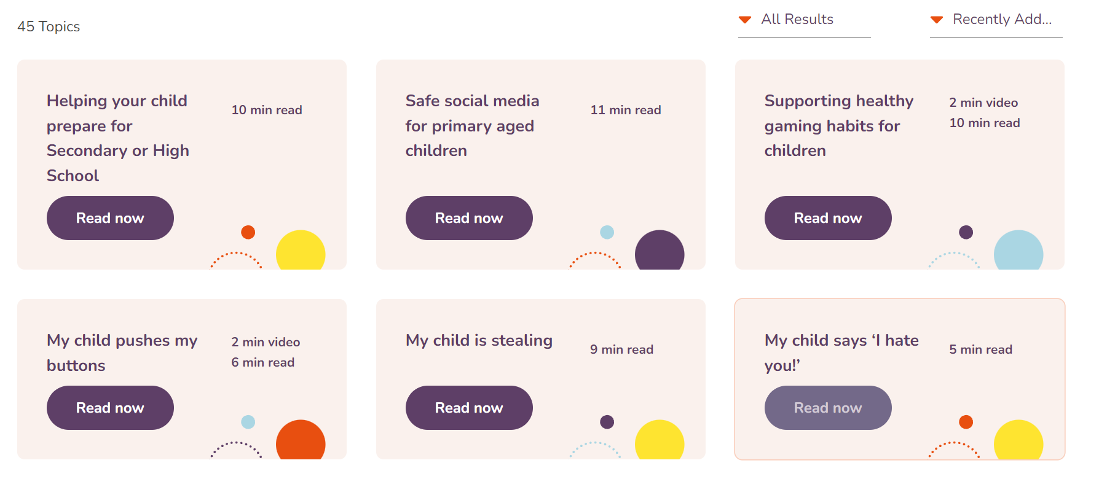
Place 2 Be

Slide 20

Trafford Sunrise
Trafford Sunrise is a service provided through the Educational Psychology team.
They offer courses each month which we publish that can support parents / carers.
If you would like to book onto these courses or inquire, their details are:
sunrise@justpsychology.co.uk

Slide 21

CAMHS
Children and Adolescents Mental Health Service.
Trafford Run service – Usually referred through GP and we advise.
Can offer very focused and professional support for families in need.
Useful links for CAMHS
Trafford CAMHS website
Guide to CAMHS website – lots of useful information.

Slide 22
What to do in a crisis situation
Place2Be list some here: https://www.place2be.org.uk/page/get-urgent-help/#.
Under 19s can text “YM” to 85258 to contact the Shout Crisis Text Line.
Under 19s can also call 0800 1111 to talk to Childline and their number won’t appear on any phone bill.

Slide 23
Any questions?
For further information I would ask that you refer to our school website.
www.spprimary.org.uk

