Slide 1

Maths – Calculation in Key Stage 1

Slide 2
Aims
To give you an insight into Year 1 and 2 expectations for the four operations of addition, subtraction, multiplication and division
To know how we teach these concepts in school
Offer suggestions for supporting your child at home
To show you where the calculation policy and other useful information is on the school website

Slide 3
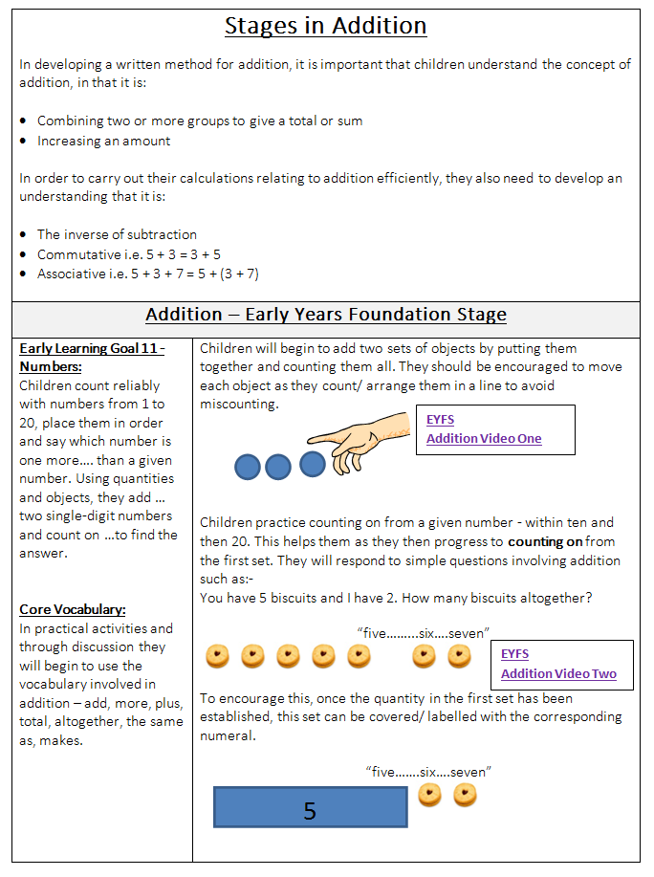
The Calculation Policy
Notes:
The ‘Calculation Policy’ is the core document behind the teaching of addition, subtraction, multiplication and division at Stamford Park Primary School. It can be found by clicking the hyperlink on the main Mathematics Curriculum title page or in the ‘Mathematics Curriculum Information’ folder. It out lines the different types of resources that should be used in each year group and the methods imparted to the children. It is designed in a progressive way, where existing skills and knowledge are built upon to further the children’s understanding of Mathematics in each year group. Each activity shows you the next steps and pre requisites.

Slide 4
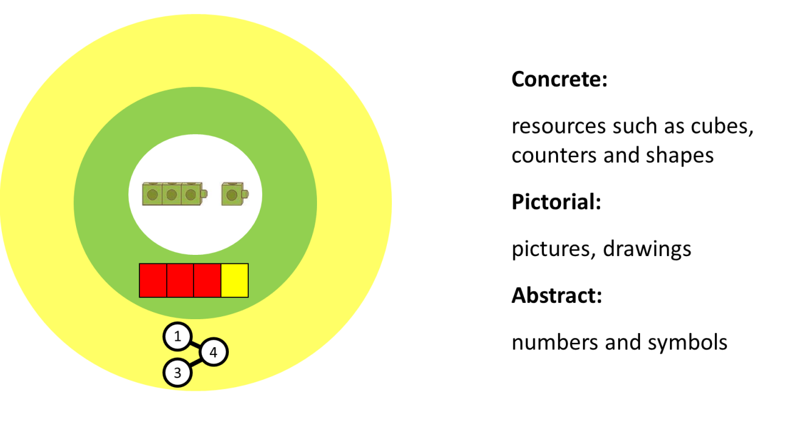

Slide 5
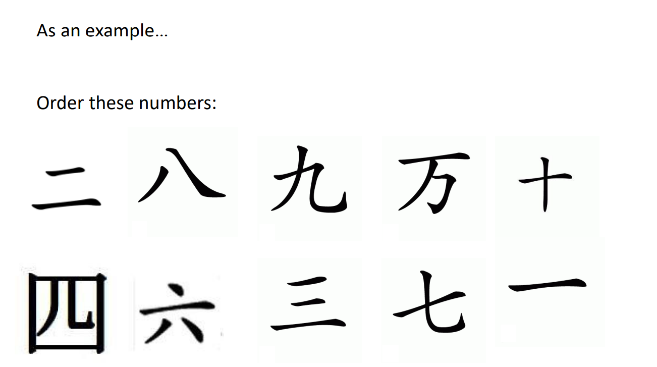

Slide 6
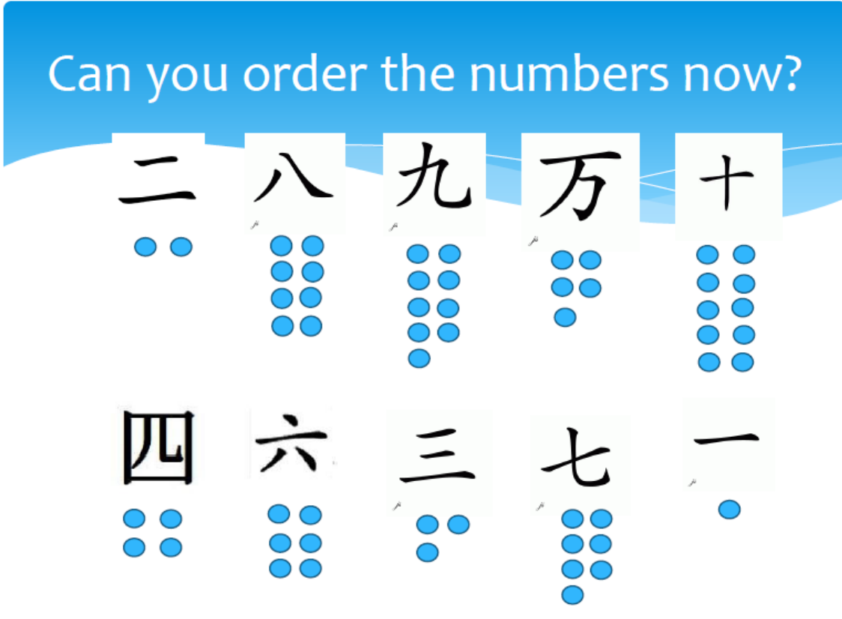

Slide 7
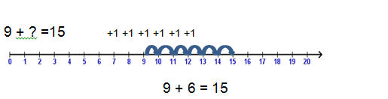
Addition and Subtraction
Children use objects and then number tracks/ number lines to help them to solve addition problems involving missing numbers:
11 + 3 = ? ? + ? = 8
Notes:
In ‘Key Stage One’ children begin to use slightly more ‘abstract’ resources to further their understanding of number and calculation. Practical resources are still heavily used also. Things such as number tracks (where the numbers are between the lines) and number lines (where the numbers are positioned below the lines) are introduced on a wider scale. In the above example, the child has ‘counted on’ from 9 to 15 to solve a missing number problem. Highlighting the differences as ‘jumps’ as they go.

Slide 8
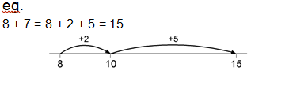
Addition and Subtraction
As their rapid recall of number bonds increases, children are encouraged to use this knowledge to help them when bridging through 10.
Notes:
Knowledge taught in EYFS such as learning ‘number bonds to 10’ (two numbers which add up to ten) is then used to help with more advanced skills such as the addition number sentence above. The 7 is broken down into a 2 and a 5 to help make adding the larger number a simpler task.

Slide 9
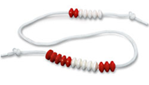
Addition and Subtraction
Bead strings or bead bars are used to illustrate addition, in particular for demonstrating bridging through ten.
7 + 6 = 13
Notes:
Bead stings are another valuable resource which visually illustrate the concept of ‘bridging through ten’. Using a wide range of resources helps the children to form a firm understanding of each concept.

Slide 10
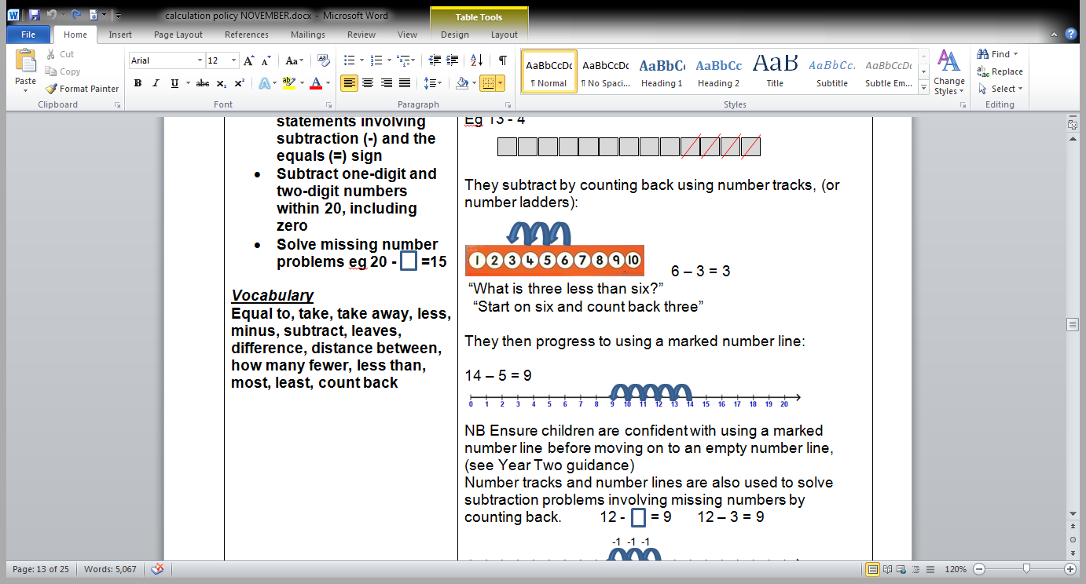
Addition and Subtraction
Children are given plenty of opportunities to count on/ back from any number up to 20, and then beyond. They continue to subtract using objects by taking some away.
Notes:
Number tracks and lines can be introduced to children while subtracting and they can ‘count back’ to find the amount left over.

Slide 11




Understanding the term “difference”
This can often cause confusion unnecessarily. When introducing, we refer to it in terms of what/ which bit is the same and what/ which bit is different.
Start to explore difference by comparing two groups of objects:
“Five is two more than 3”
“The difference is 2”
“The difference
between 3 and 1 is
2”
Notes:
Children are also taught the concept of ‘difference’. It is done it a practical and visual way to help foster understanding of the concept.

Slide 12
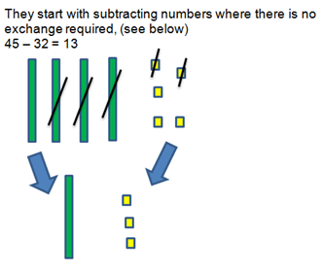
Subtraction using practical resources
Notes:
Children also use practical resources to help them to ‘take away’ one number from another. Eventually children are taught to ‘exchange’ a ten for ten ones to allow them to solve number sentences such as 24 – 7 = 17.

Slide 13
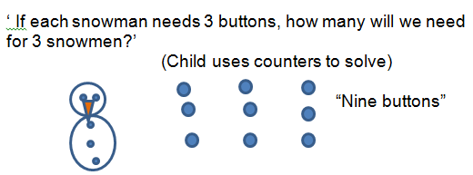
Multiplication and Division
In Year One, children will begin to understand multiplication by using a variety of objects to make sets and groups of objects. They solve multiplication problems using practical equipment and jottings.
Notes:
In Year One children will begin to understand multiplication by using a variety of objects to make ‘sets’ and ‘groups of objects’. They solve multiplication problems using practical equipment and jottings.

Slide 14
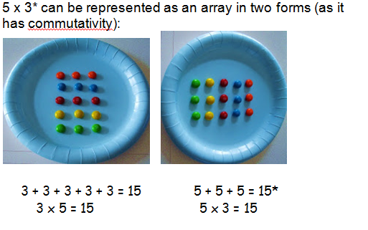
Arrays
Notes:
‘Commutativity’ is a concept taught to children using practical resources. 15 items can be arranged in 3 rows of 5 or 5 rows of 3.

Slide 15
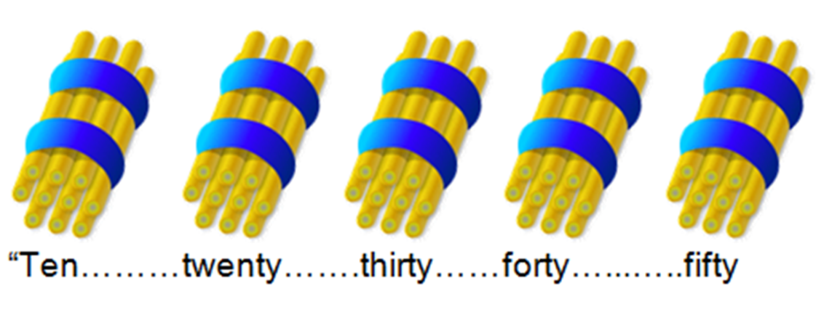
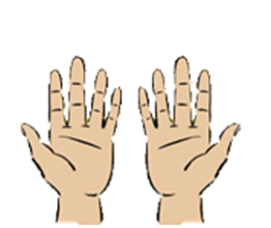
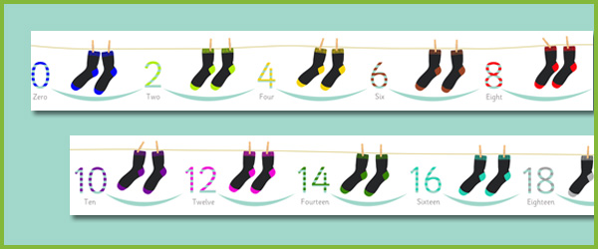
Counting in 2’s, 5’s and 10’s
“five, ten……
Notes:
Teaching the ‘multiples’ of 2, 5 and 10 are a key starting point for children’s understanding of ‘multiplication’. We talk to the children about repeatedly adding the same number.

Slide 16
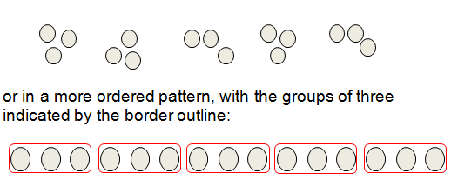
Multiplication and Division
Children should understand and be able to calculate multiplication as repeated addition, supported by the use of practical apparatus such as counters or cubes.
e.g. 5 x 3 can be shown as five groups of three with counters, either grouped in a random pattern, as below:
Notes:
Children should understand and be able to calculate multiplication as repeated addition, supported by the use of practical apparatus such as counters or cubes.

Slide 17
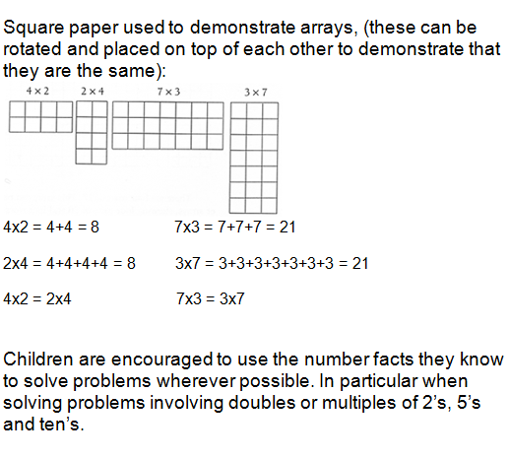
Multiplication and Division
Notes:
Children are eventually taught to draw ‘arrays’ to solve problems such as in the example above.

Slide 18
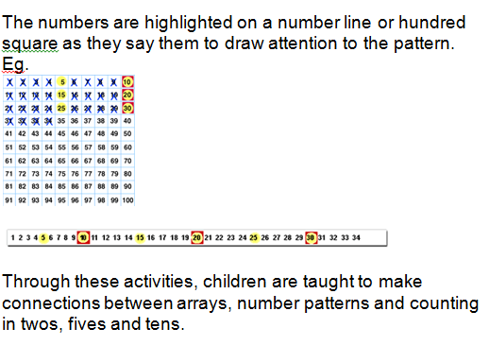
Multiplication and Division
Notes:
‘Repeated addition’ on a number line or square can help to highlight the concept of ‘multiplication’.

Slide 19
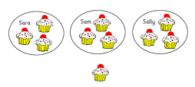
Multiplication and Division
Children should be introduced to the concept of simple remainders in their calculations at this practical stage, being able to identify that the groups are not equal and should refer to the remainder as ‘… left over’.
“Three each and one left over”
Notes:
‘Division’ is introduced using different scenarios such as the one above. The concept of a remainder is also introduced.

Slide 20
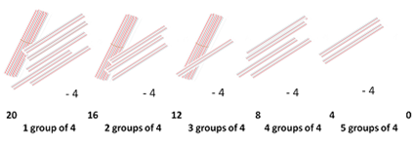
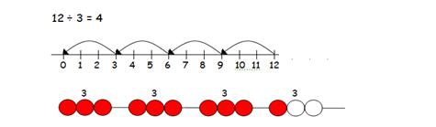
Straws, bead strings and number lines are also good resources for helping children to develop their conceptual understanding of division:
Multiplication and Division
Notes:
Straws, bead strings and number lines are also good resources for helping children to develop their conceptual understanding of ‘division’.

Slide 21
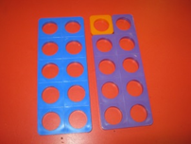
Numicon
Children consolidate rapid recall of number bonds for numbers up to ten, including recall of doubles. They apply their knowledge of pairs of numbers that make ten to help them to identify pairs of numbers to make twenty.
9 + 1 = 10 19 + 1 = 20
Notes:
In our school we heavily use ‘Numicon’ to teach various concepts. Above is an example of how it can be used to represent ‘number bonds’ to 20.

Slide 22
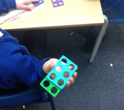

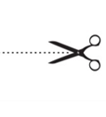
Solving number sentences with missing numbers
8 - ? = 6 10 - ? = 6
Notes:
‘Numicon’ is also a great way of visualising ‘missing number problems’ such as the ones above.

Slide 23
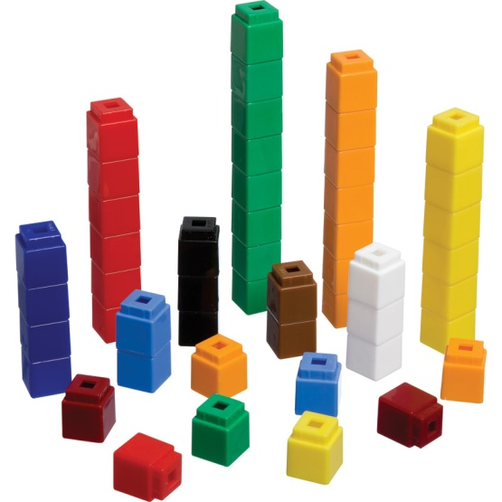
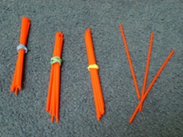
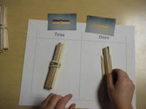
Developing Understanding of Place Value – which resources?
Bundles of 10 help children to appreciate place value and understand which digit will change if they increase a number by one or ten.
Multilink and Unifix are also used to show the value of different numbers.
Notes:
As you can see above, bundles of 10 help children to appreciate place value and understand which digit will change if they increase a number by one or ten. ‘Multilink’ and ‘Unifix’ are also used to show the value of different numbers.

Slide 24
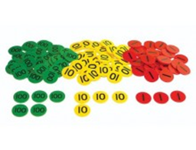
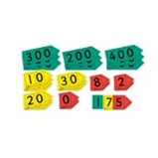
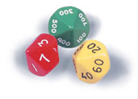
Place Value Resources
Over time these resources may be replaced with place value counters.
Notes:
During Year 2, as the children’s understanding of ‘place value’ grows and develops, different resources are introduced to further their understanding.

