Slide 1

Welcome to Stamford Park Primary School
Phonics Screening Check

Slide 2
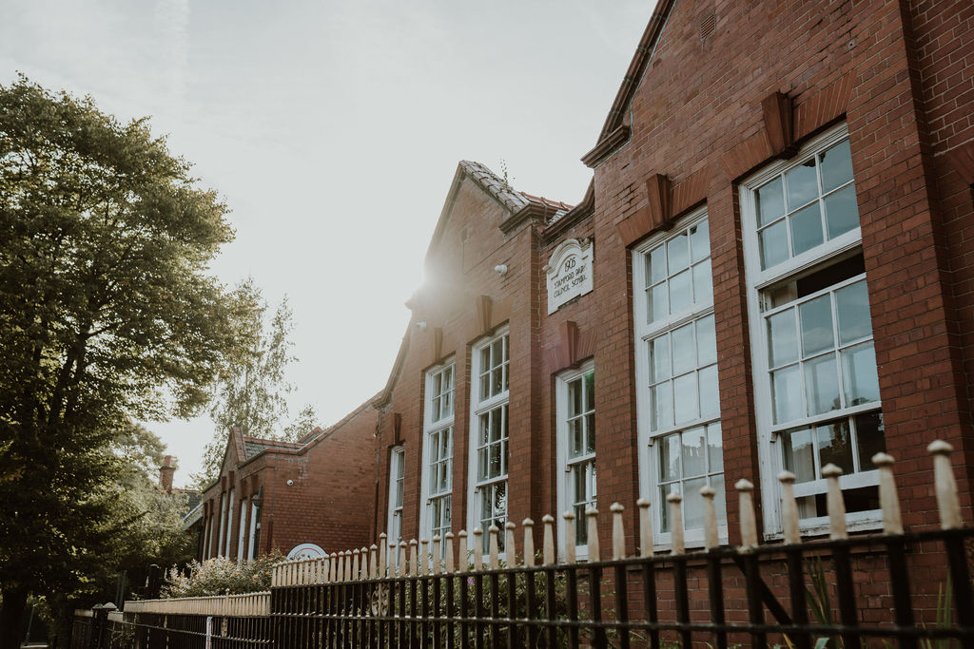
What is the Year 1 Phonics Screening Check?
A quick and easy check of your child’s phonic knowledge.
It helps us to confirm whether your child has made the expected progress in DECODING.
It is NOT a reading test.
Reading is a combination of decoding AND comprehension.
All children nationally take part in this check.

Slide 3
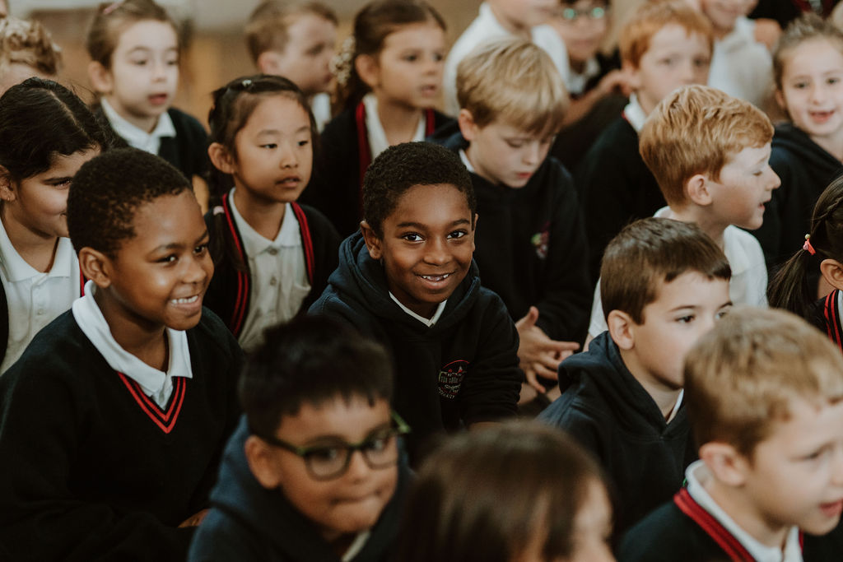
When does it take place?
This year the check will take place during the week commencing Monday 12th June 2023.

Slide 4
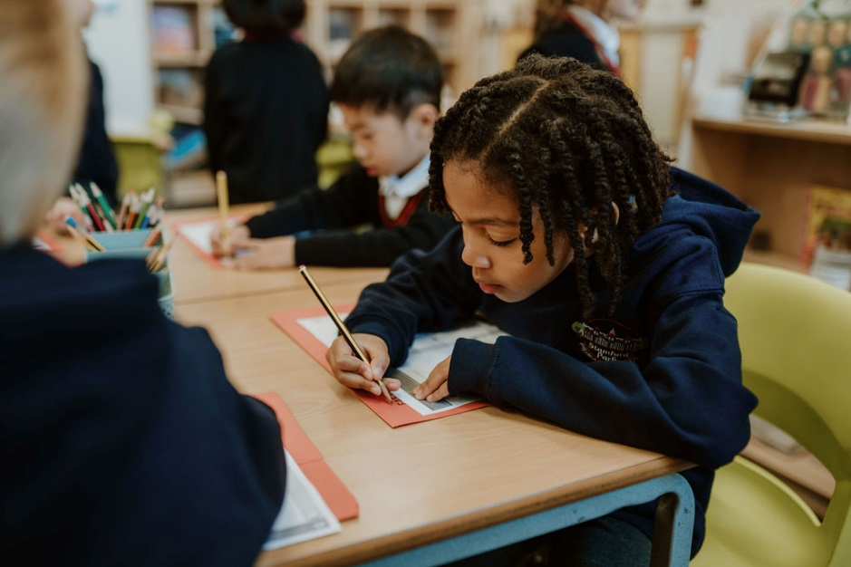
After the Check
At the end of the year, you will be informed about how your child has done in the phonic screening test.

Slide 5

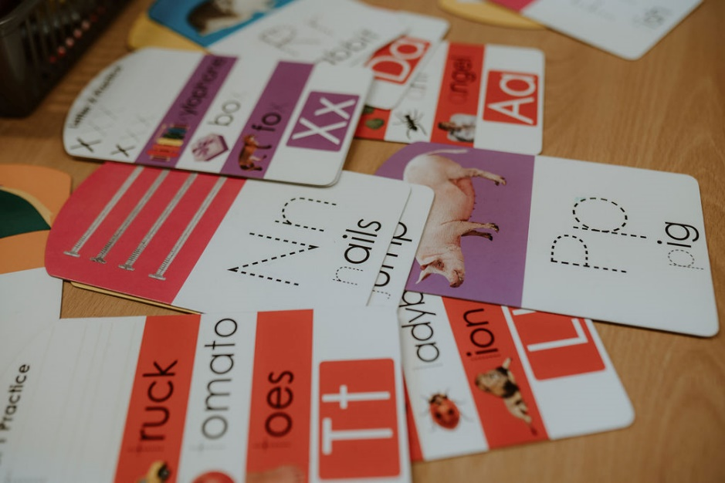
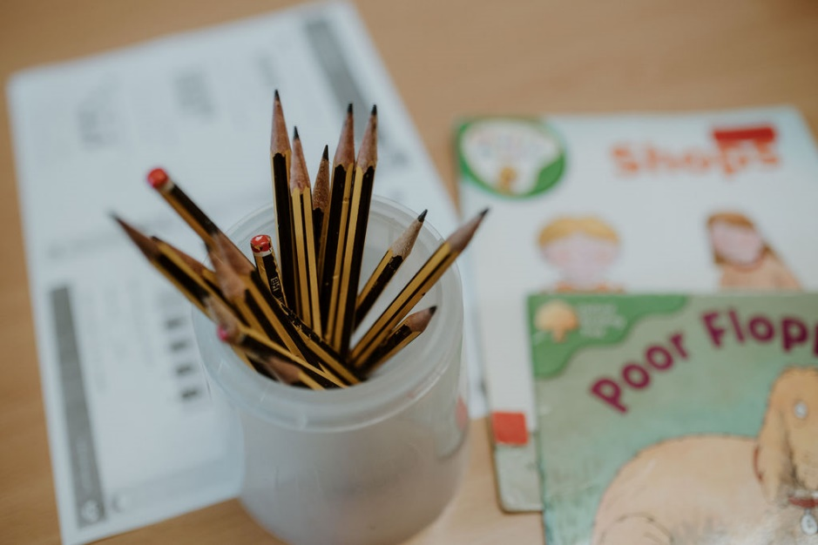
Retesting
Children who do not reach the required standard will be tested again the following year in Year 2. In 2022, the required standard was 32/40.

Slide 6
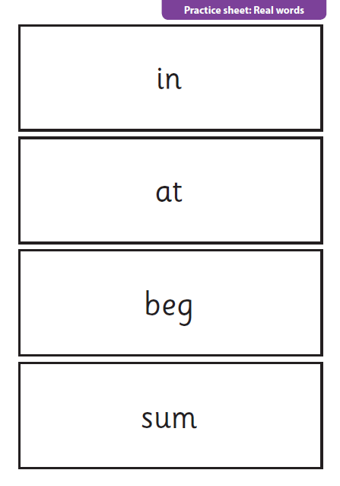
How does it work?
Your child will sit with their teacher and be asked to read 40 words aloud.
The check takes a few minutes to complete and there is no time limit.
The check is carefully designed not to be stressful to your child.

Slide 7
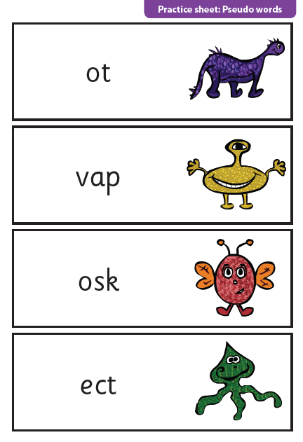
What are the ‘alien’ words?
‘Alien’ words such as ‘vap’ or ‘jound’ are included as these will be new to all children.
Children cannot read non-words from memory so this is a fair way of assessing their ability to decode.

Slide 8
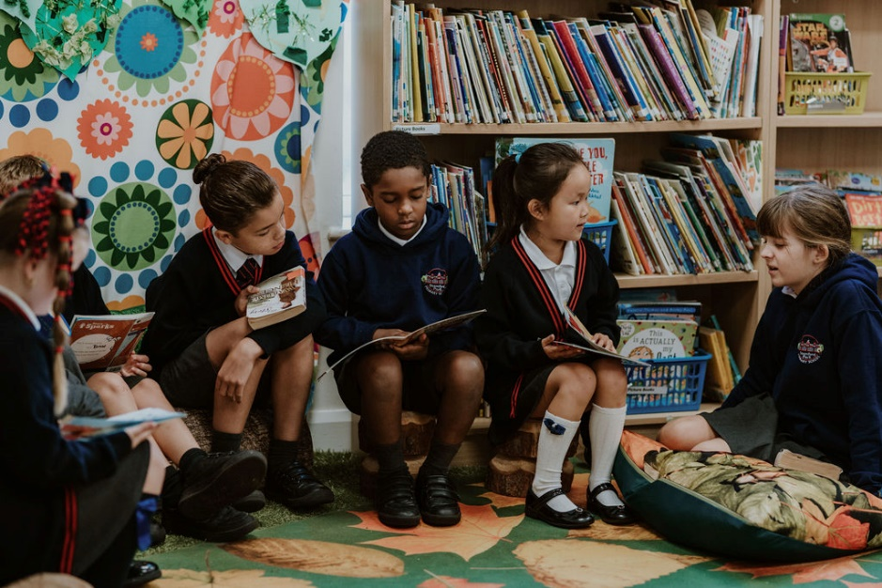
Year 1
Children have worked through phase 4.
Same sounds as in phases 2 and 3 but in words with
more complicated structures.
Phase 3 3 sounds fog
Phase 4 4 or more sounds frog
In phase 5, they are learning alternative graphemes for sounds they already know.

Slide 9
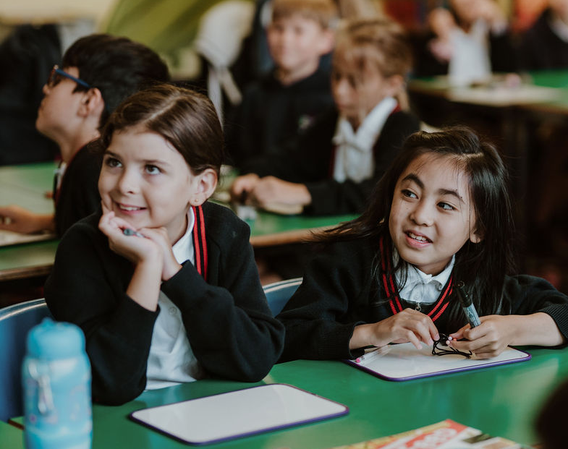
Phase 5
Digraphs
Split Digraphs
a-e (plate)
e-e (these)
i-e (smile)
o-e (home)
u-e (rule)
ay (spray) ou (cloud) ie (pie)
ea (clean) oy (enjoy) ir (birth)
ue (glue) aw (claw) wh (whip)
ph (phone) ew (chew) oe (toe)
au (haunt)
Alternative Pronunciations
i fin find
o hot cold
c cat circus

Slide 10
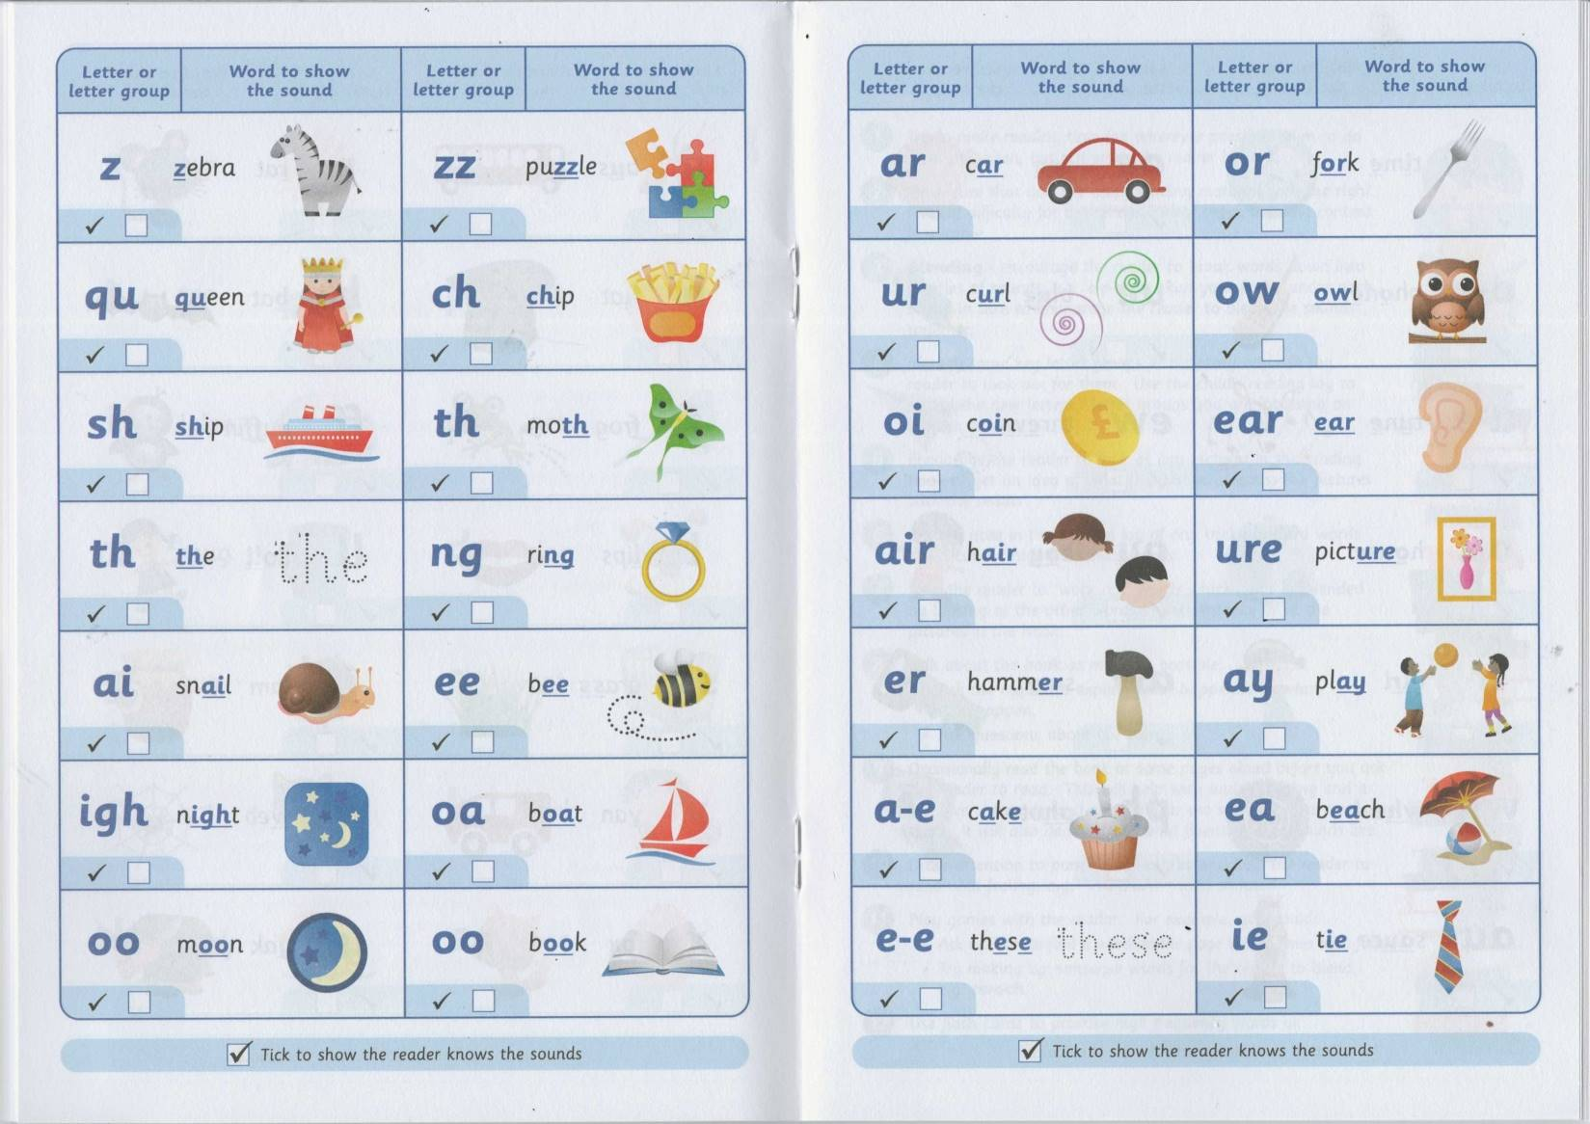
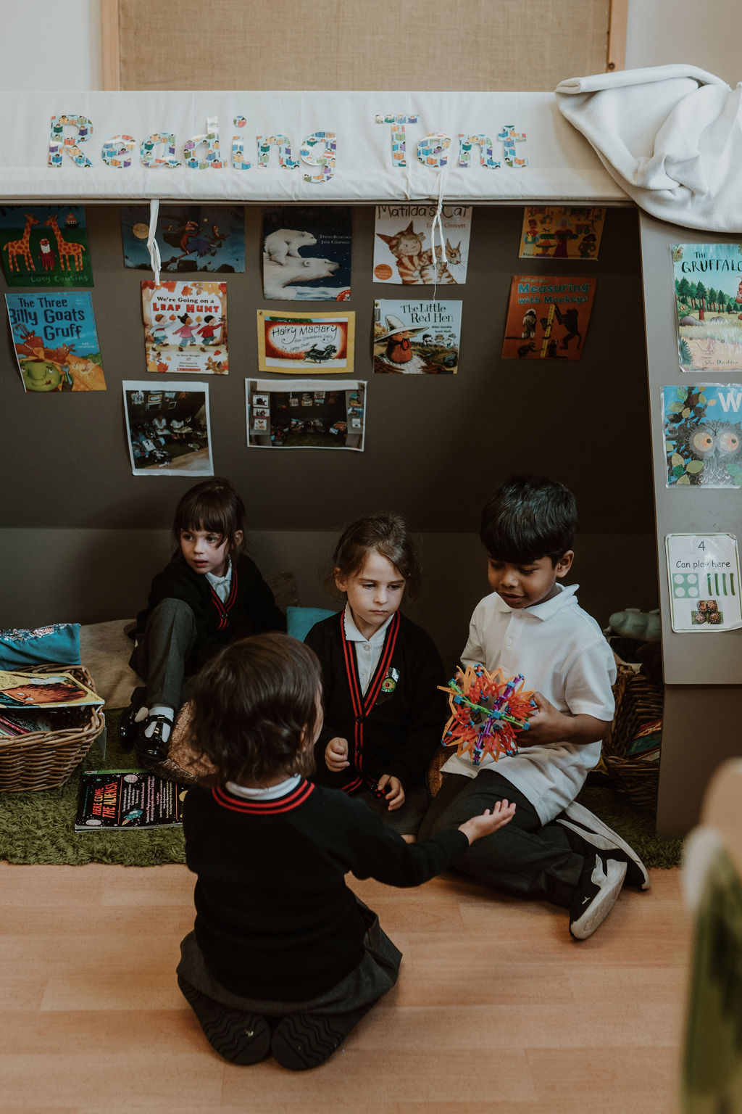
What can you do to help?
Children are being taught all of these phonemes in their daily phonics lessons.
Practise these sounds out loud (refer to your phoneme mats in your child’s reading record).
Practise these sounds in words.
Continue to read daily with your child.

Slide 11
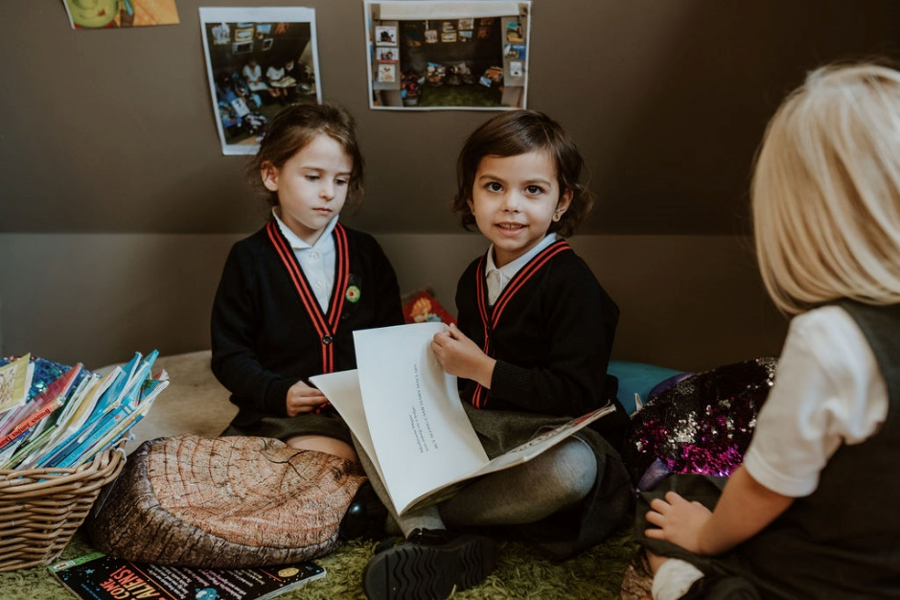
Games
Phonicsplay
Espresso
ICT games-Literacy-phonics
All of these require you to play with your child as you need to hear them sounding out the words

Slide 12
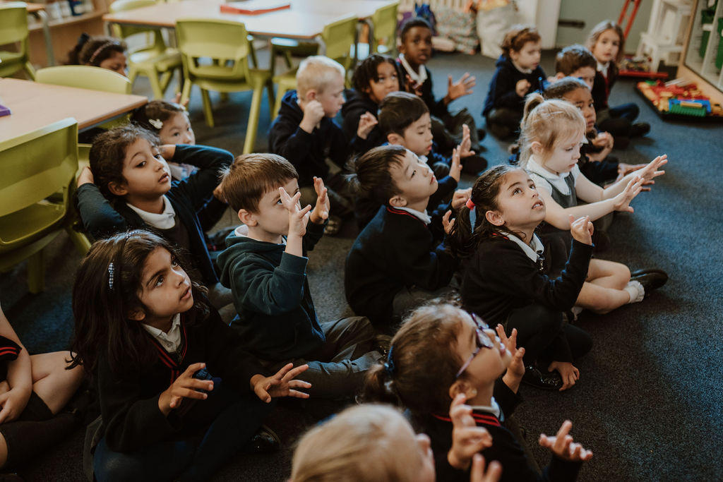
Please Remember…
All children are individuals who
develop at different rates.
The screening check ensures that
teachers understand which
children need extra help with
phonic decoding.

