Slide 1
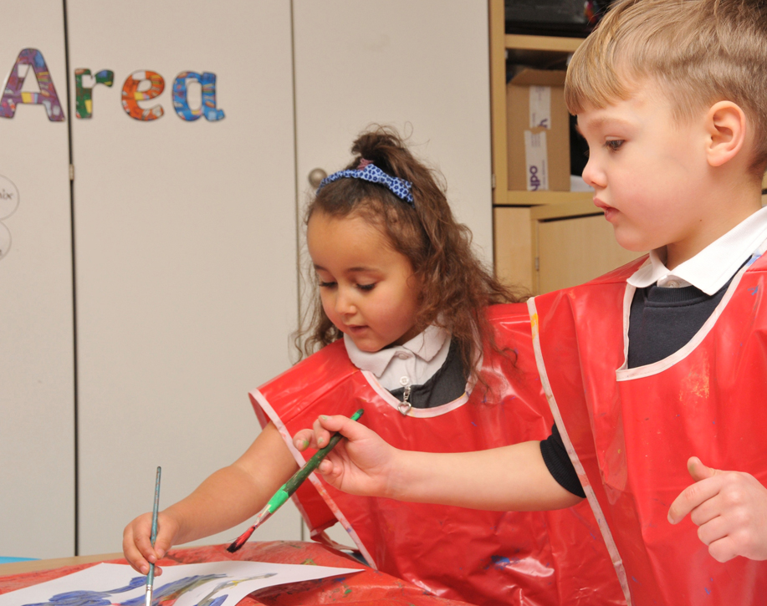
Welcome to Stamford Park Primary School

Slide 2

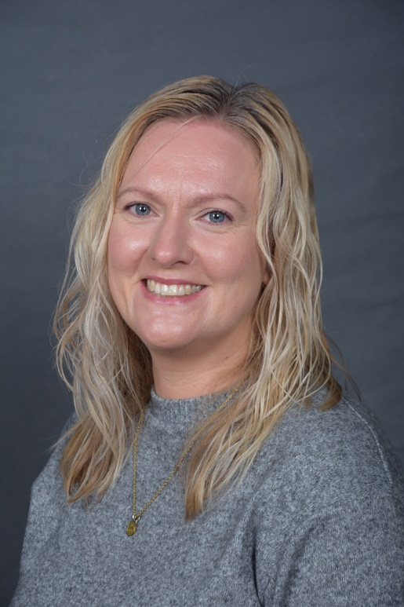
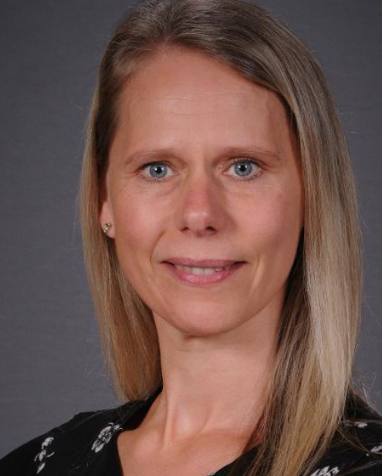
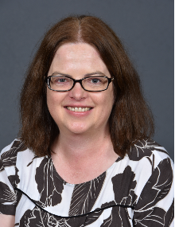
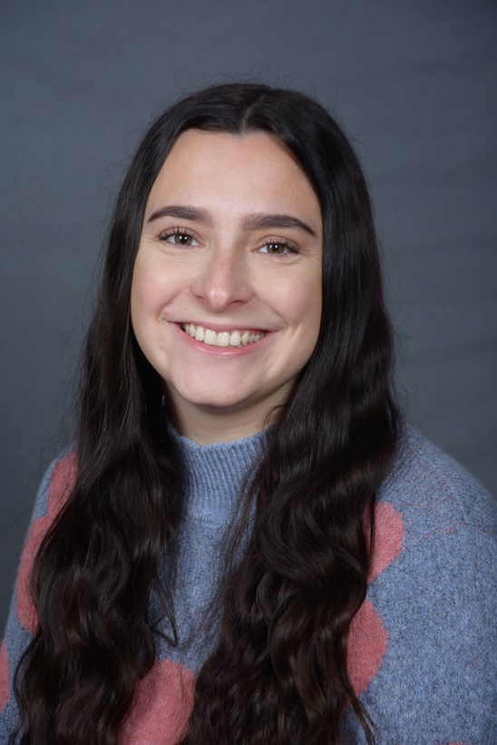
Meet the team
Mrs Williams
Class Teacher/SENDCo
Ms Bogart
Class Teacher/Early Years Lead/ Deputy Headteacher
Mrs Hemsi
Teaching Assistant
Miss Selway
Class Teacher

Slide 3
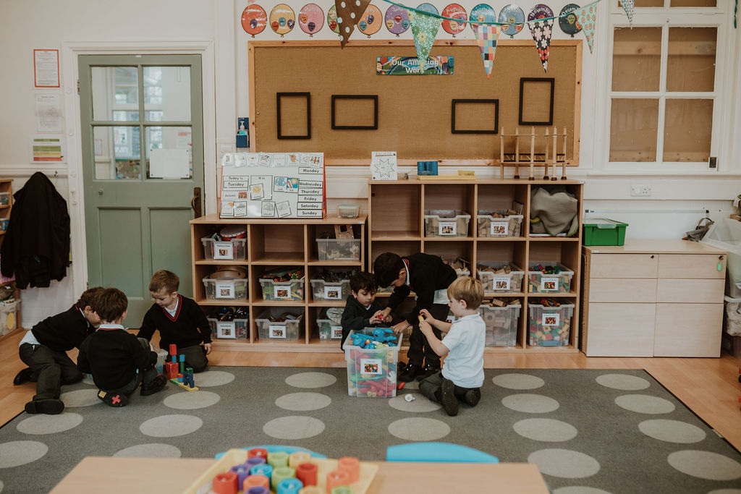
Starting
Transition documents, information and visits.
All children will be in full time by Thursday 3rd September.
You will receive further information about your child’s start date and their Class Dojo login after the stay and play you have chosen to attend.

Slide 4
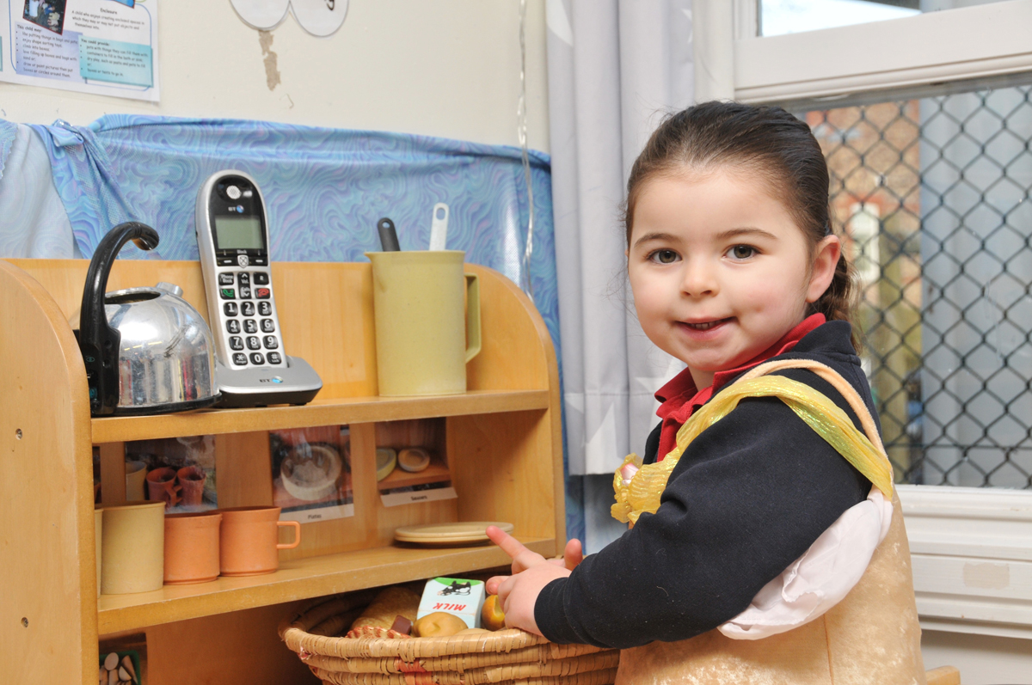
Stay and Play
6th July - 9:30pm
10th July – 2pm

Slide 5
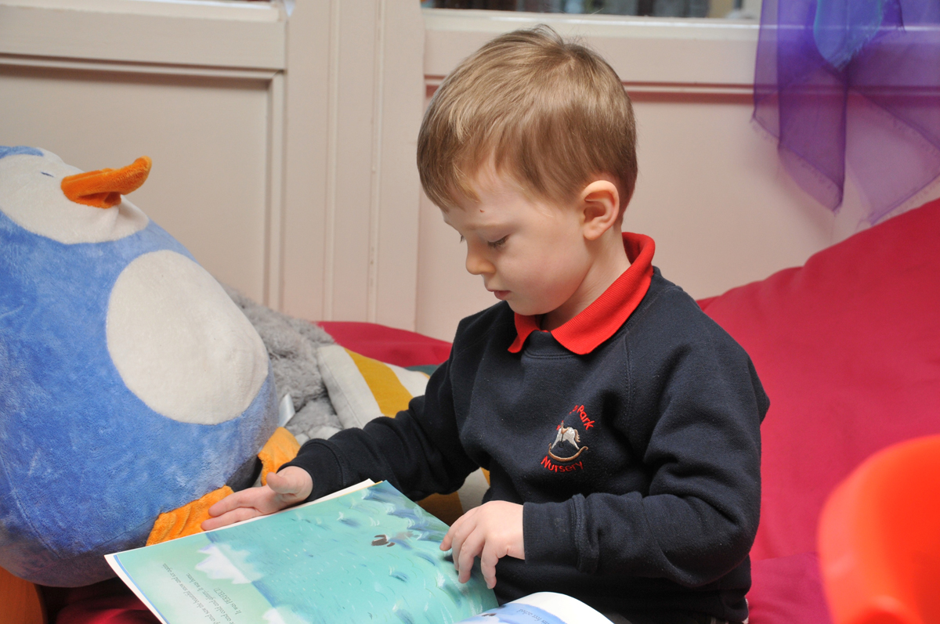
Communication
Office – absences, medication
Class Dojo
School Gate
Parents’ Evenings
Stay & Play
Social Media
Parent Helpers
Parent Rep and PTA

Slide 6
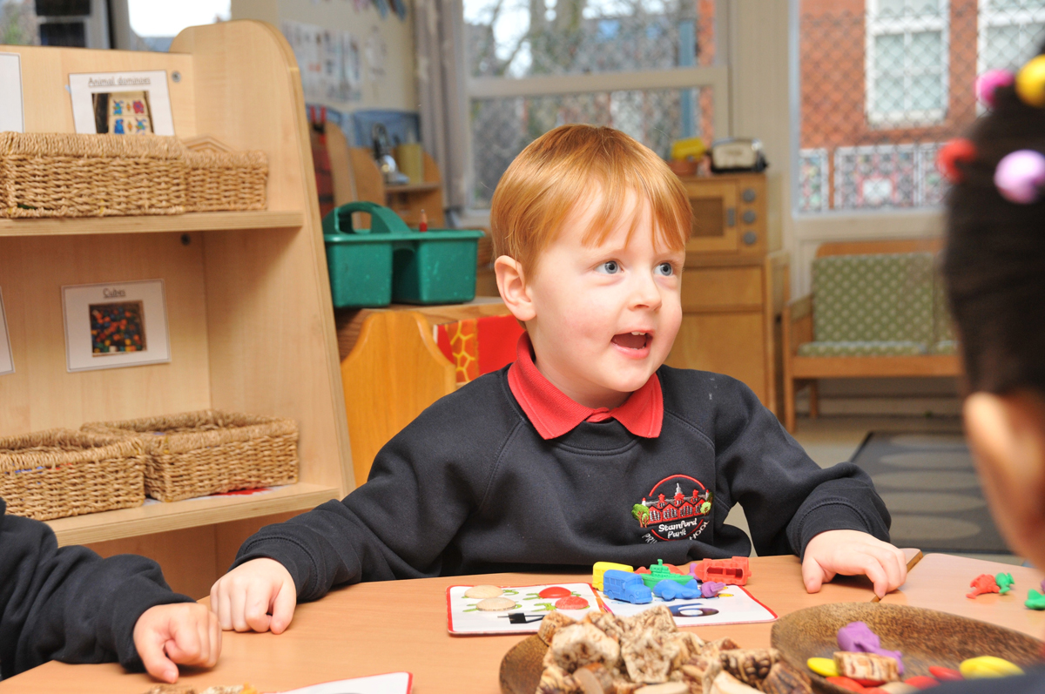
Administration
For our new families…
By tonight, login details will have been sent to you for our Parentmail and Parentpay systems.

Slide 7






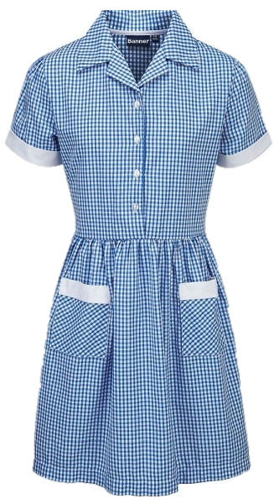





Uniform
A school cardigan or jumper.
A grey skirt, pinafore or grey trousers.
A plain white polo shirt or a plain white shirt.
Grey/navy tights or grey/navy socks.
Navy or black shoes.
PE Kit
A school hoodie.
Plain navy tracksuit bottoms.
A plain white, round neck t-shirt.
Plain navy shorts.
White, grey or navy socks.
Trainers.

Slide 8
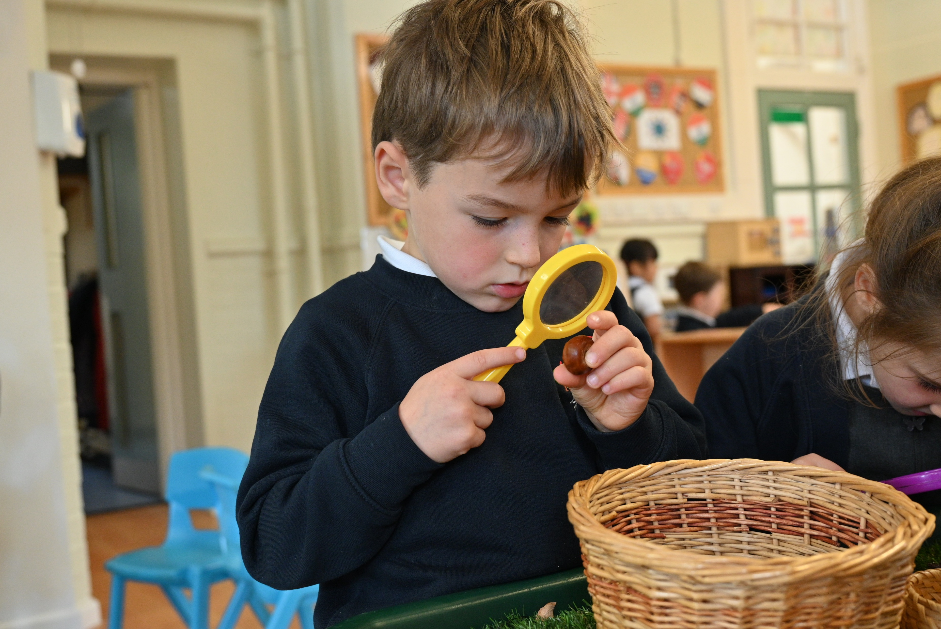
The School Day
8:45am – Drop off
9.00am – Door closes
11:45am – Lunch
3:30pm – Pick up
Bring a named water
Name all uniform and spares
Healthy snack provided by the school
Wrap around care available

Slide 9
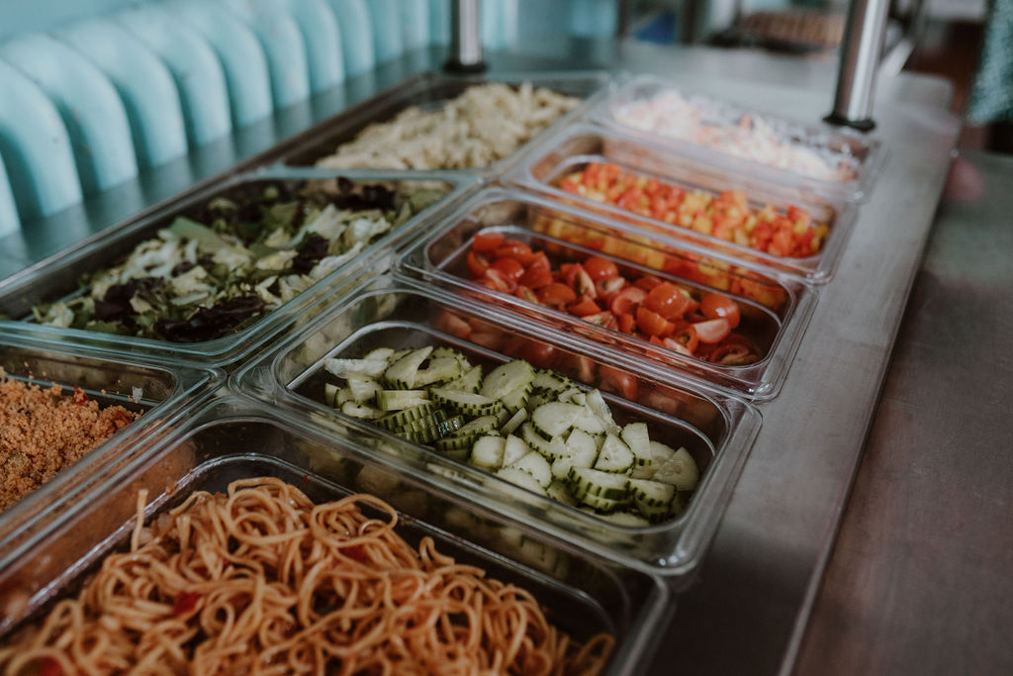
School Dinners
Provided by Mellors Catering Service
Adhere to all Government guidance
Three-week rotating menu
If bringing packed lunch, no nuts or sesame

Slide 10


Slide 11
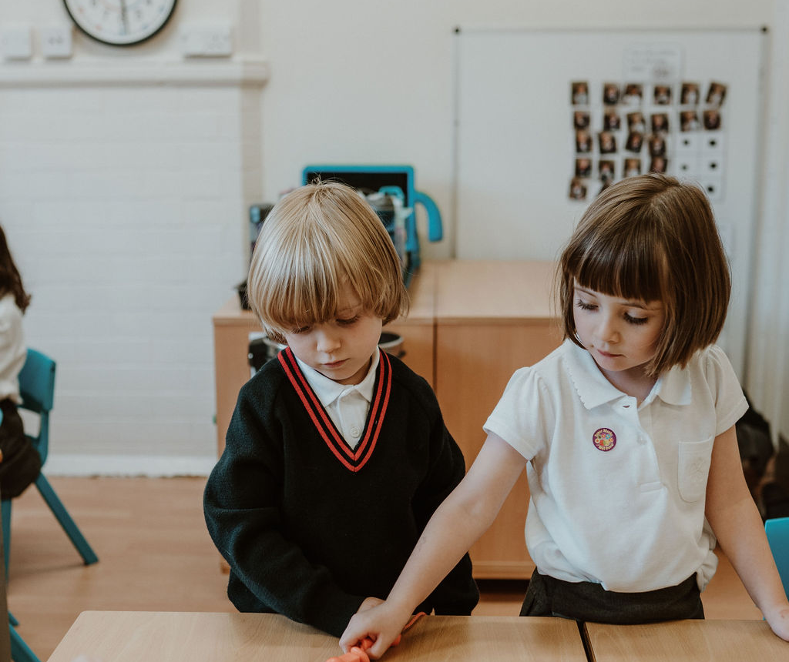
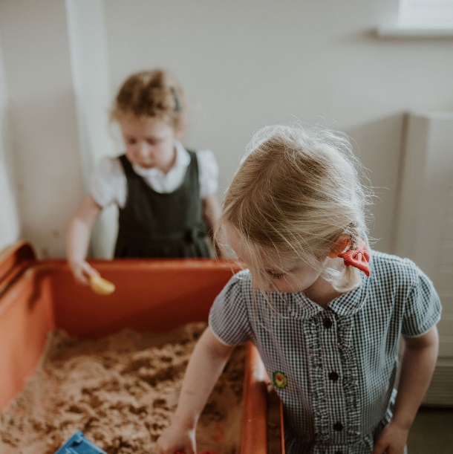
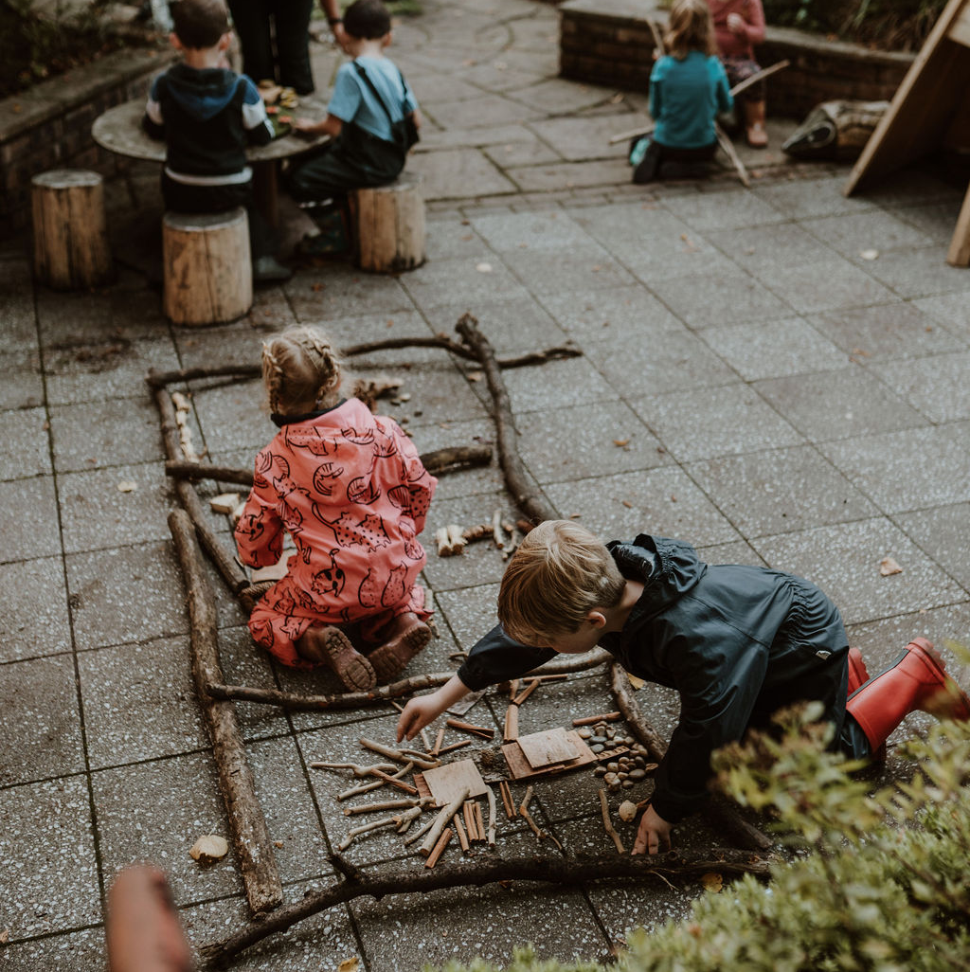
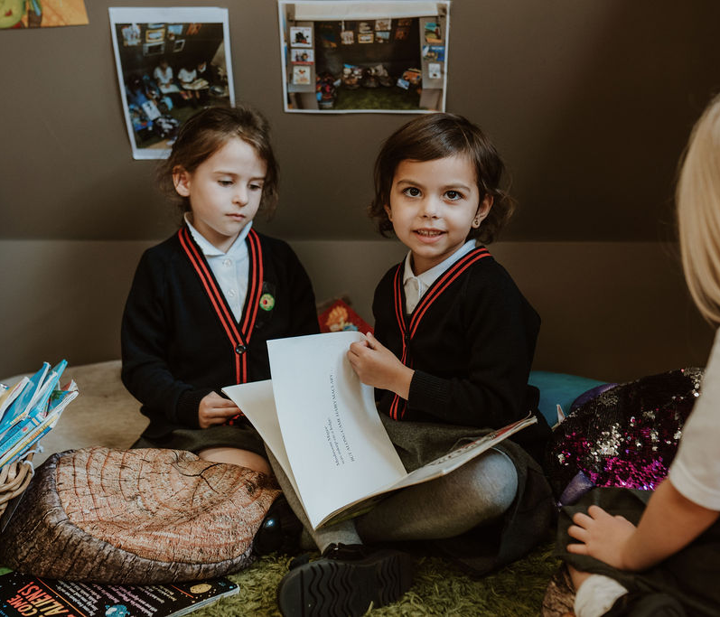

The Classrooms
Inter-connecting doors so children can move between the areas during continuous provision.
Sheltered outside areas so children can access the outdoors in all weather.
Provisions are regularly changed and adapted to spark interest and meet needs.

Slide 12

EYFS Fund
Donations gratefully received through office only.
Used throughout the year by Nursery and Reception to support flexibility of curriculum.
E.g. children’s interests, stories shared – ingredients to bake bread for ‘The Little Red Hen’, pirate role play etc.
Helps to provide enhancements to children’s learning.

Slide 13
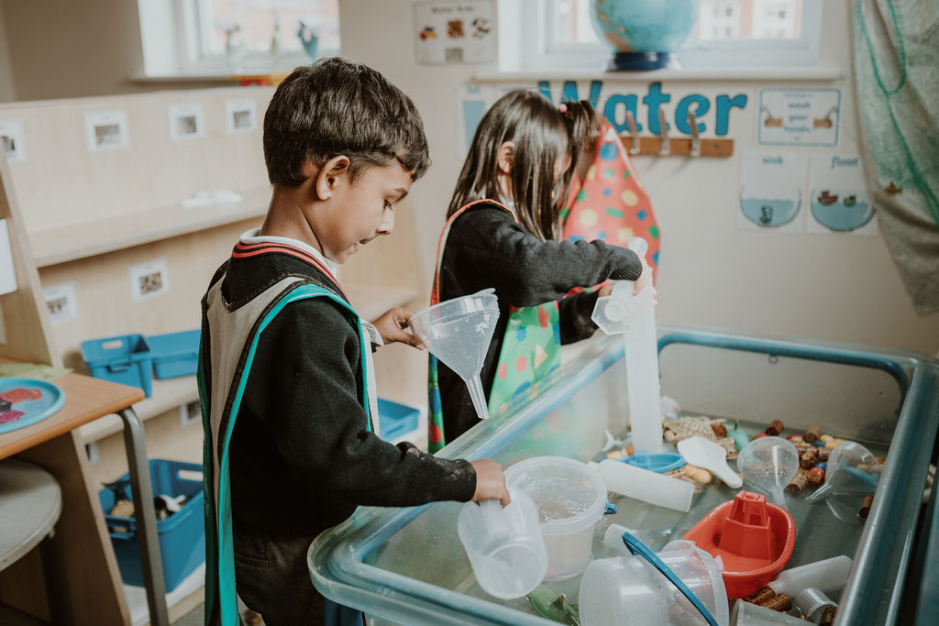
The Curriculum
Child led curriculum covering the 7 areas of the Early Years Foundation Stage Curriculum.
Outdoor provision
Specialist teaching
Phonics
Home learning – reading and Class Dojo
Trips

Slide 14
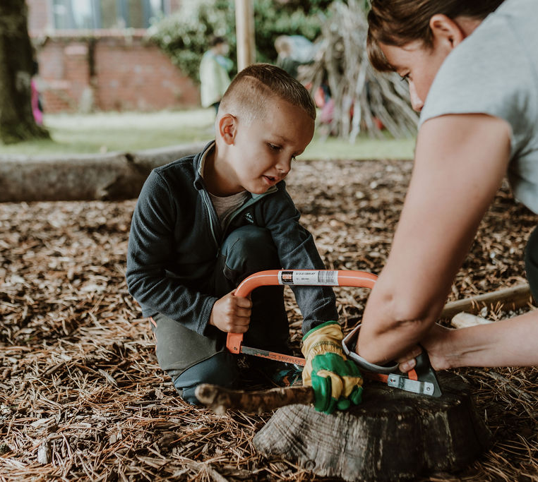
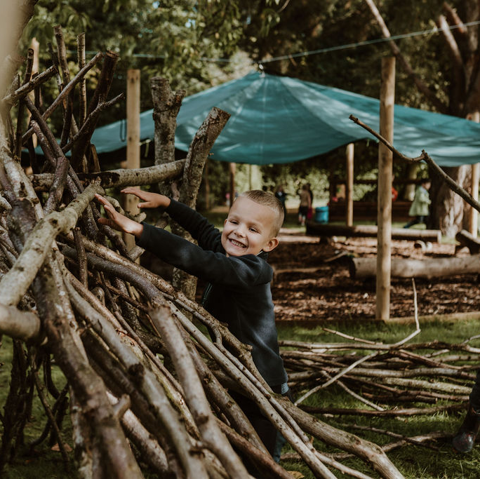
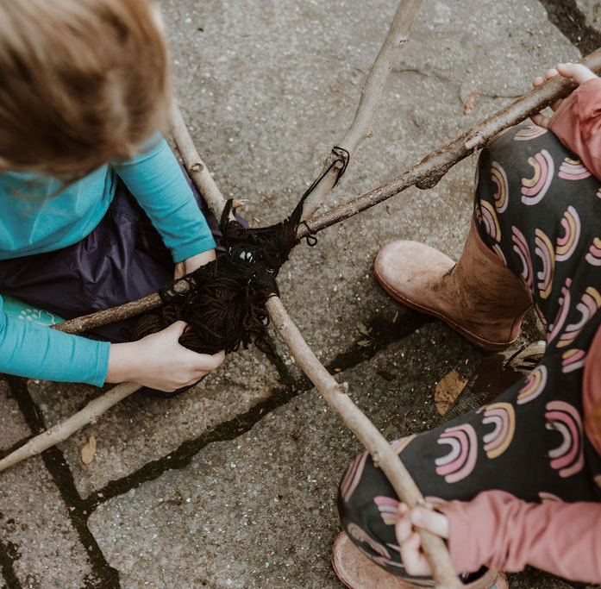
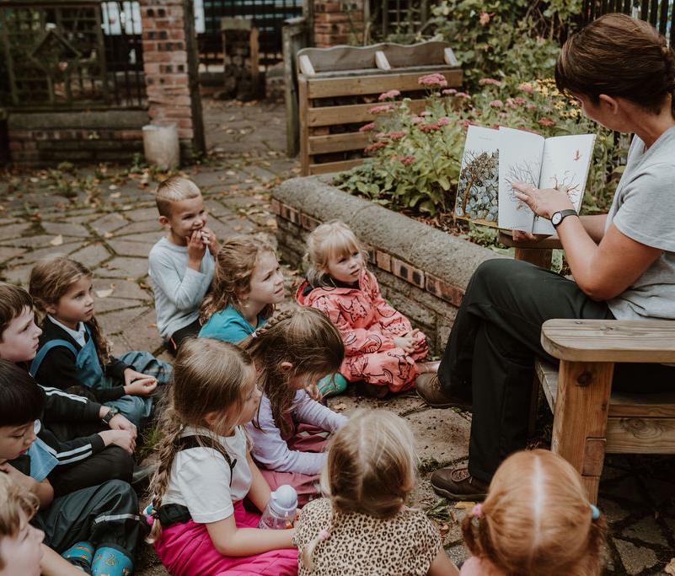
Forest School
Promotes child-initiated learning
Supports personal, social, emotional and physical development
Develops language and communication skills
Aims to encourage all children to take risks, develop resilience and develop confidence and independence
Promotes an understanding and appreciation of the outdoors and nature.

Slide 15
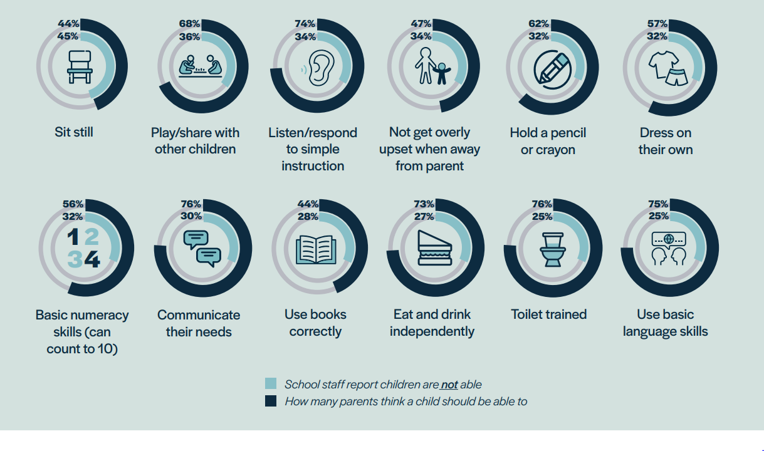
School Readiness

Slide 16
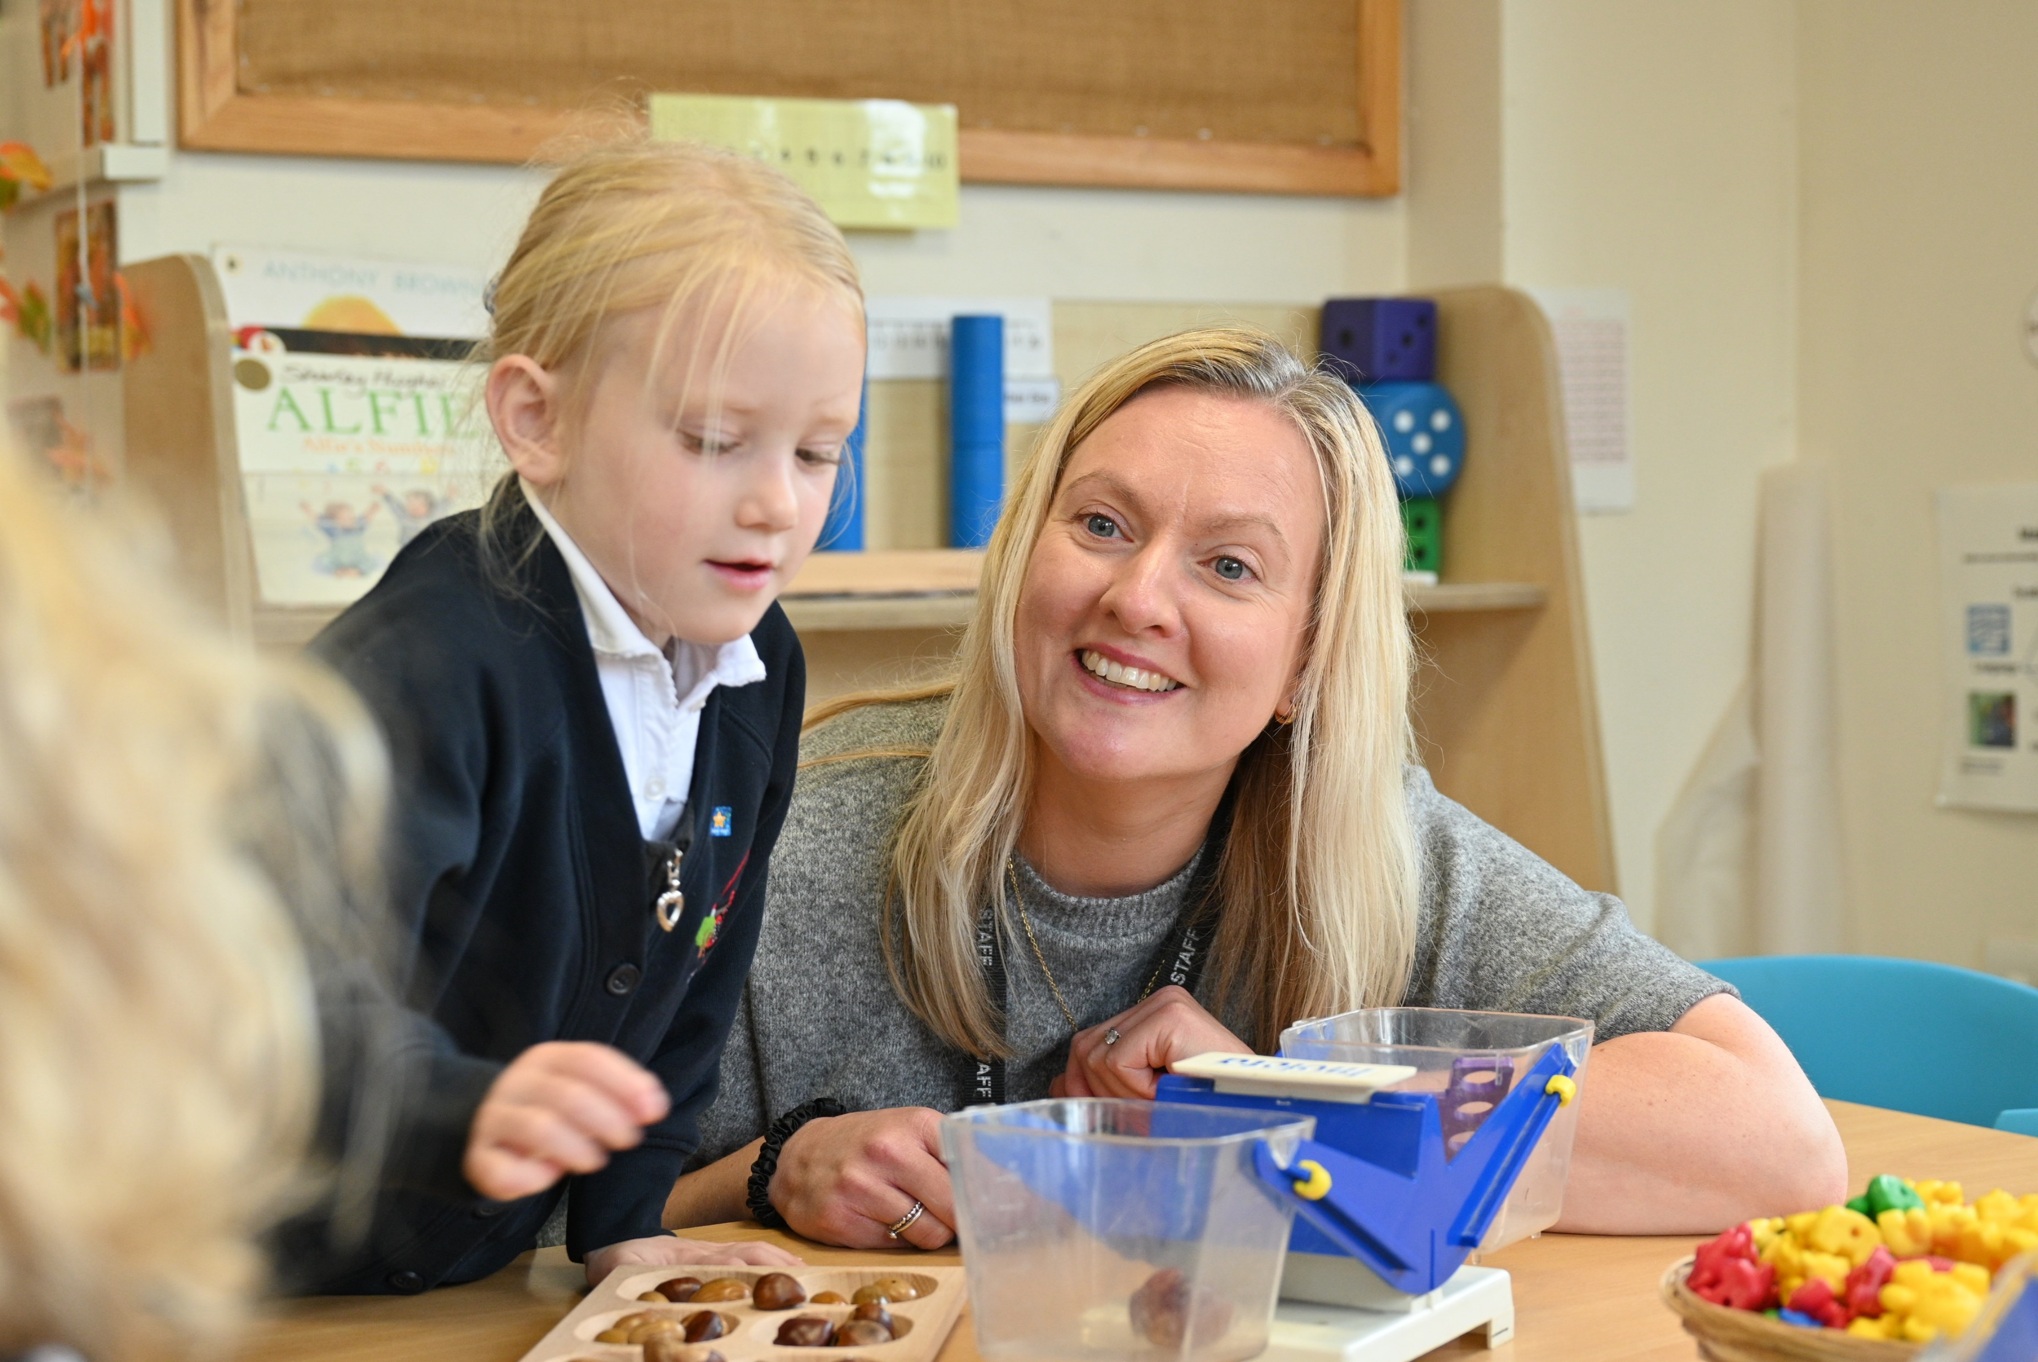
School Readiness
Support us in achieving these key skills in preparation for school.
Top tips
Letter formation
Numbers and counting – understanding of number
Turn taking games, developing patience and waiting skills
Following instructions to complete simple tasks at home
Tidying up

Slide 17
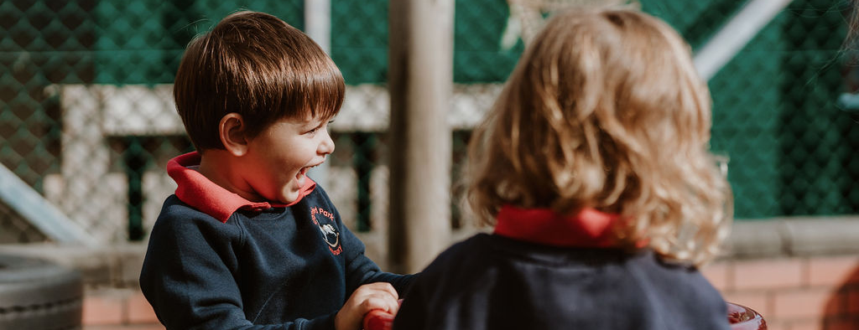

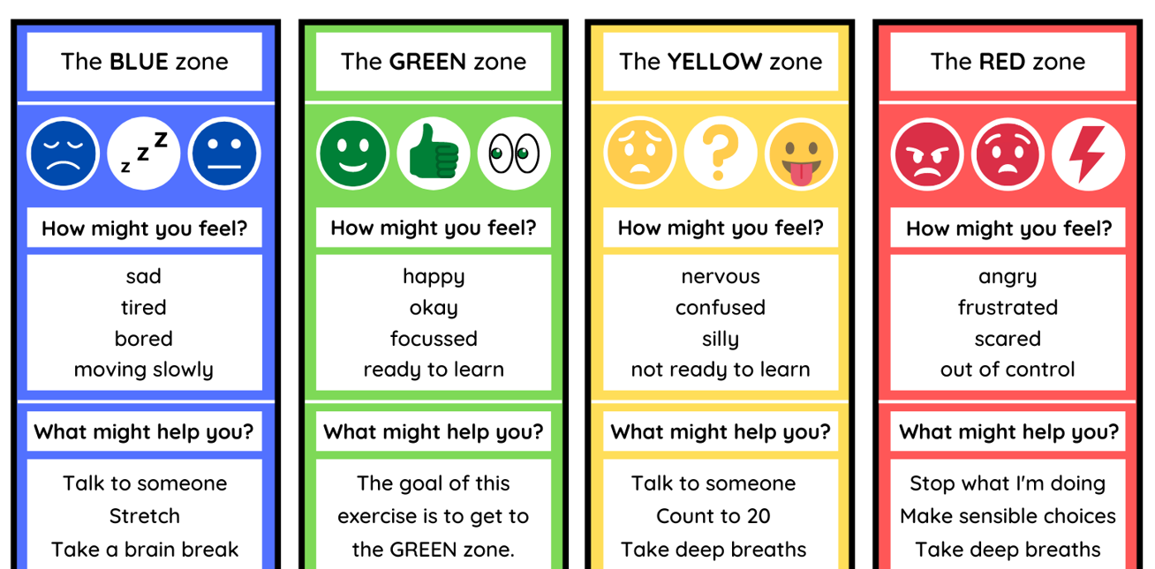
Wellbeing
Committed to wellbeing of all
Emotional literacy & resilience
Targeted support structure
PSED – Think Equal
Promote friendship & collaboration across the school

Slide 18

Additional Support
SENCo – Mrs A Williams
EAL – Ms F Esa
Pupil Premium – Mrs Durrant
Pastoral – Mrs Brownbill

Slide 19
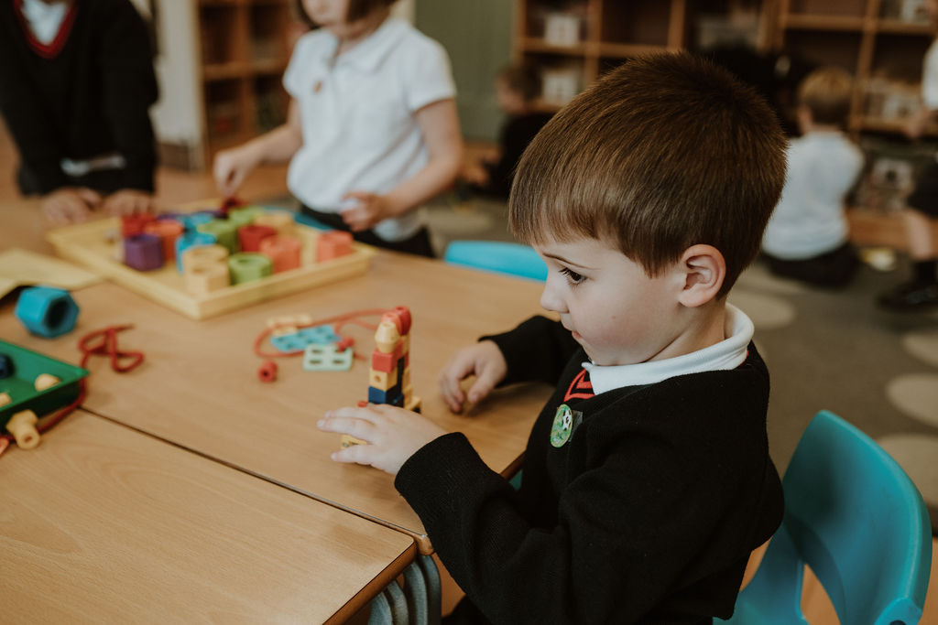
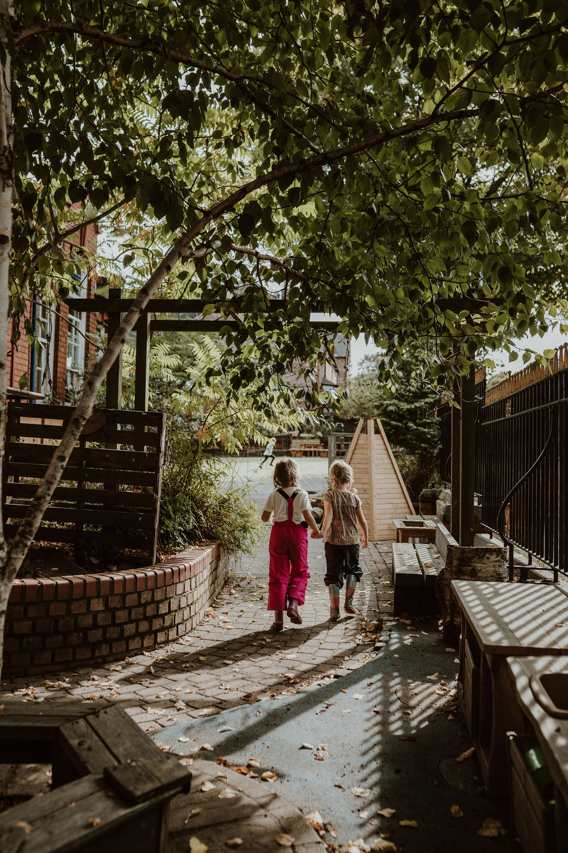

Thank you

