Slide 1

Welcome to Stamford Park Primary School

Slide 2
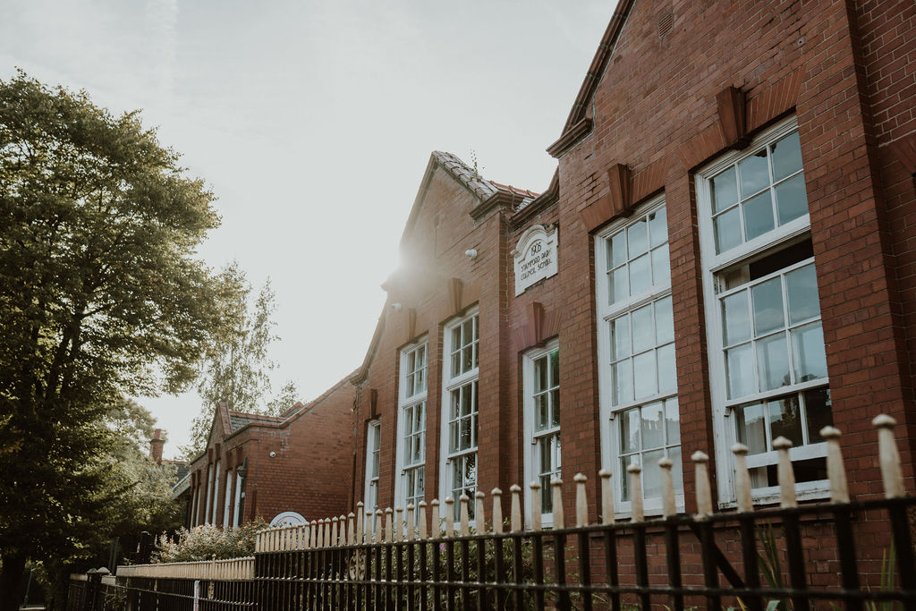
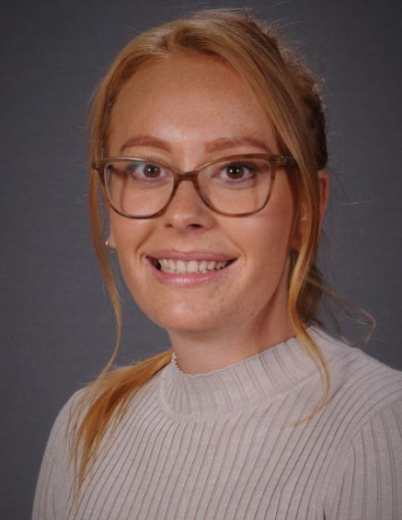
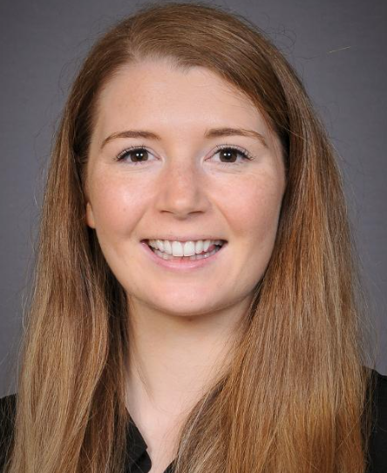
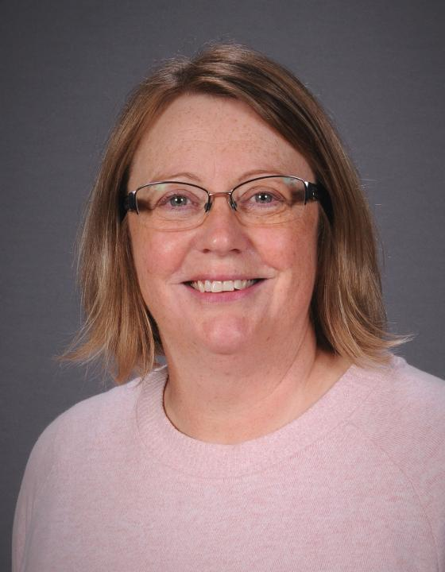
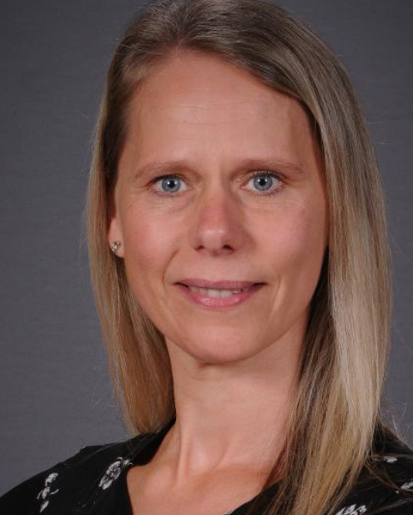
Meet the Team
Nursery Teacher
Mrs Akrigg
Nursery Teacher
Miss Skinner
Teaching Assistant
Mrs Stirrup
Early Years Lead
Ms Bogart

Slide 3
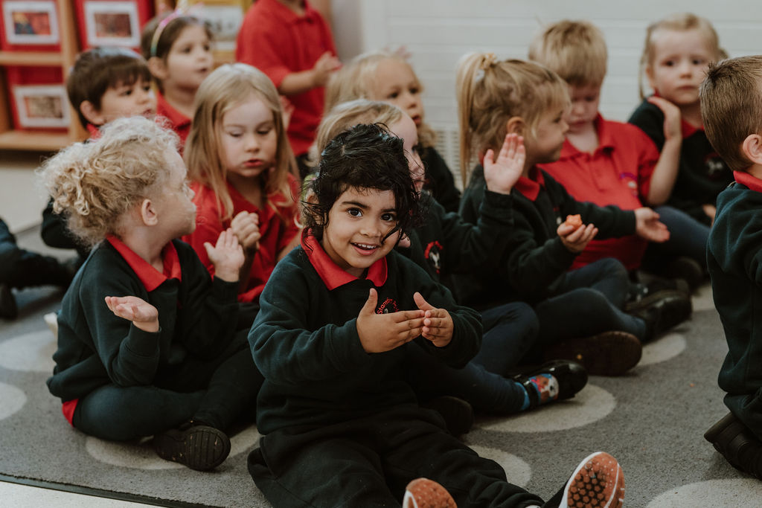
Starting
Transition documents, information and visits.
All children will be in full time by Thursday 3rd September.
You will receive further information about your child’s start date and their Class Dojo login after the stay and play you have chosen to attend.

Slide 4
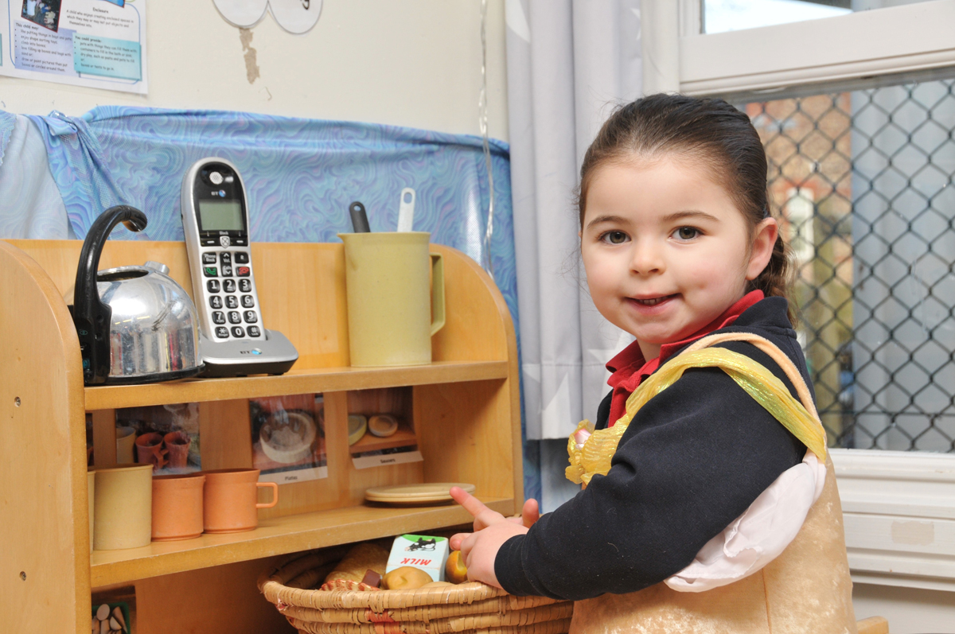
Stay and Play
30th June - 9:30am
2nd July - 1:30pm

Slide 5
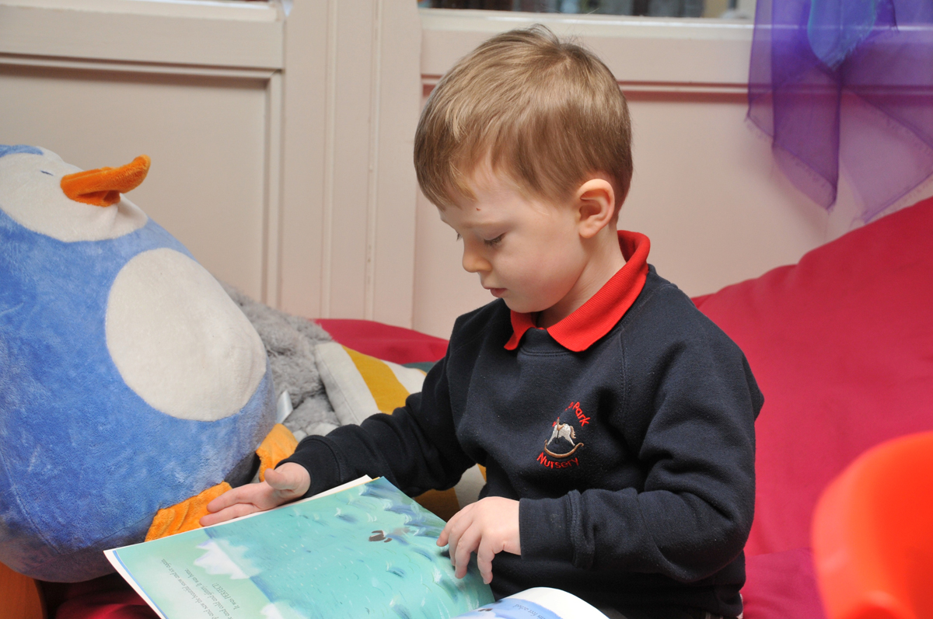
Communication
Office – absences, medication
Class Dojo
School Gate
Parents’ Evenings
Stay & Play
Social Media
Parent Helpers
EYFS fund
Parent Rep and PTA

Slide 6
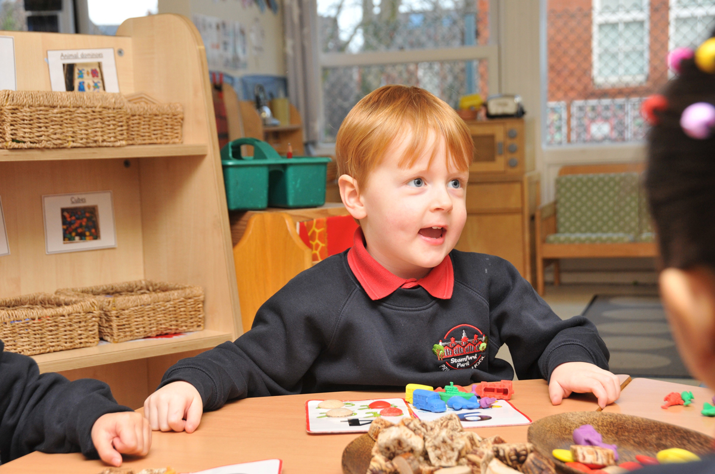
School Systems
In July, login details will be sent to you for Parentmail and Parentpay.
An invoice for fees will be sent out in July. Fees are paid termly in advance.

Slide 7





Uniform
A school cardigan or jumper
Blue joggers, shorts or leggings
A plain red polo shirt
Comfortable shoes – ideally trainers (velcro)
Wellies for wet days, which will stay in Nursery
Spare Clothes
T-shirt
Trousers / leggings x2
Underpants / knickers x2
Socks x2

Slide 8
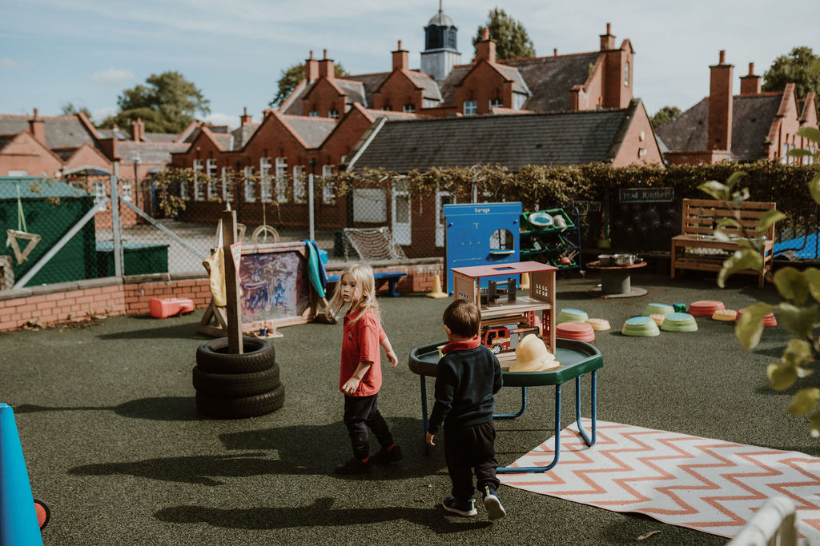
The School Day
8:45am – Nursery drop off
9.00am – Door closes
11:45am – Lunch
3:30pm – Nursery pick up
Bring a named water
Name all uniform and spares
Healthy snack provided by the school
Wrap around care available

Slide 9
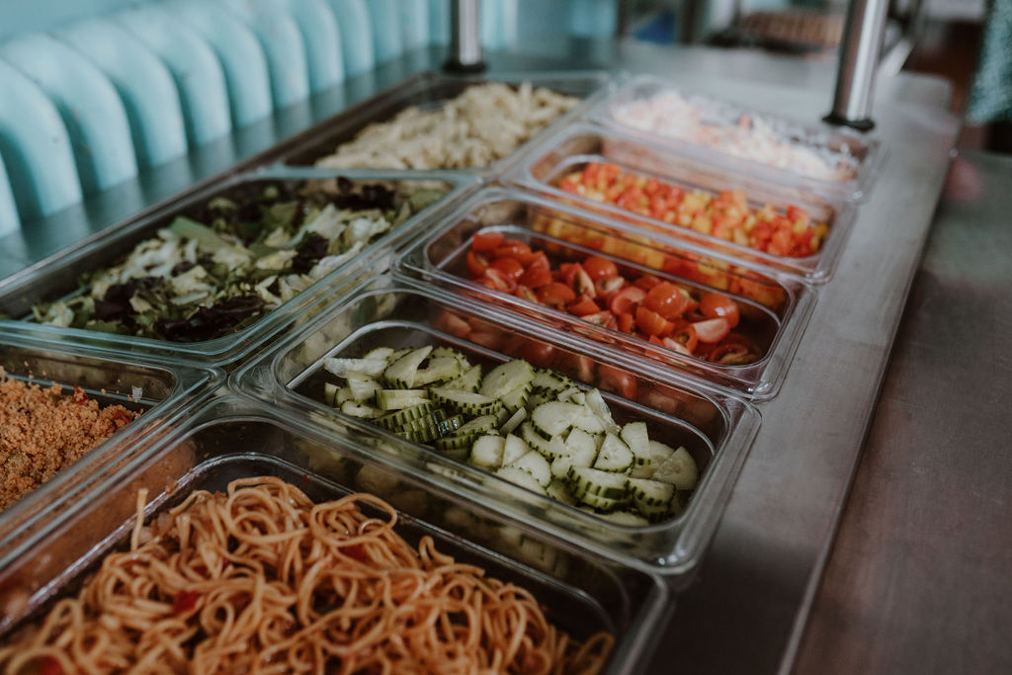
School Dinners
School meals - £2.50 per day
Provided by Mellors Catering Service
Adhere to all Government guidance
Three-week rotating menu
If bringing packed lunch, no nuts or sesame

Slide 10
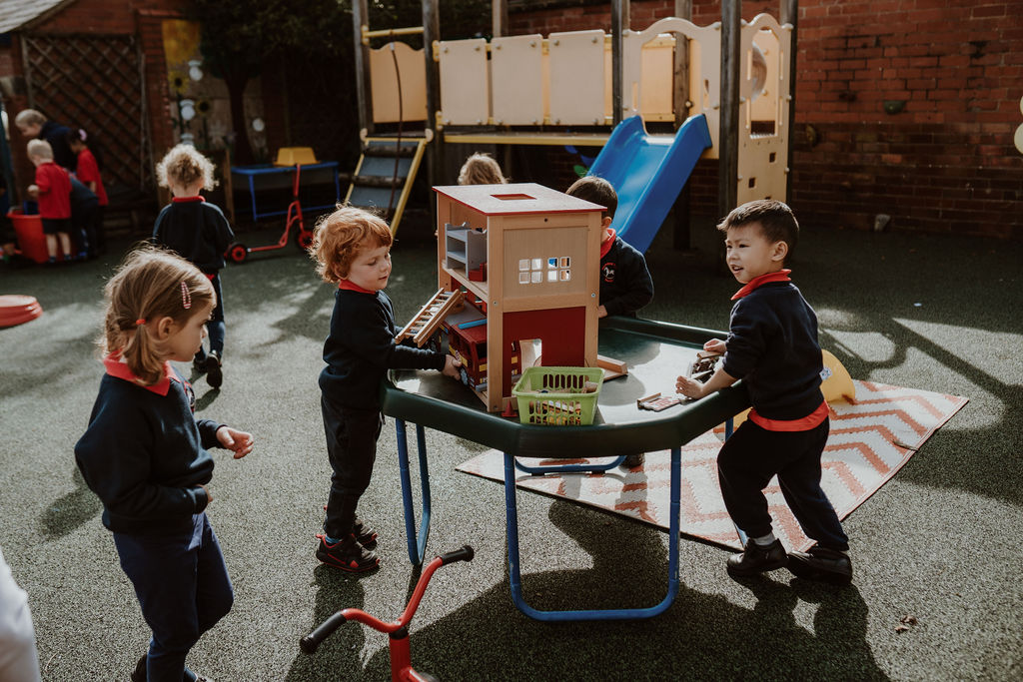
The Curriculum
Child led curriculum covering the 7 areas of the Early Years Foundation Stage Curriculum
Outdoor provision
Develop independence
Safe and happy
Progress and assessment

Slide 11
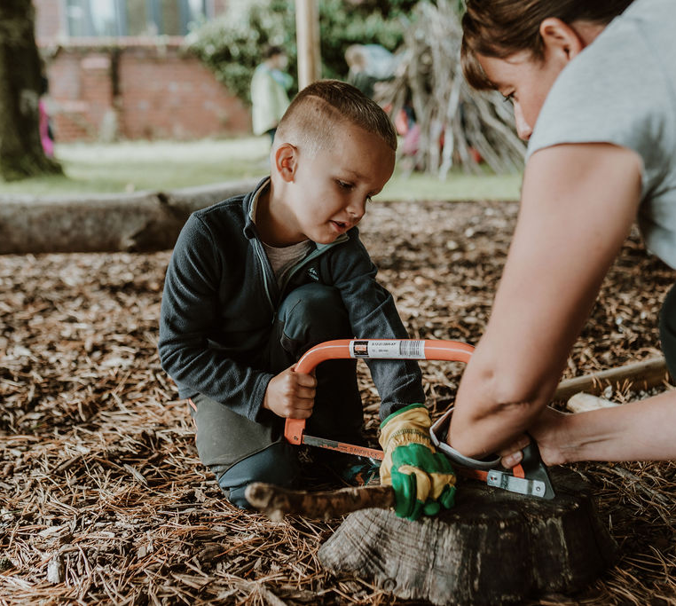
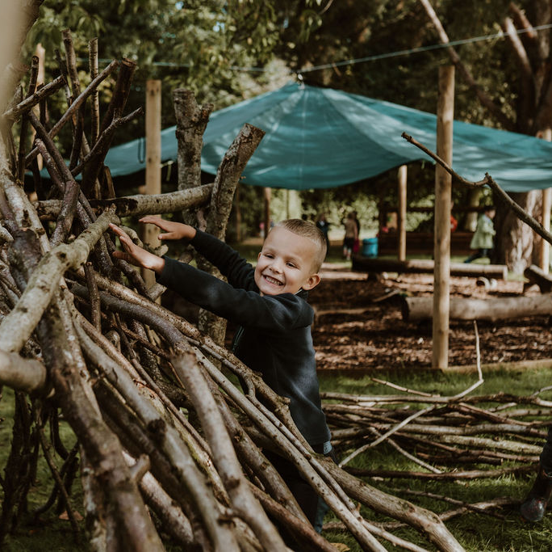
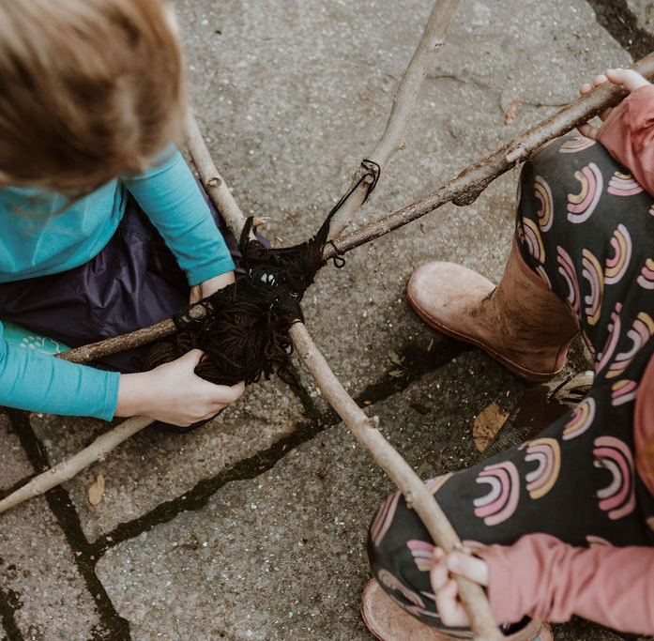
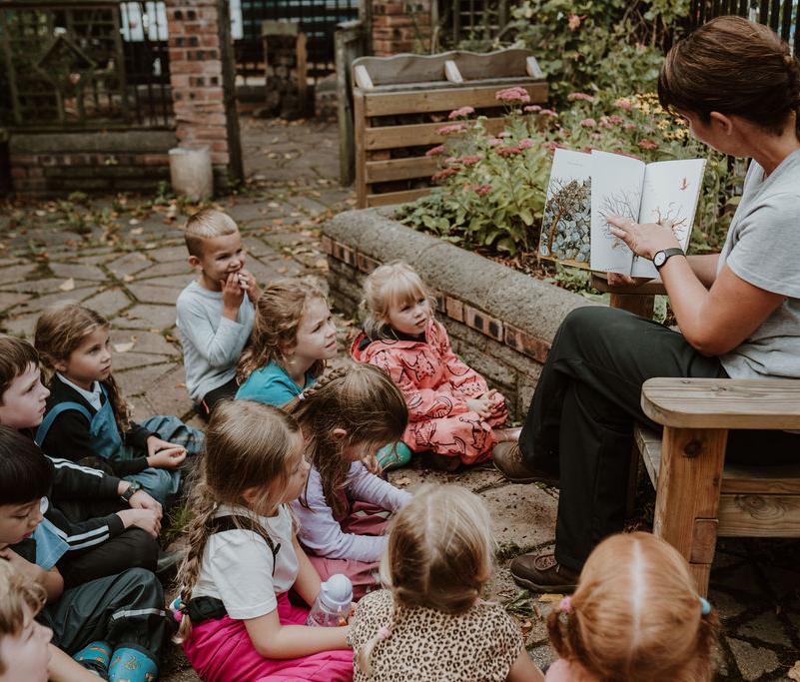
Forest School
Promotes child-initiated learning
Supports personal, social, emotional and physical development
Develops language and communication skills
Aims to encourage all children to take risks, develop resilience and develop confidence and independence
Promotes an understanding and appreciation of the outdoors and nature.

Slide 12
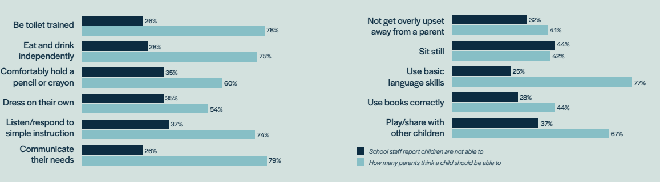
School Readiness

Slide 13
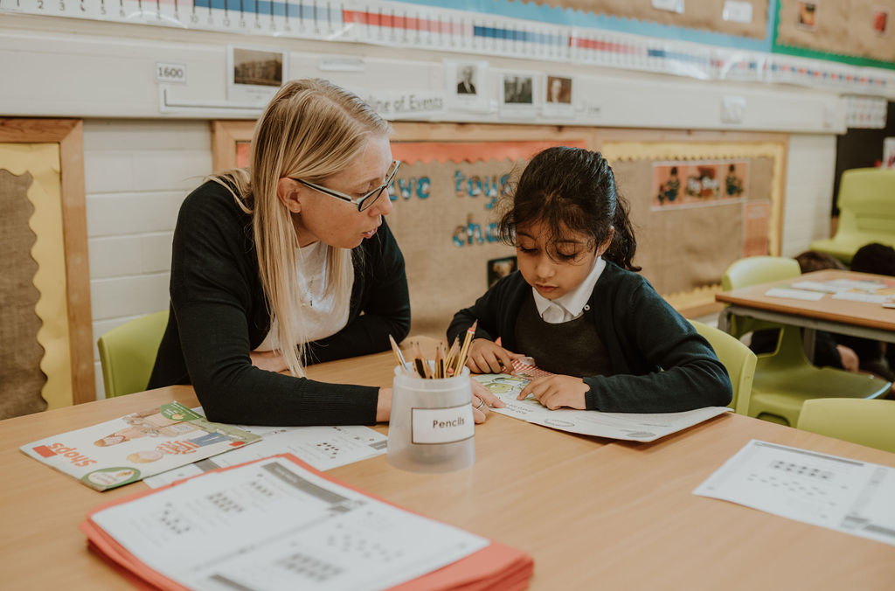
School Readiness
Support us in achieving these key skills in preparation for school.
Top tips
Letter formation – not capital letters please
Numbers and counting – understanding of number
Turn taking games, developing patience and waiting skills
Following instructions to complete simple tasks at home
Tidying up

Slide 14

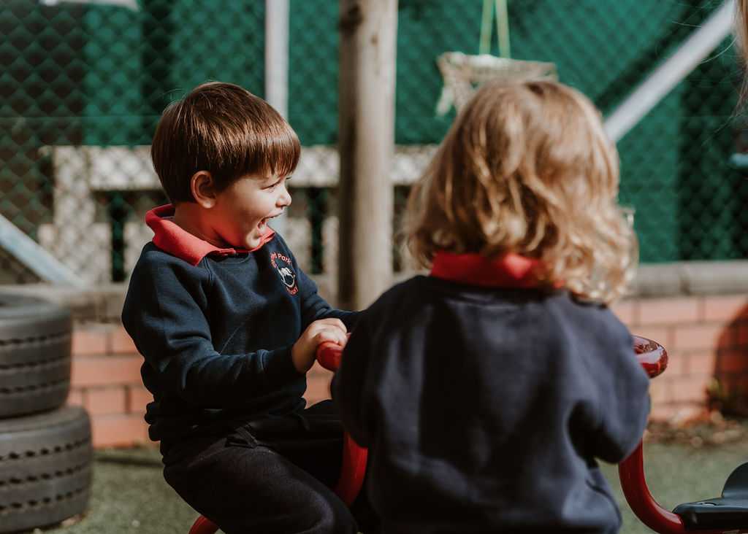
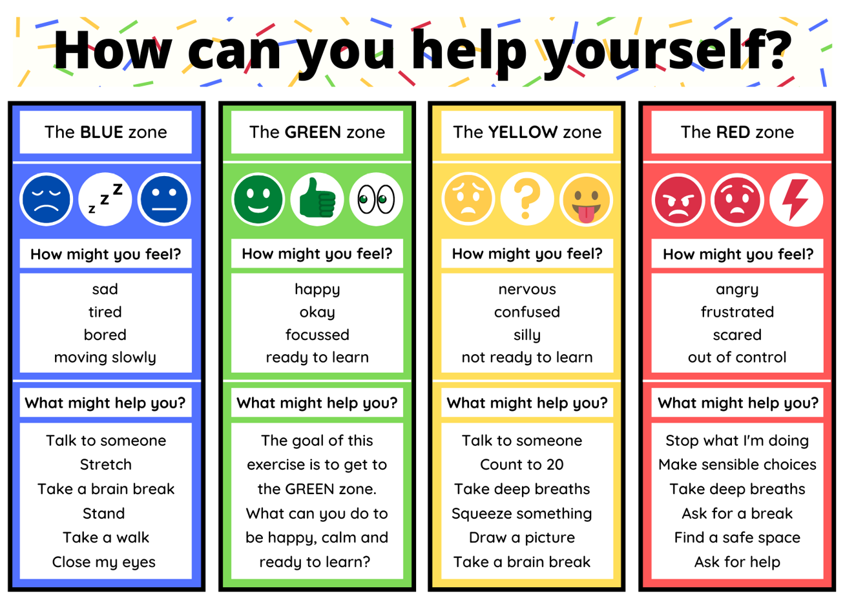
Wellbeing
Committed to wellbeing of all
Emotional literacy & resilience
Targeted support structure
PSED – Think Equal
Promote friendship & collaboration across the school

Slide 15
Additional Support
SENCo – Mrs A Williams
EAL – Ms F Esa
Pupil Premium – Mrs Durrant
Pastoral – Mrs Brownbill

Slide 16
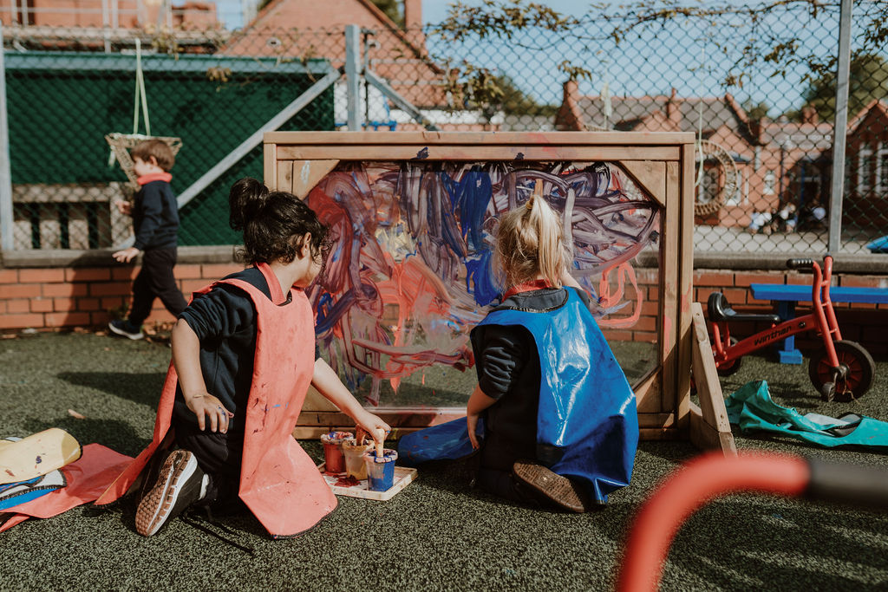
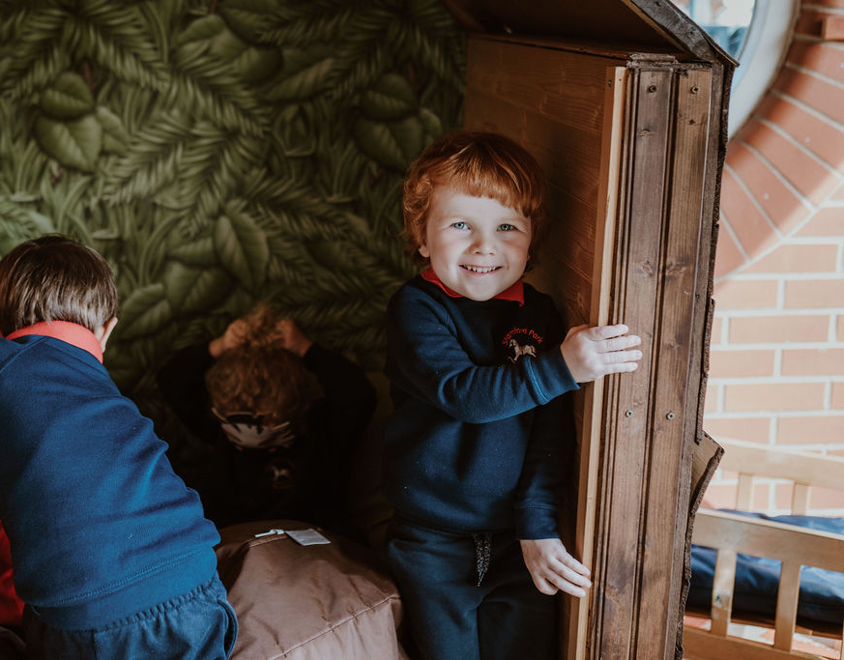
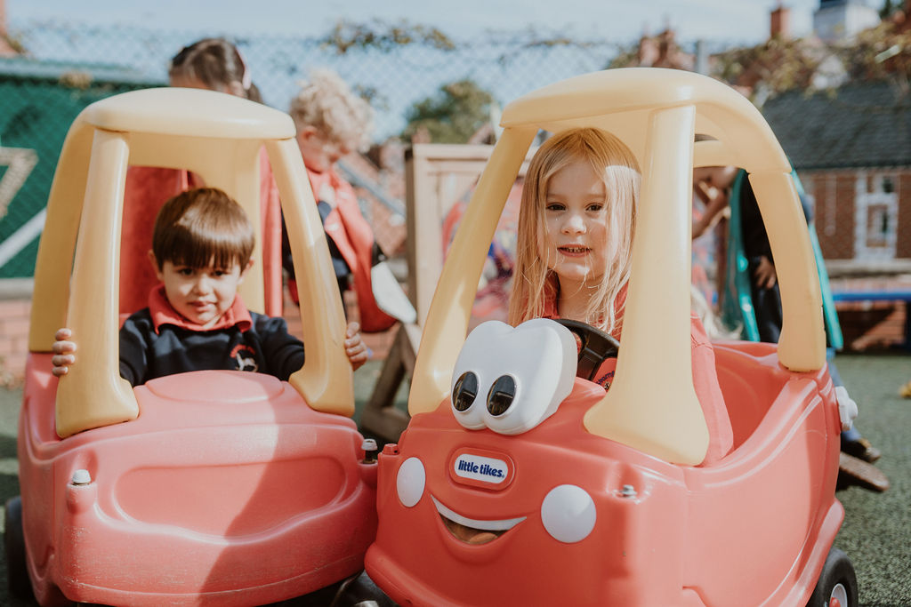
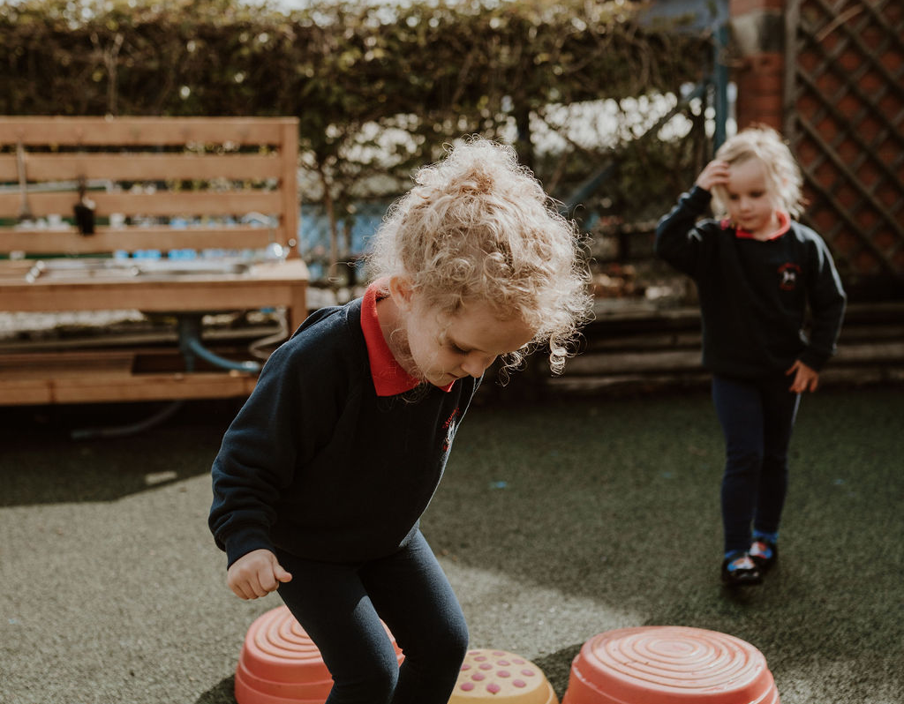
Thank you

