Slide 1

Welcome to Stamford Park Primary School

Slide 2
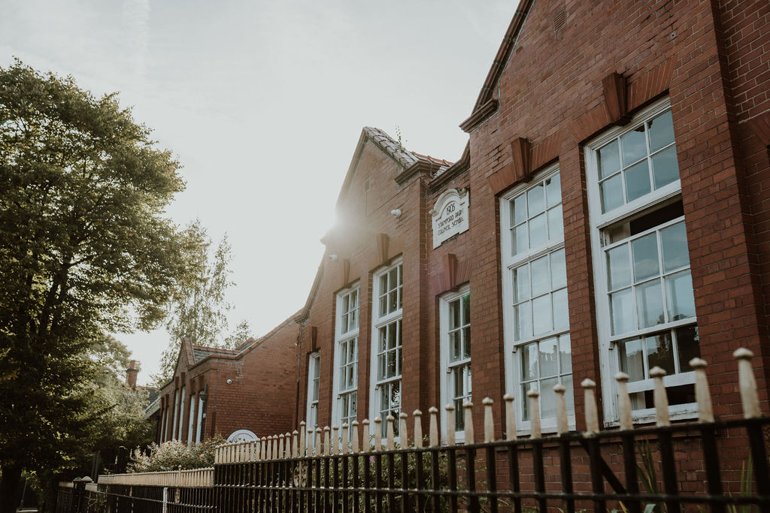
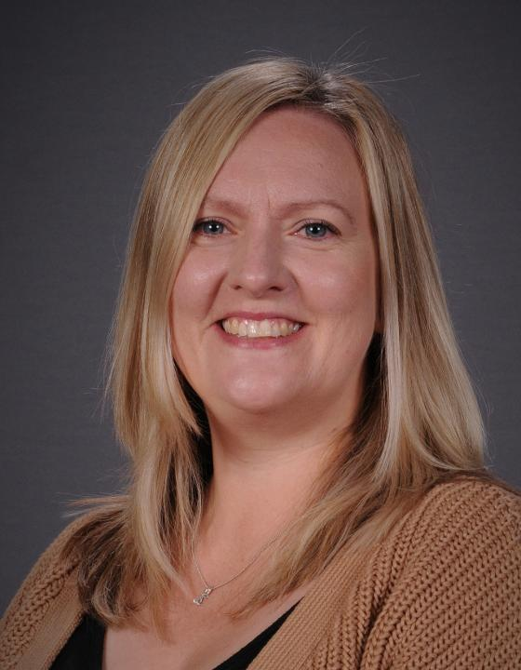
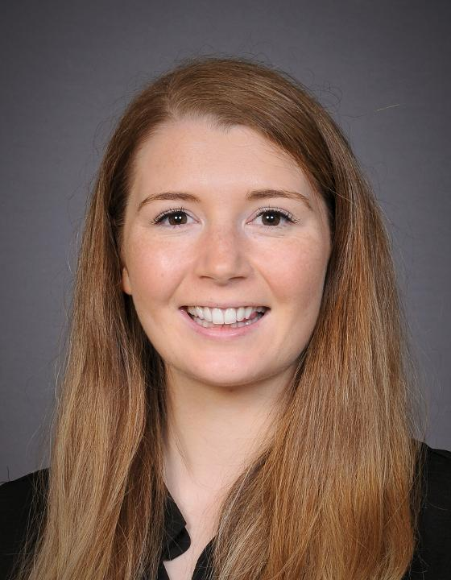
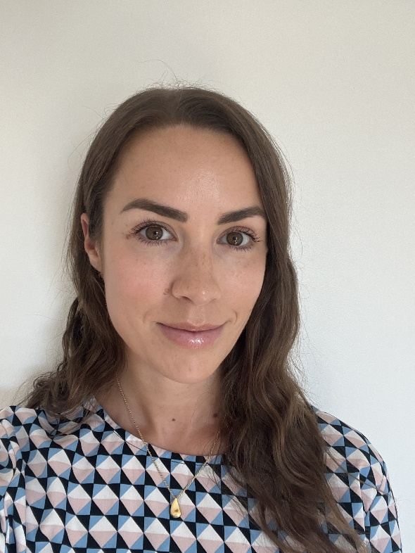
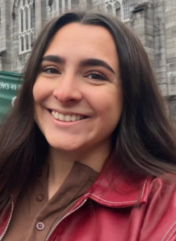
Meet the team
Mrs Williams
Class Teacher
Miss Skinner
Class Teacher
Miss Healey
Class Teacher
Miss Selway
Teaching Assistant

Slide 3
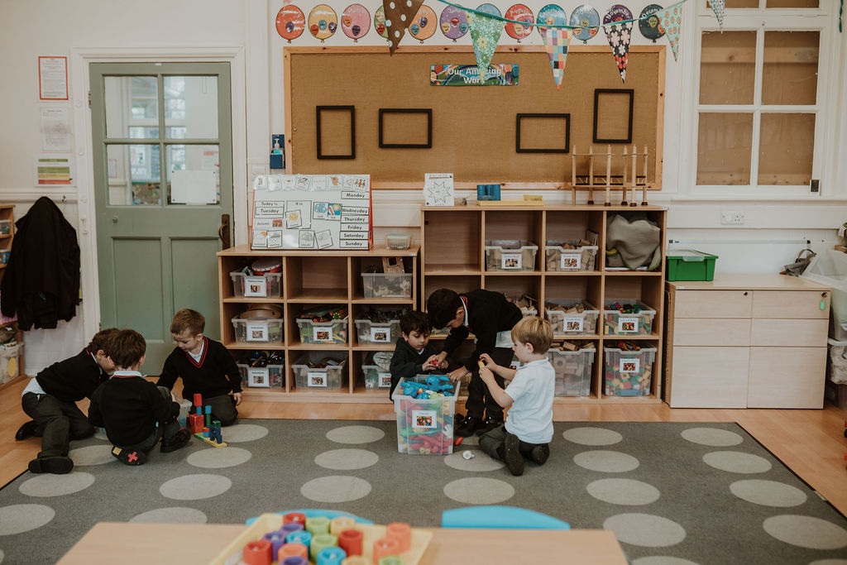
Starting
Transition documents, information and visits.
Parent Packs include helpful and important documents. Please complete Class Dojo permission and return to the school office as soon as possible or bring to stay and play.
Stay and Play
Clubs and Parent Pay
All children will be in full time by Thursday 4th September.

Slide 4












Uniform
A school cardigan or jumper.
A grey skirt, pinafore or grey trousers.
A plain white polo shirt or a plain white shirt.
Grey/navy tights or grey/navy socks.
Navy or black shoes.
PE Kit
A school hoodie.
Plain navy tracksuit bottoms.
A plain white, round neck t-shirt.
Plain navy shorts.
White, grey or navy socks.
Trainers.

Slide 5
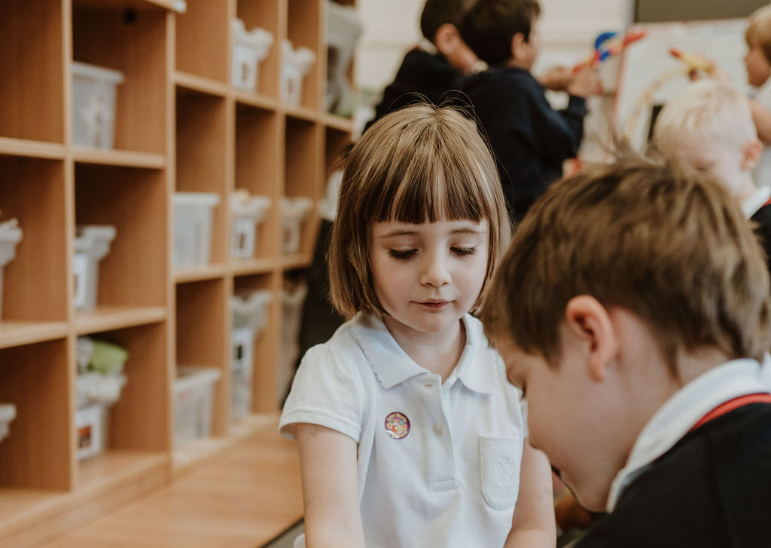
The School Day
8:45am soft opening. Children must be in school by 9:00.
Lunch 12:00 – 13:15.
15:30 End of the day.
It is important all children are in school promptly to take part in the daily routines. School ready and independence ideals are in the packs.
Bring a named water bottle and book bag everyday.
Healthy snack provided. Please do not bring your own.
Wrap around care.

Slide 6
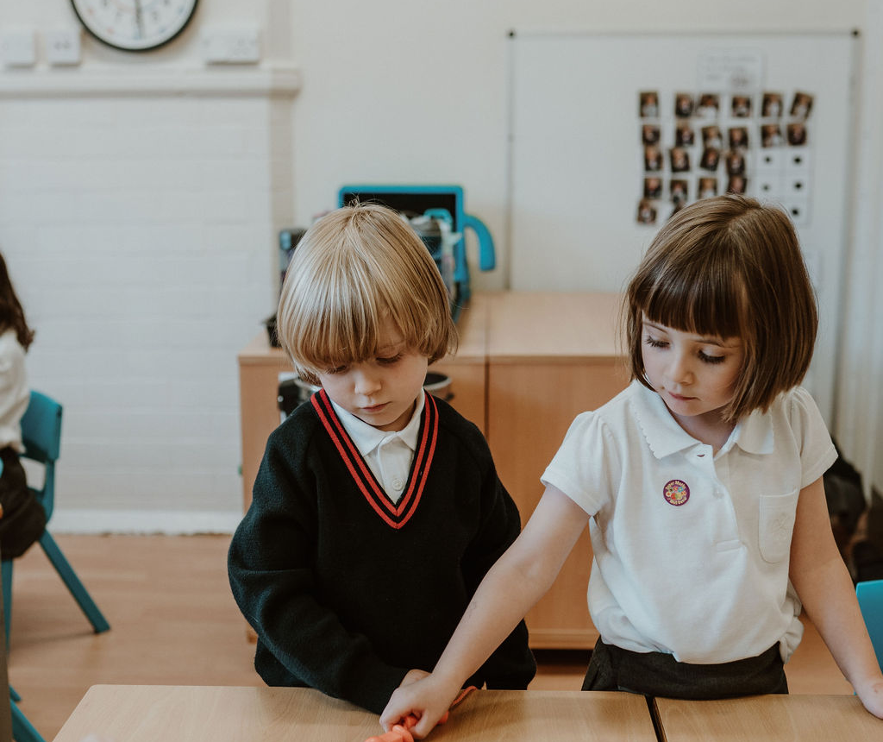
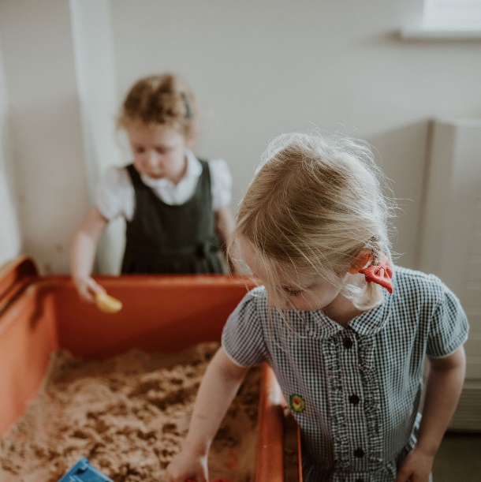
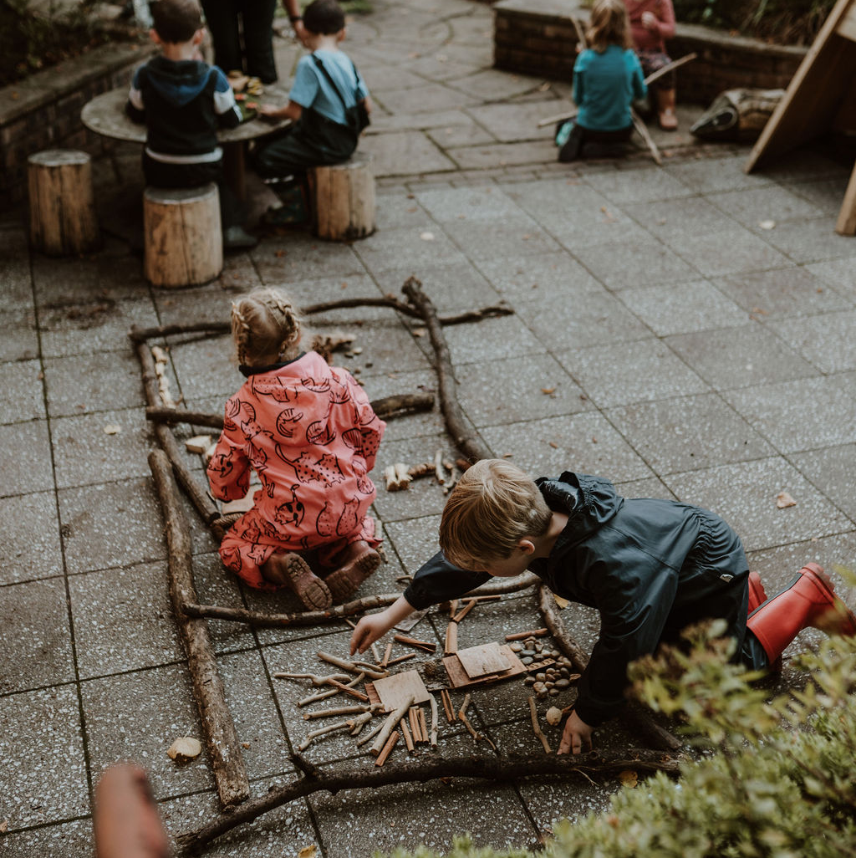
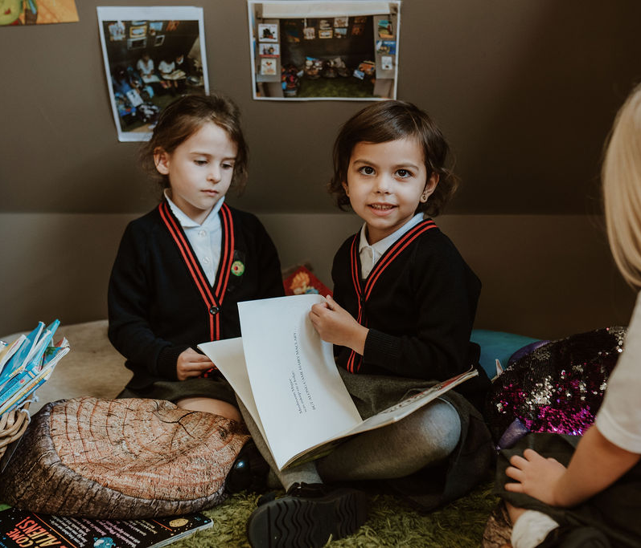
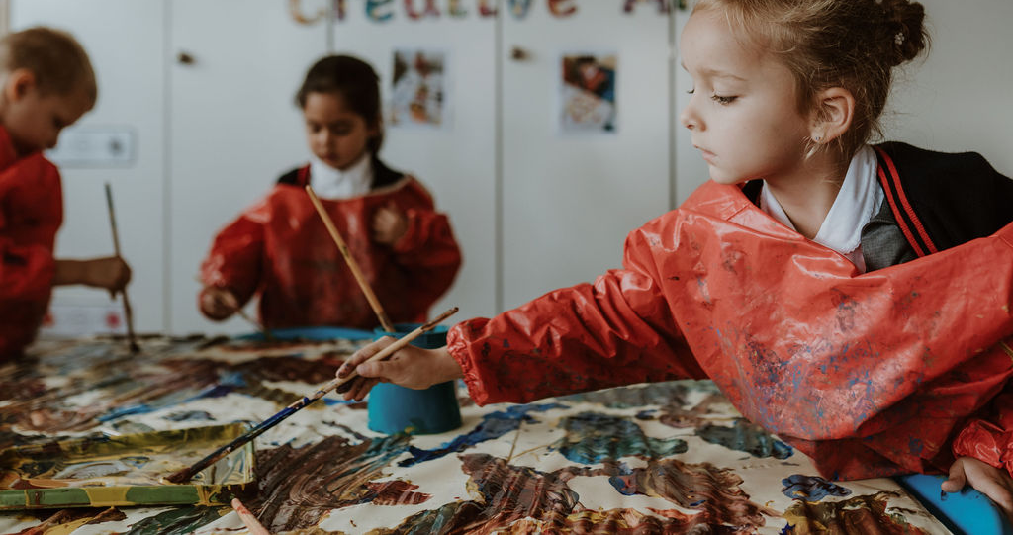
The Classrooms
Inter-connecting doors so children can move between the areas during continuous provision.
Sheltered outside areas so children can access the outdoors in all weather.
Provisions are regularly changed and adapted to spark interest and meet needs.

Slide 7
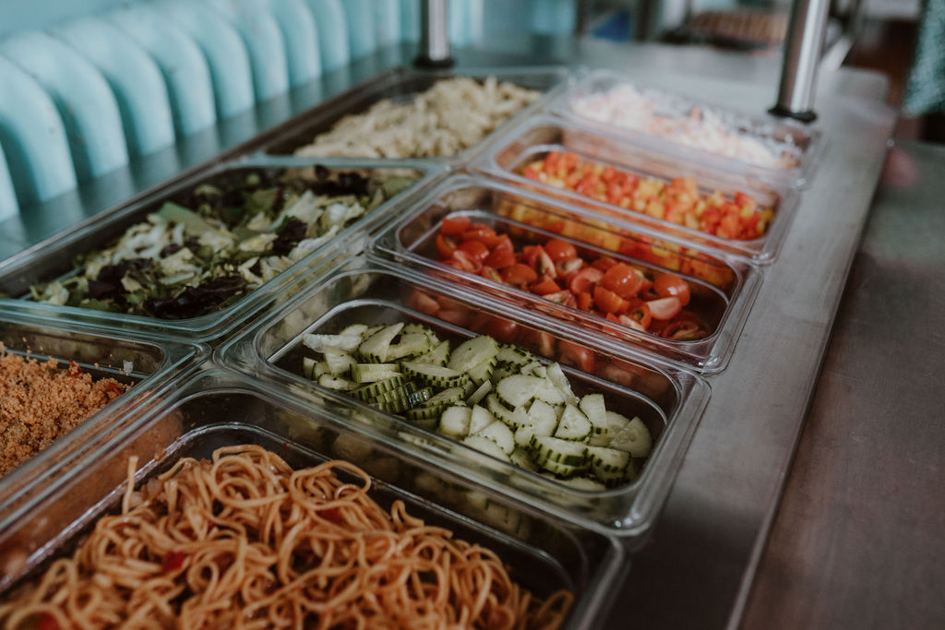
School Dinners at Stamford Park Primary
Reception children are eligible for a free school meal each day.
We have our own catering team and own kitchen on site.
‘Exceptional school dinners’ here.
Red Tractor free range products.
If packed lunch – NO NUTS

Slide 8

Communication and your support
Office – absences
Sickness/medicines
School gate
Class Dojo - permission
Social Media
Wow moments
Parent helpers
EYFS fund
Stay and Play – bag and pack (school readiness)

Slide 9
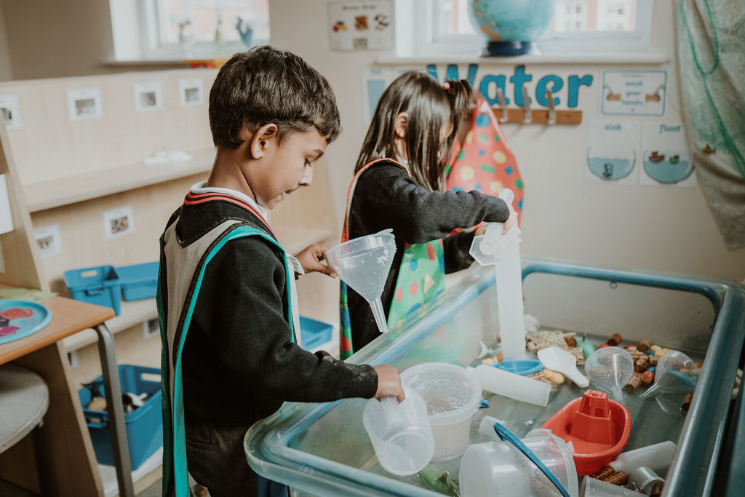
The Curriculum
Child led curriculum covering the 7 areas of the Early Years Foundation Stage Curriculum:
Personal, Social and Emotional
Communication and Language
Physical development
Literacy
Mathematics
Understanding of the World
Expressive Arts and Design
Outdoor provision
Specialist teaching
Phonics
Home learning – reading and website

Slide 10
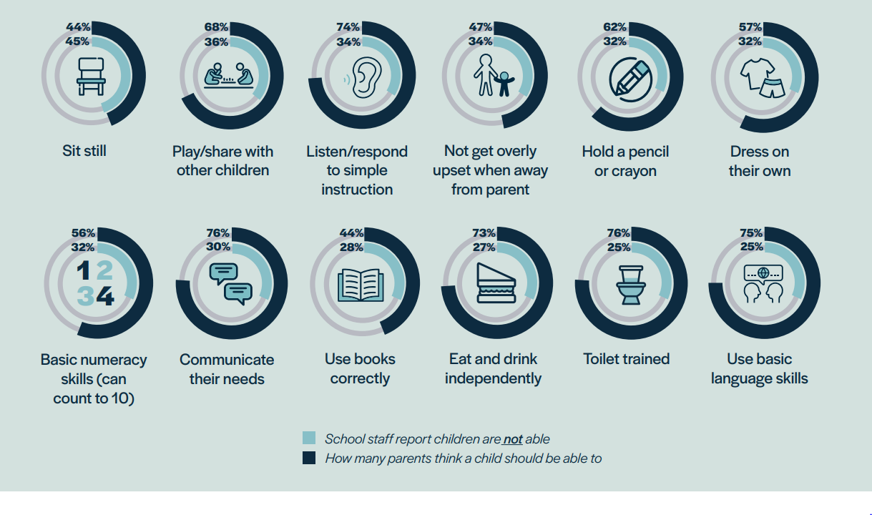
School Readiness

Slide 11
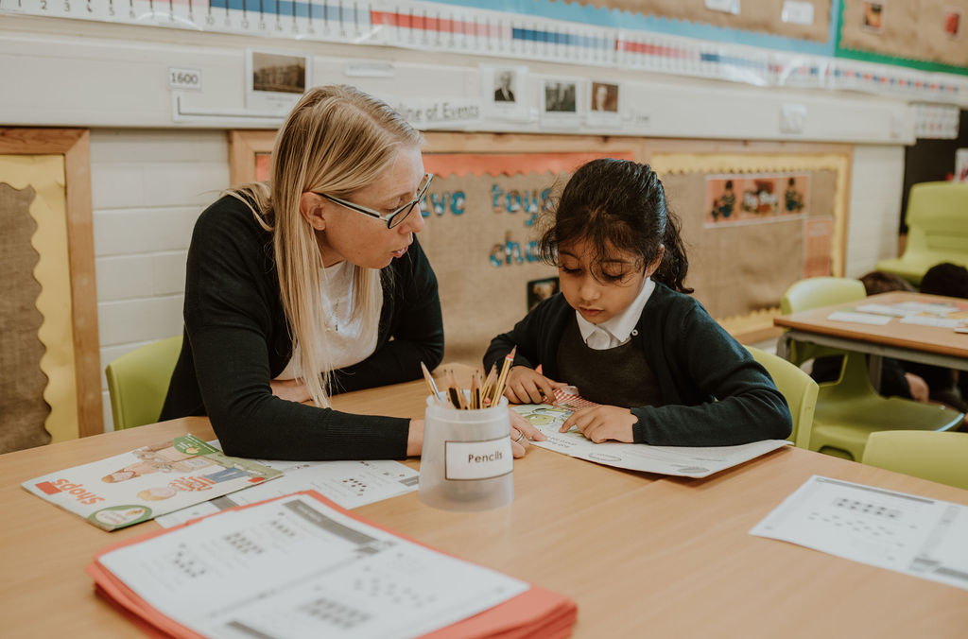
School Readiness
Prime Areas of learning
Personal, Social and Emotional Development
Listening, Attention and Understanding
Speaking
Physical Development
Gross Motor Skills
Fine Motor Skills
Communication and Language Skills
Self-regulation
Managing Self
Building Relationships

Slide 12
School Readiness
Support us in achieving these key skills in preparation for school.
Top tips
Letter formation – not in capital letters please
Numbers and counting – understanding of number
Turn taking games, developing patience and waiting skills
Getting dressed independently
Following instructions to complete simple tasks at home
Tidying up

Slide 13
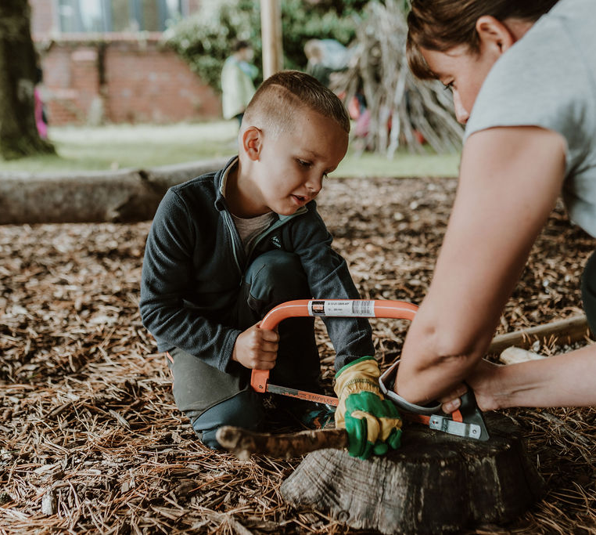
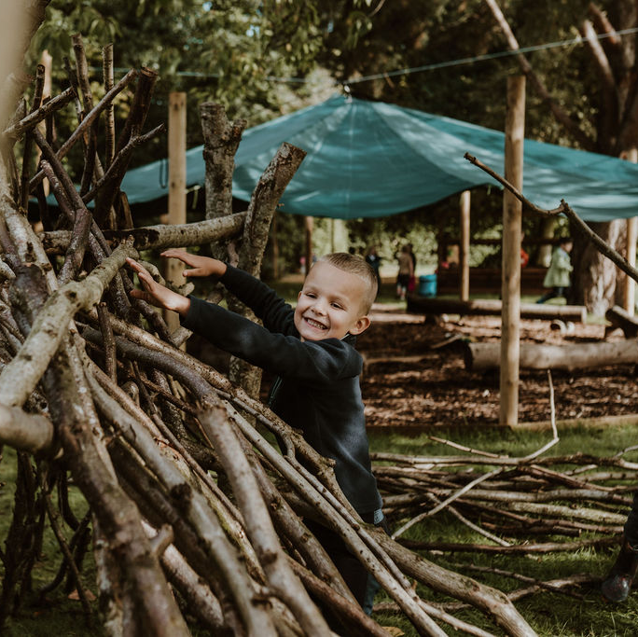
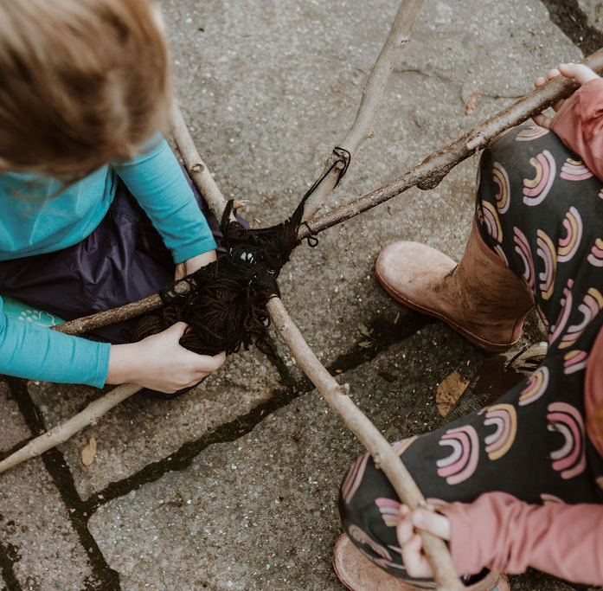
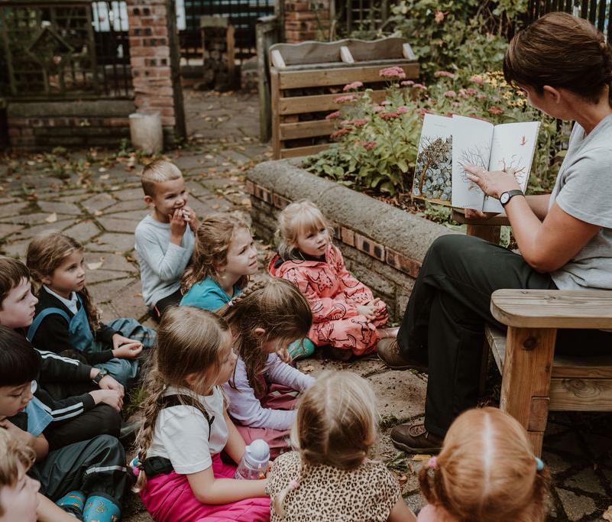
Forest School
Promotes child initiated learning;
Supports personal, social, emotional and physical development;
Develops language and communication skills;
Aims to encourage each individual to take risks, develop resilience and develop confidence and independence;
Promotes an understanding and appreciation of the outdoors and nature.

Slide 14
Assessments and SEN Support
Baseline assessment completed in the first few weeks.
Regular assessments for early identification.
Personalised & targeted support to remove barriers to learning.
Wide range of interventions.
Excellent communication.
SENDCo- Mrs Williams

Slide 15
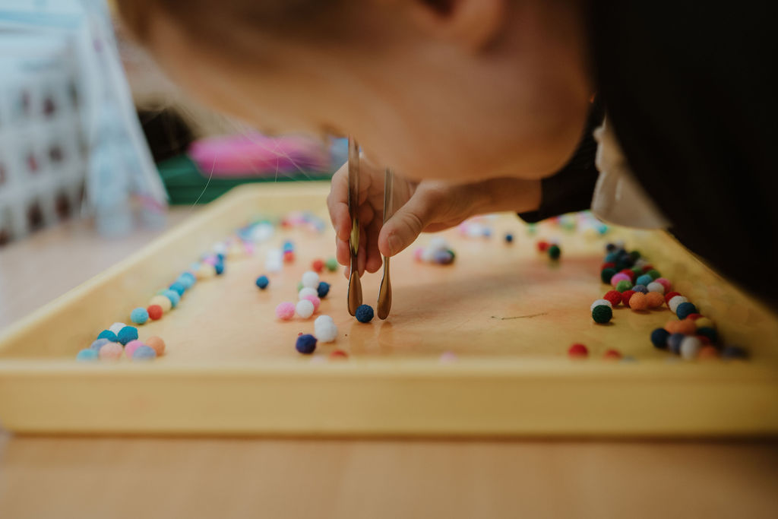
EAL
Speaking in your home language is encouraged and supported.
It is important that we know and understand how your child’s speech and development is in your home language. This will help us to know how to support your child best.
EAL lead – Ms F Esa

Slide 16
Pupil Premium
Please complete the form in the parent pack.
Potential additional funding to support your child’s academic and social development.

Slide 17

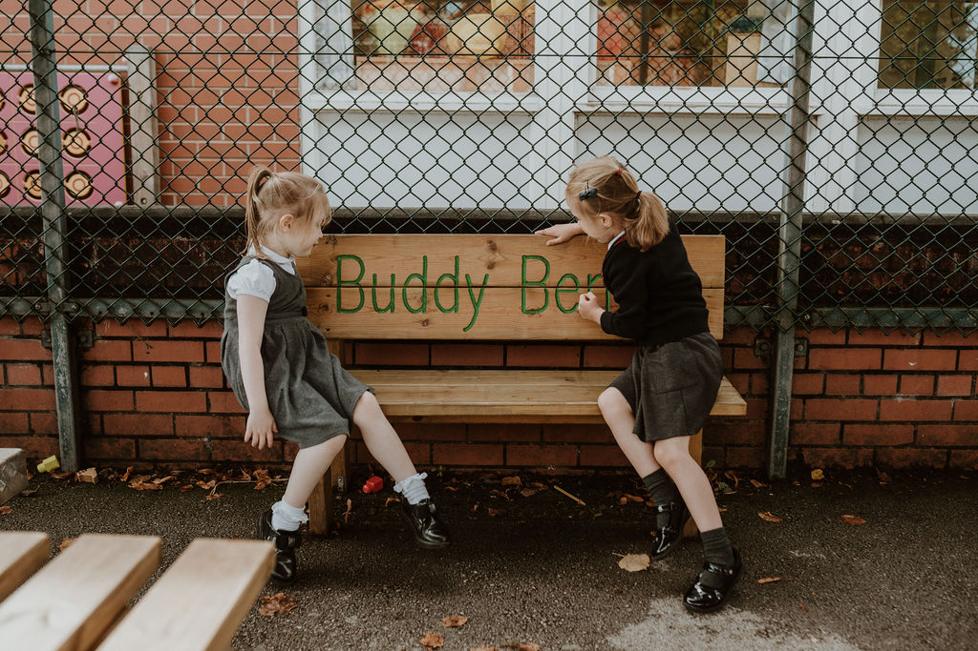
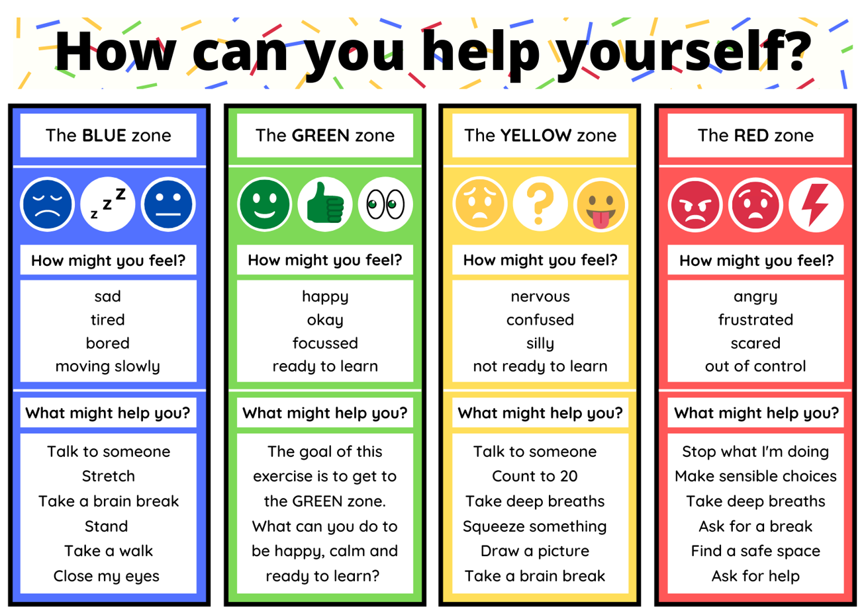
Wellbeing
Committed to wellbeing of all.
Emotional literacy & resilience.
Targeted support structure.
PSED – Think Equal.
Promote friendship & collaboration across the school.

Slide 18
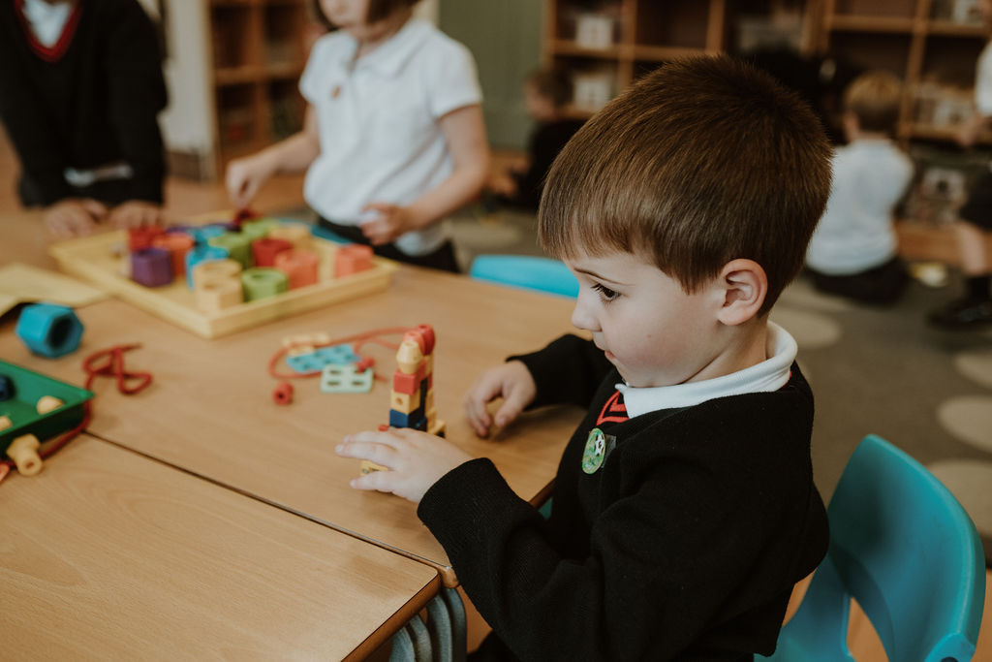
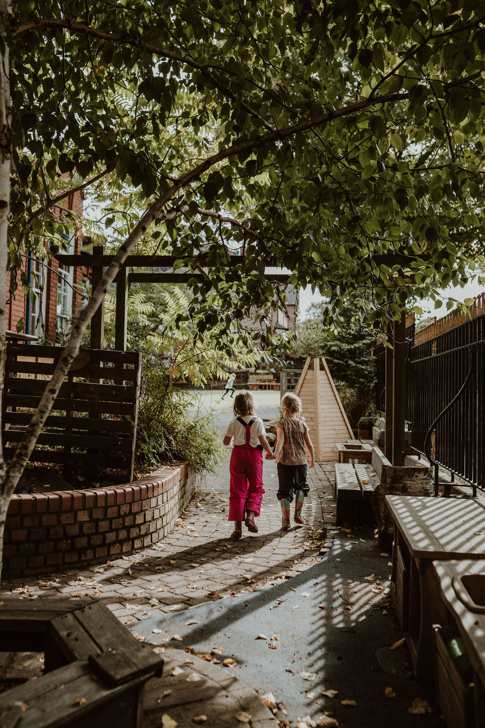

Thank you.

