Slide 1
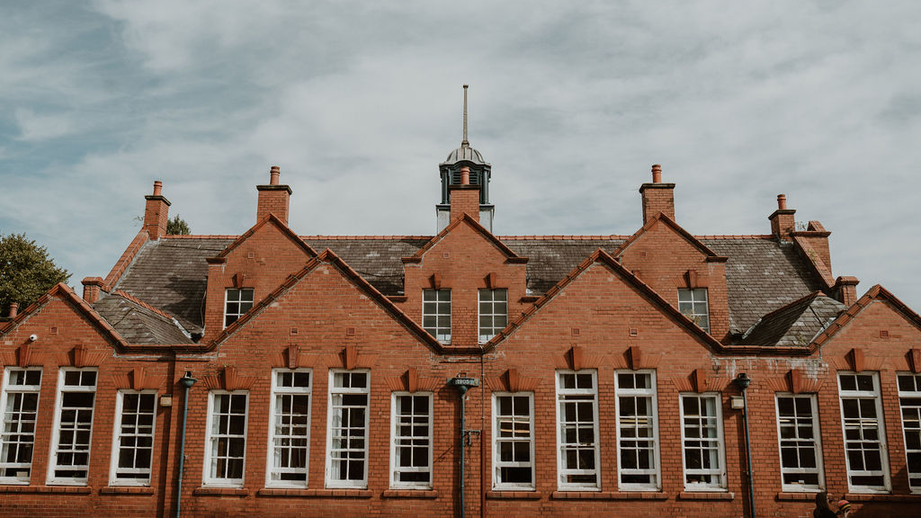
Welcome to Stamford Park Primary School

Slide 2
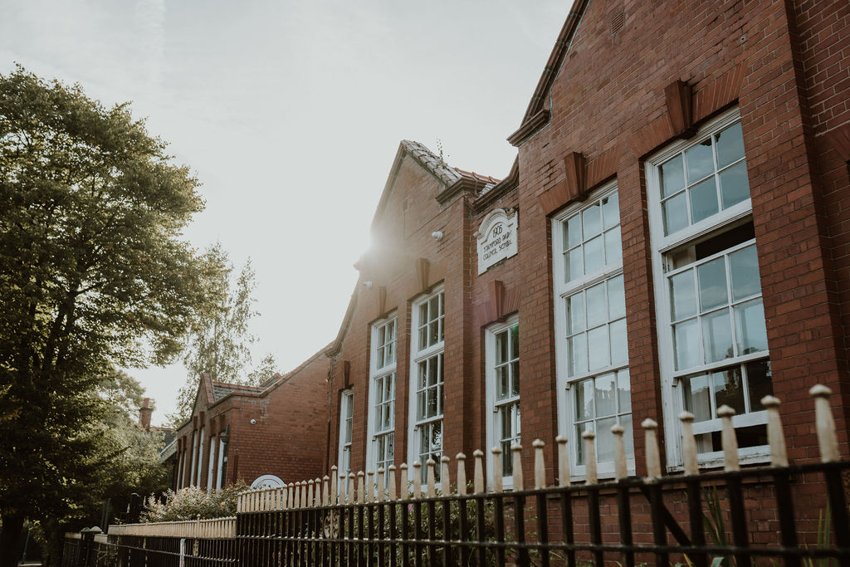
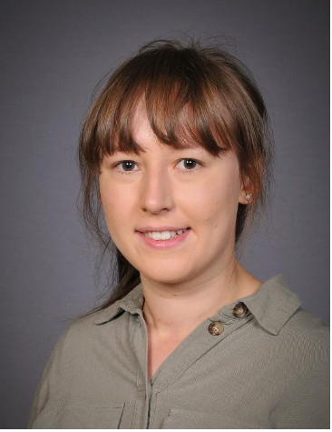
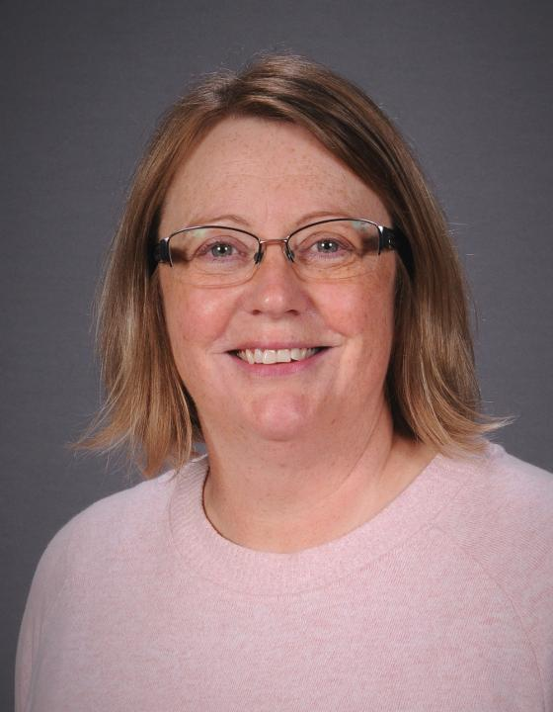
Meet the team
Nursery Teacher
Mrs Stirrup

Slide 3
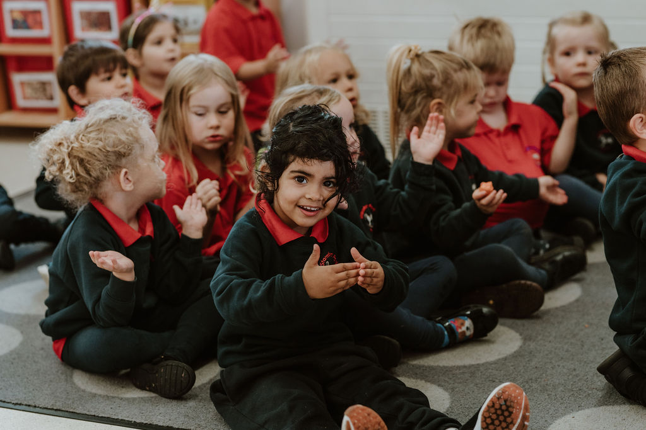
Starting
Transition documents, information and visits have begun.
Online parent packs. Please complete these and return to the school office as soon as possible.
All children will be in doing their hours by Thursday 4th September.
You will receive more information about your child’s start date and class Dojo login after the stay and play you have chosen to attend.

Slide 4





Uniform
A school cardigan or jumper.
Blue joggers, shorts or leggings.
A plain red polo shirt.
Comfortable shoes – ideally trainers (velcro)
Wellies for wet days, which will stay in Nursery.

Slide 5
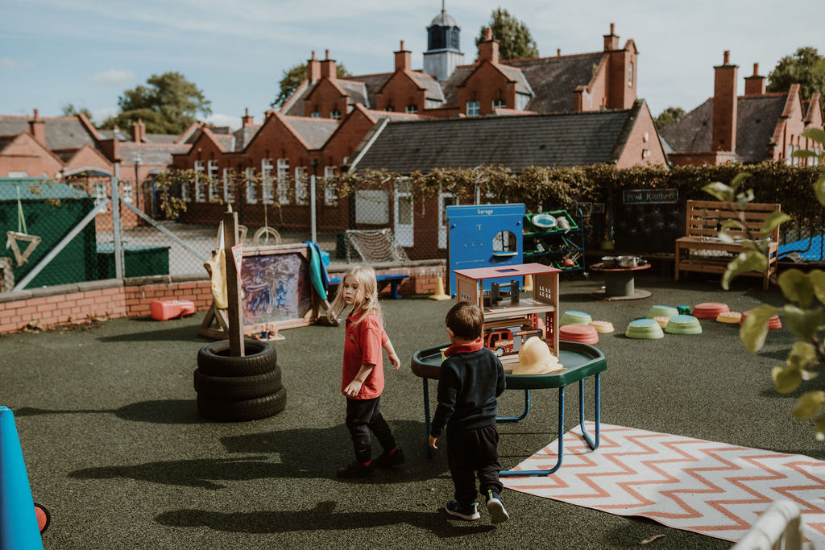
The School Day
8:45am Nursery arrive. Gate closes at 9am.
11:45am Lunch.
3:30pm Home time for all children.
Bring a named water bottle and bag with spare clothes.
Label all uniform and spares.
Healthy snack provided.
Wrap around care.

Slide 6
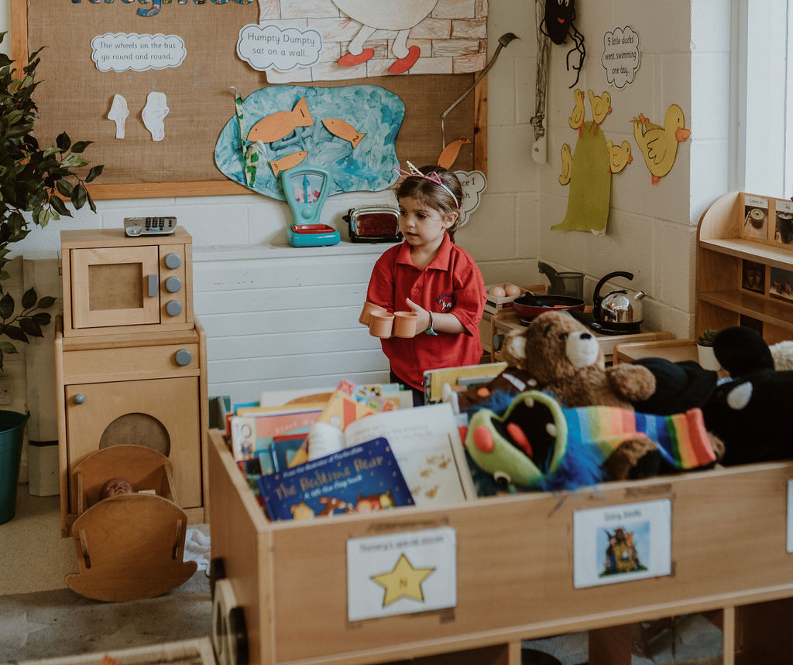
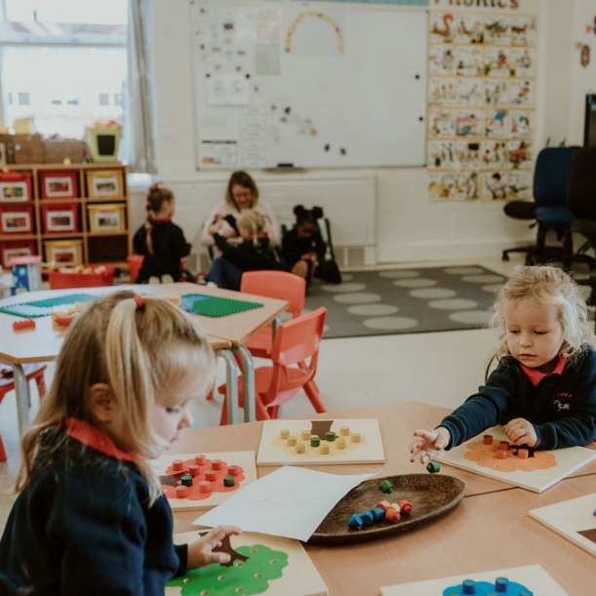
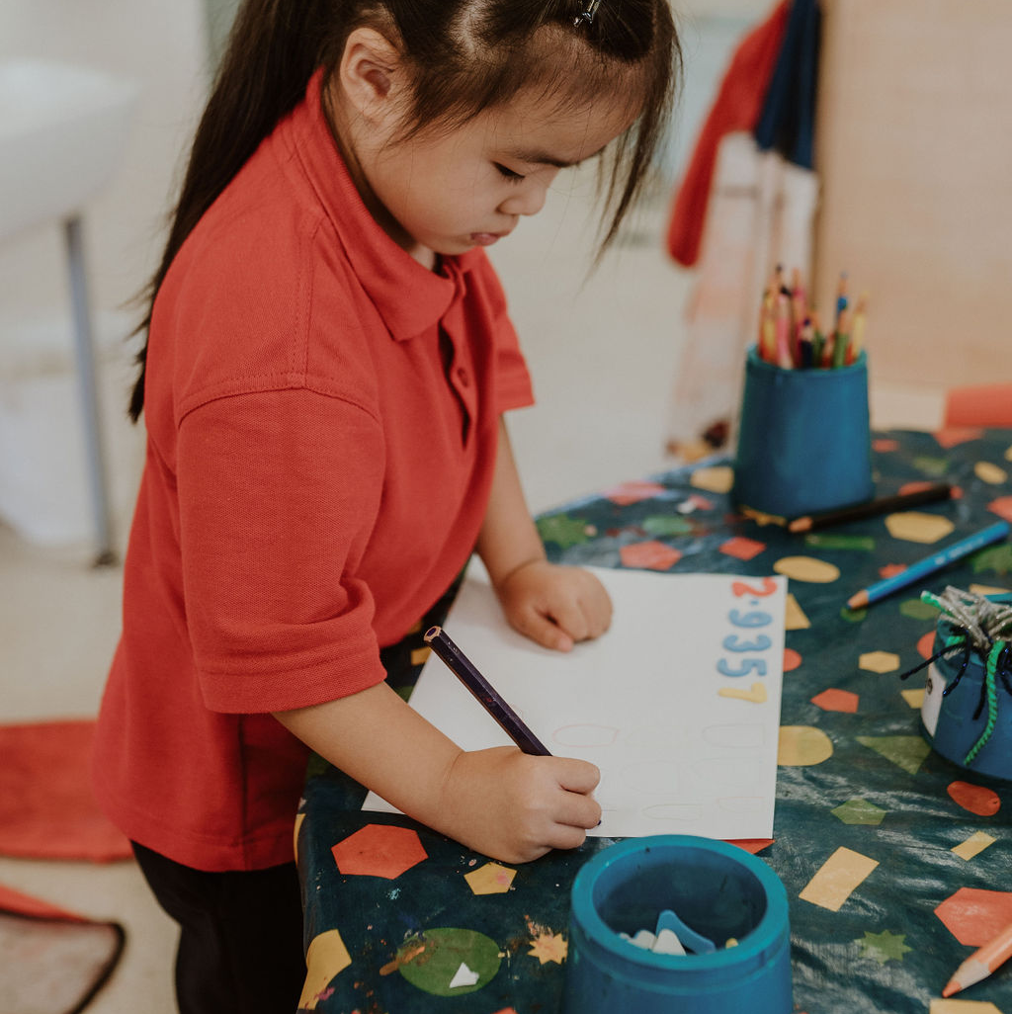
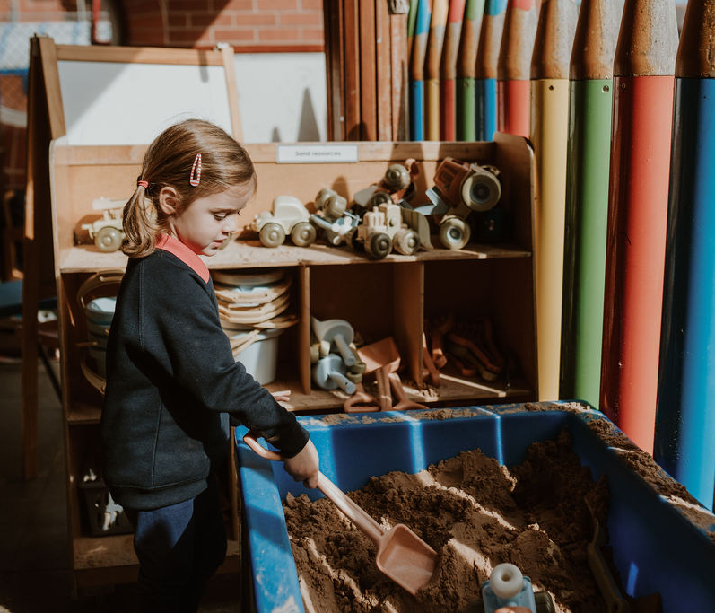
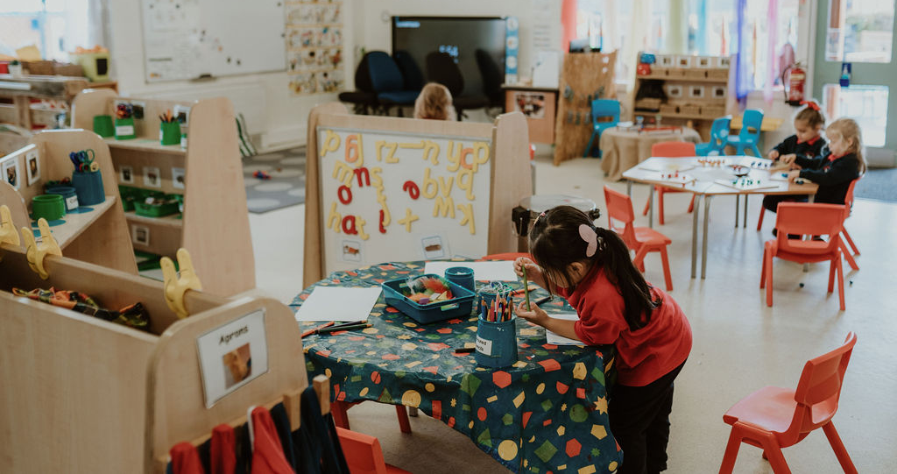
The Classroom
Large open space so children can move between the areas with ease.
Sheltered outside areas so children can access the outdoors in all weather.
Outside space at the front and the back used every day.
Provisions are regularly changed and adapted to spark interest and meet needs.

Slide 7
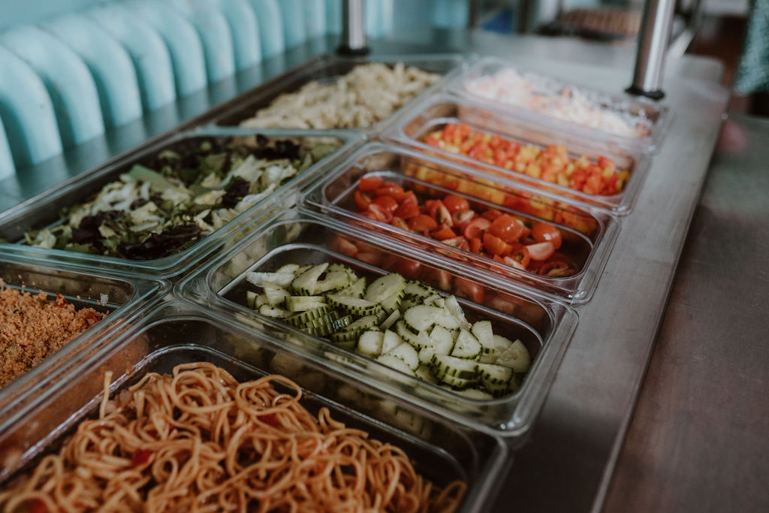
School Dinners at Stamford Park Primary
School meals are currently £2.40.
We have our own catering team and own kitchen on site.
‘Exceptional school dinners’ here.
Red Tractor free range products.
If packed lunch – NO NUTS

Slide 8

Communication and your support
Office – absences
Sickness/medicines
Stay & Play
School gate
Parents’ Evenings
Class Dojo
Social Media and website
Wow moments
Parent helpers
Independence
EYFS fund
Parent rep and PTA

Slide 9
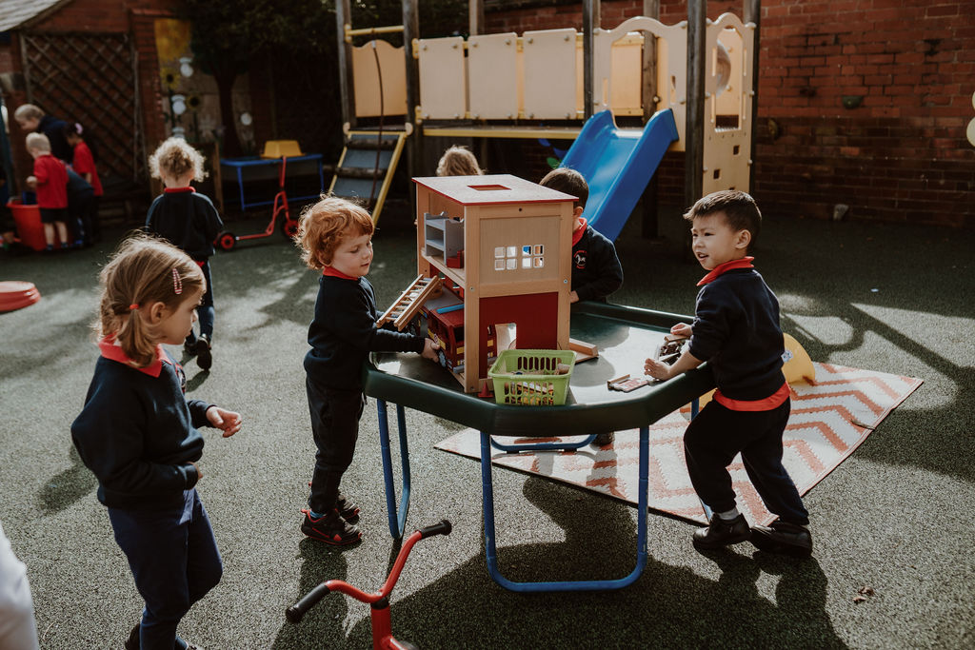
The Curriculum
Child led curriculum covering the 7 areas of the Early Years Foundation Stage Curriculum.
Outdoor provision.
Developing independence and self-care.
Key worker.
Ready for Reception.

Slide 10
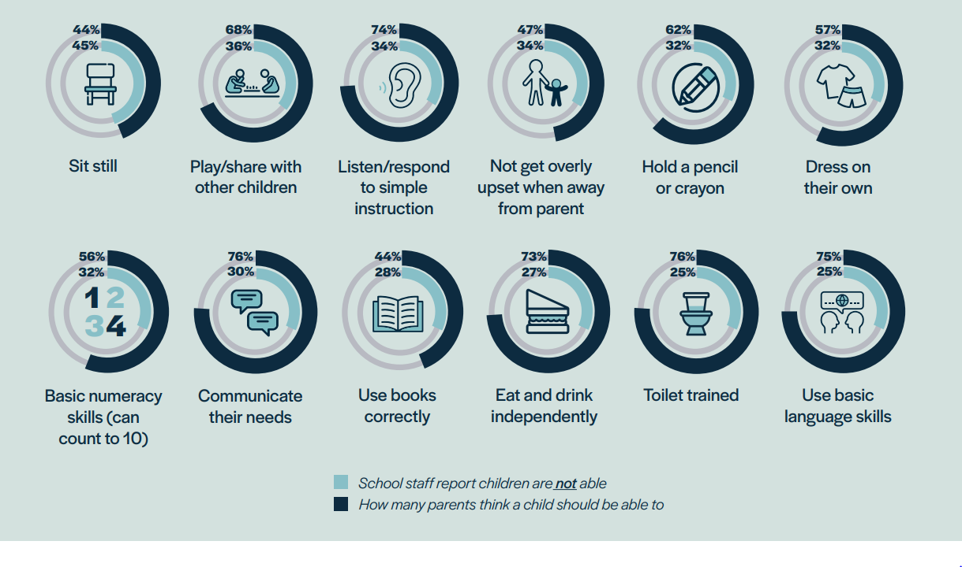
School Readiness

Slide 11
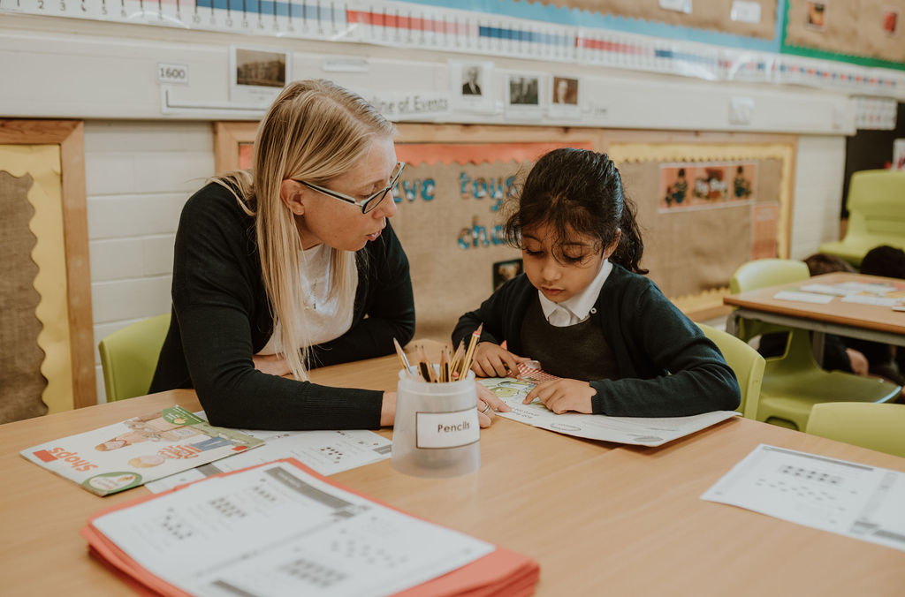
School Readiness
Prime Areas of learning
Personal, Social and Emotional Development
Listening, Attention and Understanding
Speaking
Physical Development
Gross Motor Skills
Fine Motor Skills
Communication and Language Skills
Self-regulation
Managing Self
Building Relationships

Slide 12
School Readiness
Support us in achieving these key skills in preparation for school.
Top tips
Letter formation – not in capital letters please
Numbers and counting – understanding of number
Turn taking games, developing patience and waiting skills
Following instructions to complete simple tasks at home
Tidying up

Slide 13
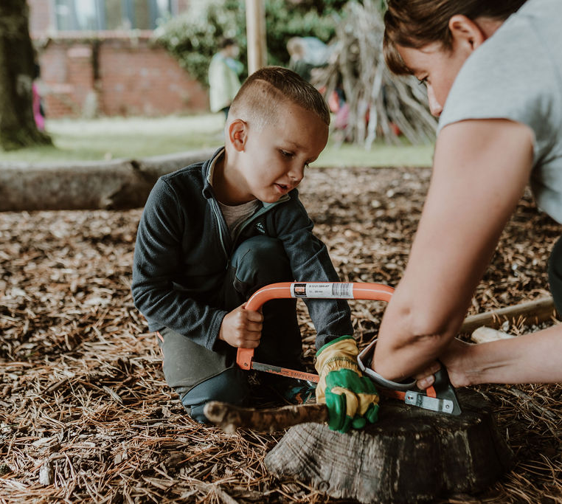
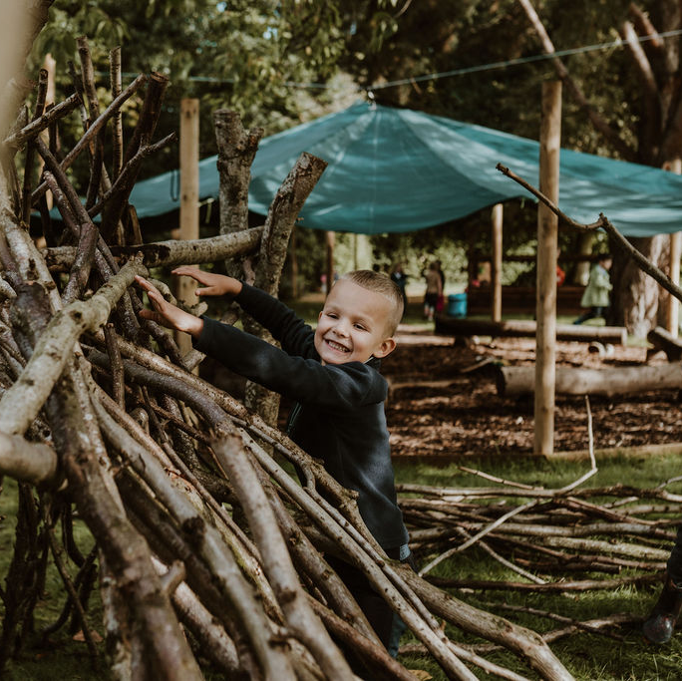
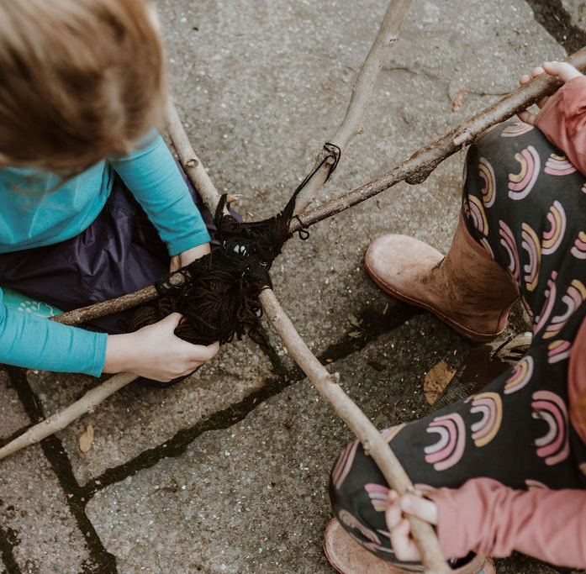
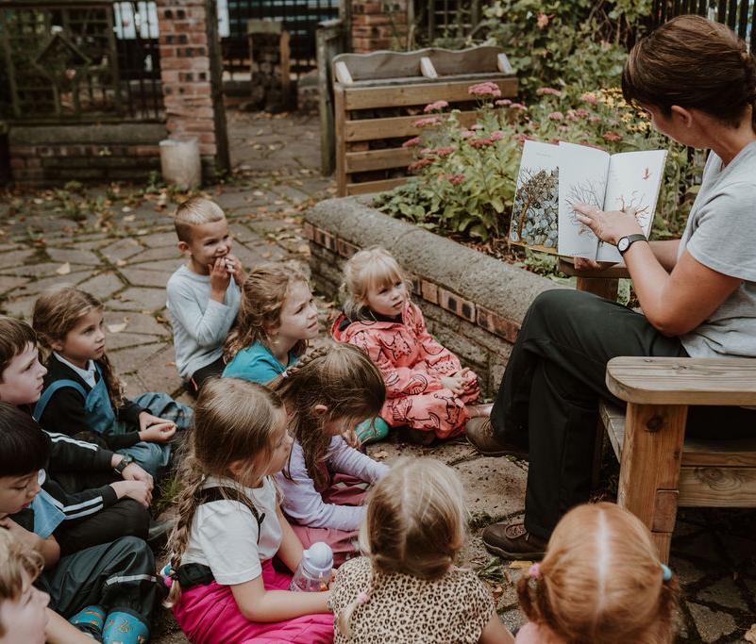
Outdoor learning
Promotes child initiated learning;
Supports personal, social, emotional and physical development;
Develops language and communication skills;
Aims to encourage each individual to take risks, develop resilience and develop confidence and independence;
Promotes an understanding and appreciation of the outdoors and nature.

Slide 14
Assessments and SEN Support
Regular assessments for early identification.
Personalised & targeted support to remove barriers to learning.
Wide range of interventions.
Excellent communication.
SENCo – Mrs. A Williams

Slide 15
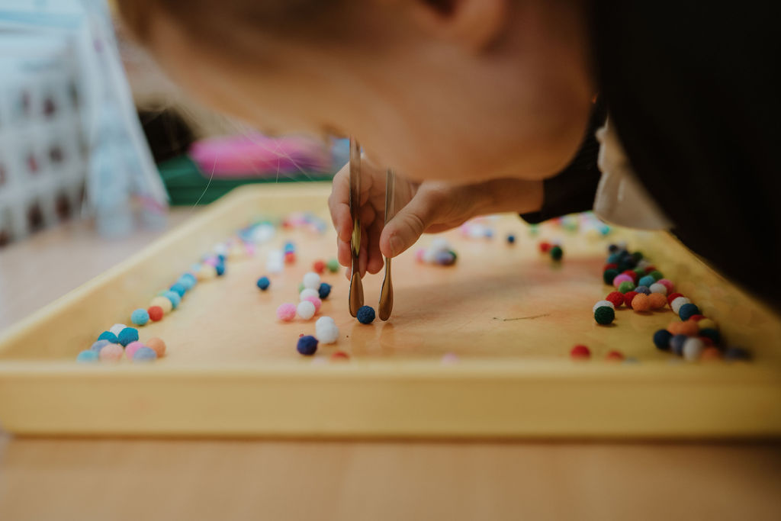
EAL
Speaking in your home language is encouraged and supported.
It is important that we know and understand how your child’s speech and development is in your home language. This will help us to know how to support your child best.
EAL lead – Ms F Esa

Slide 16
Pupil Premium
Please complete the form in the parent pack.
Potential additional funding to support your child’s academic and social development.

Slide 17

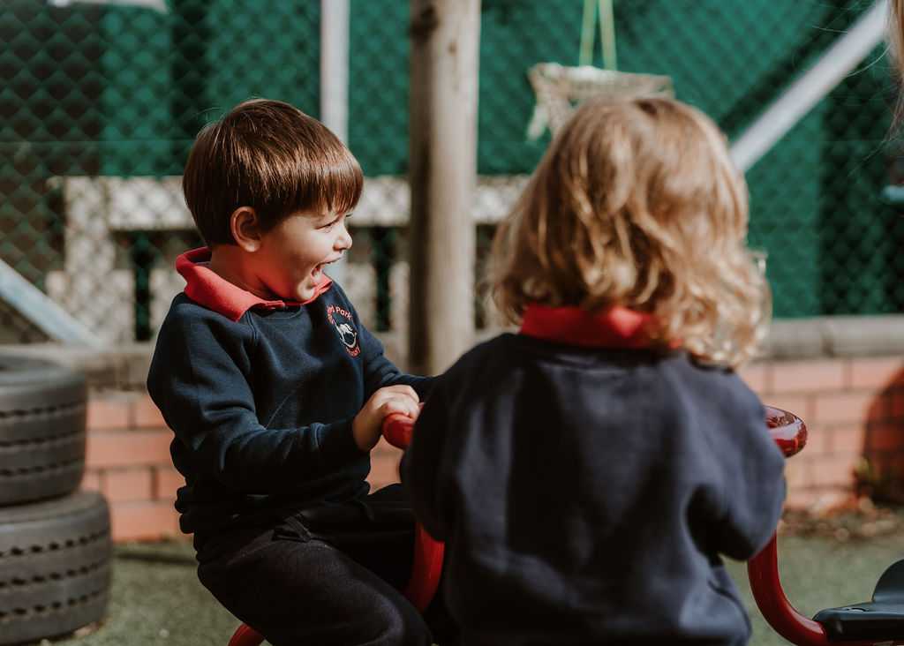
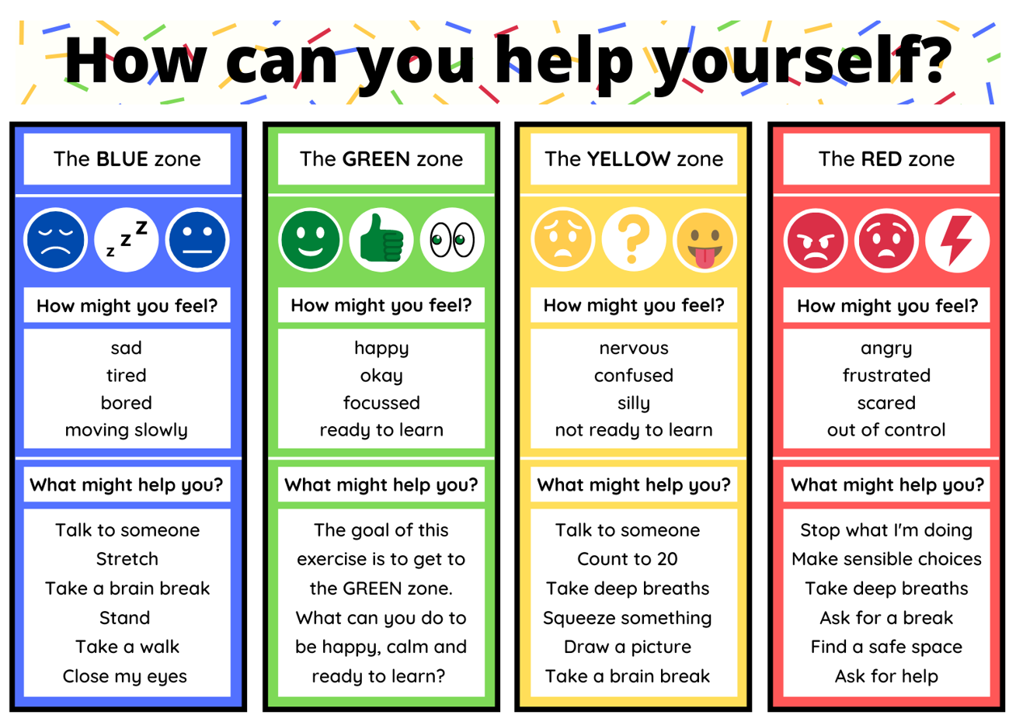
Wellbeing
Committed to wellbeing of all.
Emotional literacy & resilience.
Targeted support structure.
PSED – Think Equal.
Promote friendship & collaboration across the school.

Slide 18
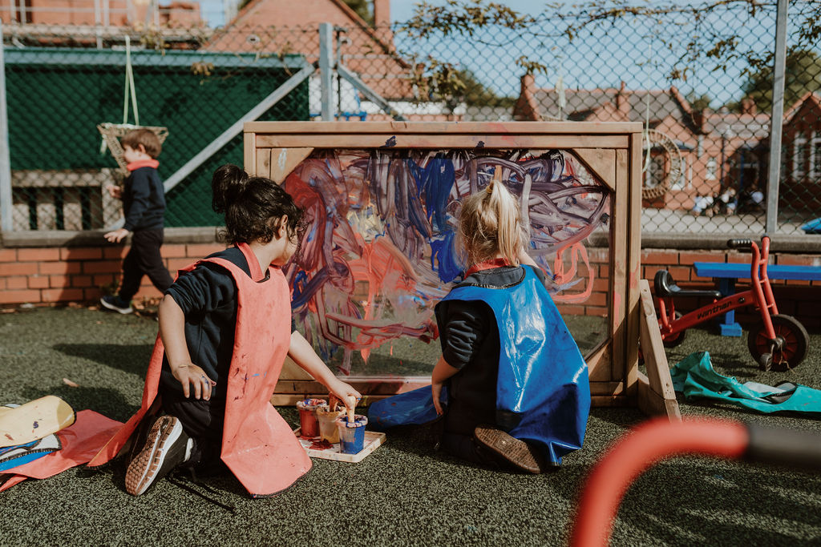
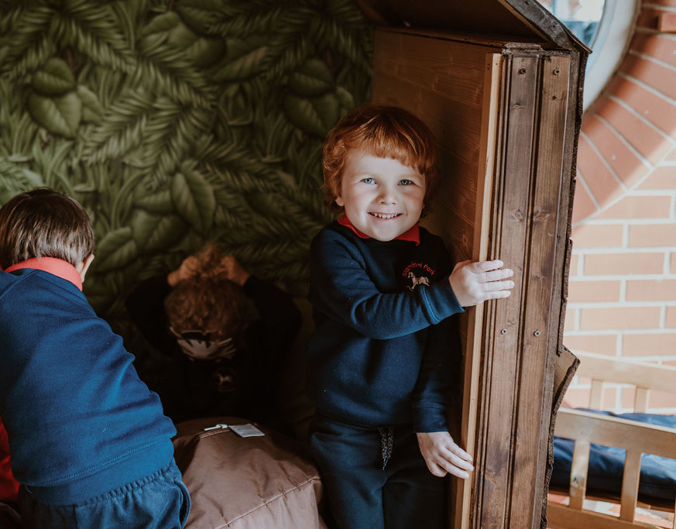
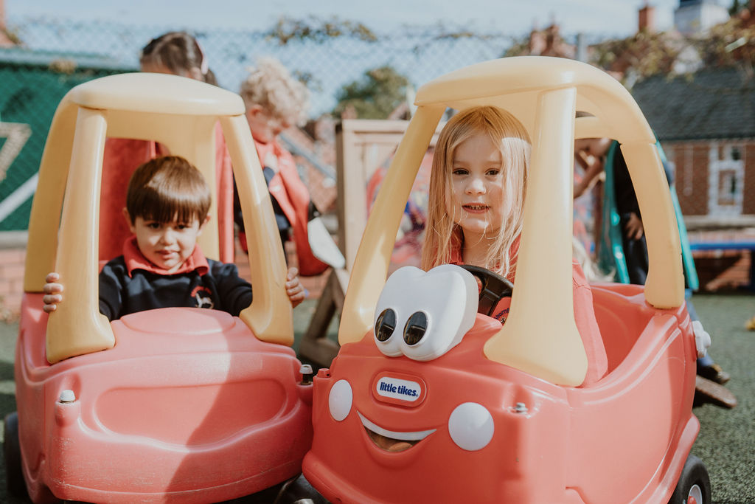
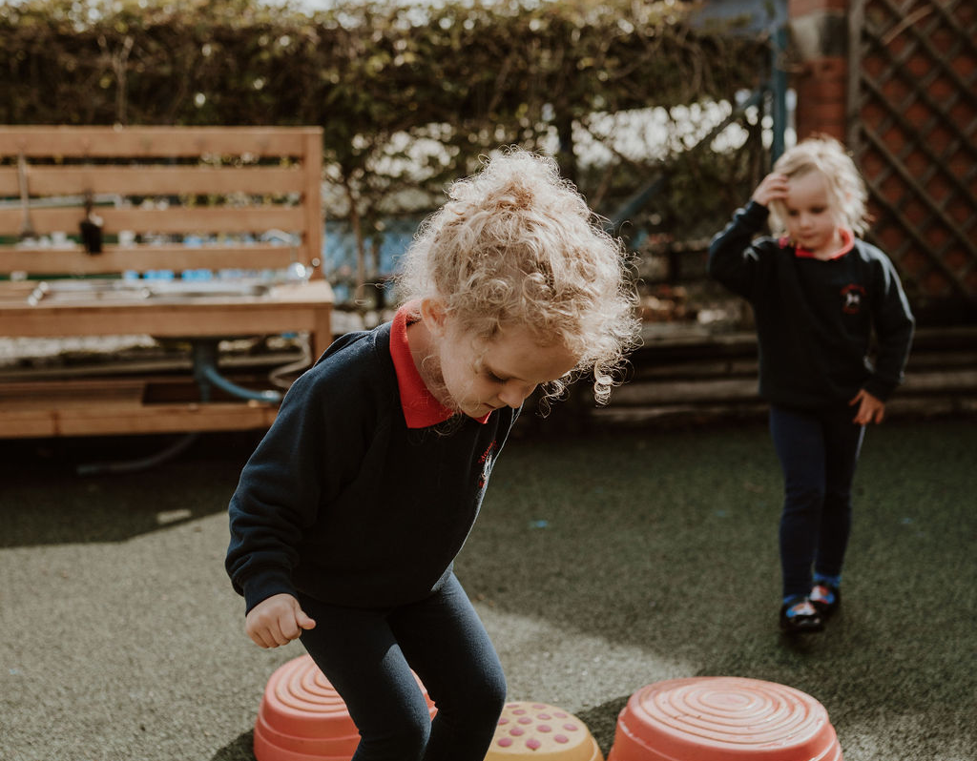
Thank you.

